Slide 1
Managing Behavioral Disruptions in Early Grades
Reversing the Rising Frequency and Intensity of Student Misbehavior
Part II: Create Conditions for Positive Classroom Behavior
District Leadership Forum

Slide 2
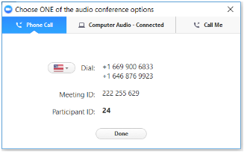
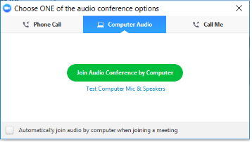
Audio Options
Using Your Telephone
Using Your Microphone and Speakers
If you select the “Phone Call” option, please dial in with the phone number and access code provided.
If you select the “Computer Audio” option, please be sure that your speakers or headphones are connected.

Slide 3


Using Zoom
Mic and Video Controls
Asking a Question
Click the mic and camera pictures until they have a red line indicating they are both off.
To ask the presenter a question, type it into the Chat panel and press send.

Slide 4



Upcoming Webconferences
Managing Behavioral Disruptions in Early Grades
-
Promote the Social Emotional Well-Being of Students
and Teachers
Wed., May 15
3:00 – 4:00 p.m.
Eastern Time
Support the social-emotional needs of both students and teachers
Learn tips for selecting the right SEL curriculum, as well as implementing SEL practices for adults
-
Enhance Support for Higher-Needs Students
Thurs., May 23
3:00 – 4:00 p.m.
Eastern Time
Support students who have greater behavioral needs, including those with a history of trauma
Learn best practices related to trauma-informed care, support teams, and reintegration into the classroom
Register for any of the above webconferences at eab.com.

Slide 5


Managing Behavioral Disruptions in Early Grades
Reversing the Rising Frequency and Intensity of Student Misbehavior
1
2
3
4
Prevent Misbehavior Through Early Intervention
Create Conditions for Positive Classroom Behavior
Promote the Social Emotional Well-Being of Students and Teachers
Enhance Support for Higher-Needs Students
Transition Program for Incoming High-Risk Kindergarteners
Universal Behavioral Screening to Identify Students in Need of Support
Teacher Home Visit Program
Trusted Adult-Student Relationship Mapping
Self Regulation-Friendly Classroom Audit
Expanded Time for Free Play
Districtwide PBIS Implementation
Standardized Behavior Guidelines and Data Collection
Direct Instruction of Key Social-Emotional Skills
Embedded SEL Routines for Adults
Teacher Burnout Coping Supports
Trauma-Informed Perspective of Student Behavior
Cross-Functional Behavior Health Intervention Team
Cognitive Behavioral Support for Students with a History of Trauma
Reintegration-Focused Alternative Classroom

Slide 6


Teachers Inadequately Prepared to Manage Behavior
Teacher Prep Programs Overlook Evidence-Based Instructional Strategies
Classroom Management Not a Priority for Teaching Programs
Report In Brief:
Training Our Future Teachers: Classroom Management
National Council on Teacher Quality (2014)
40% of 1 Course
Average time spent teaching classroom management (average load = 10 to 15 courses)
Investigates 122 teacher preparation
programs across the US (a mix of undergraduate, graduate, secondary, and elementary)
Examines time spent on classroom
management, focus of instruction, and whether programs teach evidence-based approaches
Finds that classroom management strategies are:
  Given inadequate course time
  Scattered across the curriculum
  Rarely evidence-based
  Taught only theoretically
Concludes that future US teachers are
rarely given the tools they need to
effectively manage classrooms
Positive Discipline Practices Commonly Ignored as an Effective Classroom Tool
“Especially out of favor seem to be strategies that impose consistent consequences for misbehavior, foster student engagement,
and— most markedly—use praise and other means to reinforce positive behavior.
Half of all programs ask candidates to develop their own ‘personal philosophy of classroom management,’ as if this were a matter of personal preference.”
“Training Our Future Teachers: Classroom Management,” National Council on Teacher Quality, January 2014, https://www.nctq.org/dmsView/Future_Teachers_Classroom_Management_NCTQ_Report; EAB interviews and analysis.

Slide 7


Improving School Environment Begins in the Classroom
Disruptive Behavior Harms Both Students and Teachers, Impedes Learning
Disruptive Classrooms Take a Heavy Toll on Teachers
Positive Environnent Can Be Created In Multiple Different Ways
44%
Of US teachers who left the profession cited disruptive student behavior as a reason for leaving (2005)
“A positive school environment is defined as a school having appropriate facilities, well-managed classrooms, available school-based health supports, and a clear, fair disciplinary policy.”
National Center on Safe Supportive Learning Environments
53%
Of US teachers who moved schools cited disruptive student behavior as a reason for moving (2005)
Practice 5:
Self Regulation-Friendly
Classroom Audit
Practice 6:
Expanded Time for Free Play
Practice 7:
Districtwide PBIS Implementation
Practice 8:
Standardized Behavior Guidelines
and Data Collection
Source: Mobility in the Teacher Workforce Findings from The Condition of Education 2005,” National Center for Education Statistics, https://nces.ed.gov/pubs2005/2005114.pdf; “Topics & Research: Environment,” National Center on Safe Supportive Learning Environments, https://safesupportivelearning.ed.gov/topic-research/environment; EAB interviews and analysis.

Slide 8
Physical Space Affects Learning and Attention
Study in Brief: Visual Environment, Attention Allocation, and Learning in Young Children
Randomized controlled trial of 24 kindergarteners placed in six
different classrooms
Children were taught six introductory science lessons on material they previously had not been taught
Found that children in highly decorated classrooms were more distracted, spent more time
off-task, and learned less than
if they were in classrooms with
no decorations
Source: Fisher, A., Goodwin, K, Seltman, H., “Visual Environment, Attention Allocation, and Learning in Young Children: When Too Much of a Good Thing May Be Bad, Psychological Science 25 (7), 2014,” http://journals.sagepub.com/doi/abs/10.1177/0956797614533801; EAB interviews and analysis.

Slide 9



Understanding the Theory to Change the Practice
Practice #5: Self Regulation-Friendly Classroom Audit
Rondout SD 72 Transforms Physical Space from Triggering to Comforting
Educate Adults about Environmental Triggers
Modify the Physical Space
to Support Student Growth
Teach Students to
Use Spaces Effectively
Licensed OT¹ teaches educators, parents on environmental effects on children’s brains
Presentation focuses
on how light, sound, temperature affect behavior
Teacher study groups and ongoing PD¹ sessions discussing neuroscience research help teachers understand how principles can be applied in practice
Teachers reorganize their classrooms in order to:
  Decrease clutter and reduce colors
  Vary types of space (e.g., individual, collaborative)
  Provide more natural or incandescent light
  Create alerting and calming areas
  Allow standing desks and moving chairs
Teachers educate
students on using the newly-designed space
Examples include:
  Using calming corners
  Calming themselves down via blankets or beanbag chairs
  Alerting themselves via obstacle courses and other physical activities in the classroom
Profiled Institution:
Rondout School District 72, Illinois
Occupational Therapist.
Professional development.
Source: Rondout School District 72, Illinois; EAB interviews and analysis.

Slide 10
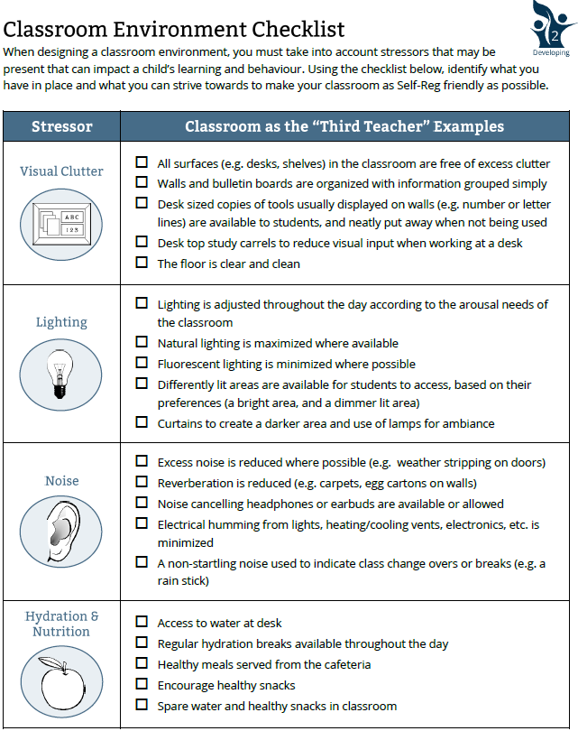

Enabling Teachers to Quickly Modify Classroom
Practice #5: Self Regulation-Friendly Classroom Audit
Checklist Allows Educators to Address Student Needs
2-page checklist allows teachers to systematically scan the classroom for important potential stressors
Provides specific guidance on how to adjust the classroom
Grouping helps teacher think in categories: visual clutter, lighting, noise, hydration and nutrition, seating options, smells
Full Classroom Environment Checklist available in the Appendix
Profiled Institution:
The MEHRIT Centre, Canada
Source: “Self-Reg Toolkit 2017-2018,” The Mehrit Centre, Ontario, Canada, https://self-reg.ca/toolkit2017/; EAB interviews and analysis.

Slide 11
Easy to Spot the Change in Environment
Practice #5: Self Regulation-Friendly Classroom Audit
Educating Teachers Leads to Improved Classroom Experience for Students
Classroom Conducive to Better Self Regulation
Typical Elementary
School Classroom
Source: EAB interviews and analysis.

Slide 12


The Developmental Need for Play Overlooked
Academic Pressure Pushing Out Play Time in Early Childhood Education
Play Time for Youngest Learners Declining Despite Known Benefits
60
“Developmentally appropriate play is a
singular opportunity to promote the social, emotional, cognitive, language, and self-regulation skills that build executive function and a prosocial brain. […]
Play is not frivolous: it enhances brain structure and promotes executive function
which allows us to pursue goals and ignore distractions.”
The Power of Play: A Pediatric Role in Enhancing Development in Young Children
Average recess time
has declined by nearly 60 minutes per week
(2001-2015)
25
Elementary students get
an average of 25 minutes of recess per day (2018)
“It’s not taking a break from learning
when we talk about play. Play is one
of the most important ways in which children learn.”
Jack Shonkoff, Harvard University
Center on the Developing Child
22%
Only 22% of districts require daily recess for elementary students (2014)
Sources: “Recess in Schools,” Children at Risk, 2015; “Data Uncovered the Positive Impacts of Recess on Student Development, Behavior and Social Interactions,” IPEMA and Voice of Play, 2018; “Strategies for Supporting Recess in Elementary Schools,” Center for Disease Control, 2014; Yogman, M. et al., “The Power of Play: A Pediatric Role in Enhancing Development in Young Children,” 2018; Deruy, E., “Learning Through Play: Education Does Not Stop When Recess Begins,” The Atlantic, 2016; EAB interviews and analysis.

Slide 13
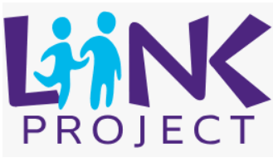




Putting Play Back in the School Day
Practice #6: Expanded Time for Free Play
LiiNK Program Promotes Play Breaks and Character Education
Profiled Institutions:
The LiiNK Project, TX
Eagle Mountain-Saginaw ISD, TX
Overview of LiiNK Program Components
Daily Unstructured Play Breaks
Character
Development Curriculum
Four 15 minute unstructured play breaks per day
  2 before lunch, 2 after lunch
  Outdoor whenever possible
Does not replace any existing breaks for lunch, specials
Focus on reducing transition time to minimize disruption
to the day
  Transitions consistently <1 minute each way by end of
  first year of implementation
Includes implementation of Positive Action character development curriculum
Daily lessons, 15 minutes each
Impact evaluated in 3 randomized control trials¹
Emphasis on:
  Development of self-concept
  Personal responsibility
  for body and mind
  Getting along with others
  Continual self-improvement
Sources: Jones, S. Brush, K. Bailey, R. Brion-Meisels, G. McIntyre, J. Kahn, J. Nelson, B. Stickle, L., “Navigating SEL From the Inside Out,” Harvard Graduate School of Education and The Wallace Foundation, 2017; EAB interviews and analysis.
Positive effects found on academic performance, behavior (i.e., bullying, aggressive,
and disruptive), motivation, depression, anxiety, absenteeism, and suspensions

Slide 14



Gradual Implementation and Training Key to Success
Practice #6: Expanded Time for Free Play
Administrators Can Focus on Building Buy-In, Supporting Implementation
Roll-Out of LiiNK Program Across Eagle Mountain-Saginaw ISD
Current LiiNK schools add one additional grade level per year
LiiNK started in
two pilot schools, grades K and 1
Pilot school adds grade 2
11
LiiNK implemented
in 11 elementary schools, grades K-5
New cohort of schools starts LiiNK, grades K and 1
Cohort of 3-4 schools add LiiNK per year
All LiiNK School Staff Participate in Three Days of Training Before Program Implementation
Training focuses on providing context and planning implementation
Training starts in January, rolled out gradually across the spring
  Benefits of unstructured play, overview of character education curriculum, addressing concerns about losing instructional time
  Daily schedule development
  (i.e., instruction, specials, character education, play breaks, transitions)
Source: EAB interviews and analysis.

Slide 15

Schedule Review Surfaces Opportunity for Play
Practice #6: Expanded Time for Free Play
LiiNK Implementation Focuses Staff 0n Using Time Efficiently
Play Breaks Optimize Existing Instructional Time and Improve Student Well-Being
Sample Daily Schedule¹
8:15am | Arrivals, announcements
8:25am | Instructional content
9:10am | Outdoor play break
9:25am | Instructional content
10:15am | Outdoor play break
10:30am | Instructional content
11:15am | Lunch
11:45am | Co-curricular (e.g., gym, music, art)
12:35am | Outdoor play break
12:50pm | Instructional content
1:45pm | Outdoor play break
2:00pm | Instructional content
District administrators take a systematic approach to schedule review, adjustment with school building leaders as LiiNK implementation expands across the district
1
  Calculate total time allotted for the school day
2
  Subtract time for play breaks and character
  education to build in as non-negotiable
3
  Find opportunities to increase efficiency
  in the day (e.g., planning time, transitions)
4
  Slightly decrease instructional periods as needed, with adjustments varying by grade level
Meant to be an illustrative example, does not reflect actual schedule at Eagle Mountain-Saginaw ISD.
Source: EAB interviews and analysis.

Slide 16


LiiNK Program Impact Evident Inside the Classroom
Practice #6: Expanded Time for Free Play
Students with More Recess Demonstrate Improved Behavior and Focus
Liink Program Decreases Disruption and Promotes Positive Classroom Behavior
Off-Task Behavior¹, First Grade
“Before LiiNK was in place recess really depended on the classroom you were in
and the campus you were at—the teachers could go either way. On one hand they could be the type of teacher that would say ‘you all have been acting out, we’re going to lose 5 minutes of recess’ so the kids wouldn’t get as much. On the other hand others might say ‘it’s a beautiful day
we just can’t bear to go back inside yet.’
But districtwide, when we brought LiiNK in, we realized as a whole that one short recess a
day wasn’t enough for our students.”
Candice Williams, LiiNK Program Specialist
Eagle Mountain-Saginaw ISD
Appropriate Behaviors²
Off-task behavior captures: full movements (e.g., sitting standing walking); stationary behaviors
(e.g., bouncing, fidgeting); vocal behaviors (e.g., talking to self or others); and aggressive behavior.
Appropriate behaviors include: following directions, working quietly at seat, being respectful of classmates and teacher.
Sources: LiiNK Project, “Results,” https://liinkproject.tcu.edu/results/; EAB interviews and analysis.

Slide 17



A Positive Approach to Schoolwide Behavior
Practice #7: Districtwide PBIS Implementation
PBIS Framework an Alternative to Punitive Disciplinary Practices
Positive Behavioral Interventions & Supports (PBIS)
Multi-tiered framework that promotes a number of evidence-based prevention and intervention practices centered around consistently encouraging positive behavior and social competence among students
How Does PBIS Approach Discipline and Behavior?
Universal
Expectations
Set clear expectations of student behavior in the classroom and beyond
Explicit
Behavioral Instruction
Explicitly teach expectations to all students via lessons, reminders, and behavior modeling
Rewarding
Positive Behavior
Continuously identify, call out, and praise positive behavior
Practical Examples:
Positively-stated
behavior matrices
Behavioral code with clearly outlined acceptable and unacceptable behaviors
Clear and consistent classroom structures and routines
Presentations that directly explain schoolwide expectations, rewards, consequences
Role-play and scenario activities in classrooms to demonstrate examples and “non-examples” of positive behavior
4:1 positive-to-negative interactions ratio
Token economies
and rewards
Group contingencies¹
Source: Positive Behavioral Interventions and Supports: OSEP Technical Assistance Center, https://www.pbis.org/; EAB interviews and analysis.
Behavior management programs that provide rewards for an entire group, e.g., “The Good Behavior Game.”

Slide 18



Proof of Concept Prompts Spread of Model
Practice #7: Districtwide PBIS Implementation
PBIS Supported by Decades of Research and Endorsed by US Government
Brief History of PBIS
1980s
1990s
2000s
Now
PBIS an Evidence-Based Alternative to Punishment
Congressional Support Boosts Framework Adoption
Adoption Eased by Extended Support
PBIS Squarely in the Mainstream
Research reveals evidence of positive effects of non-punitive discipline on reducing problem behaviors
PBIS emerges as a way to elevate results from classroom interventions into a framework for school-level change
Continued success
and more evidence of effectiveness help PBIS grow as leading alternative to punitive discipline
Congress reauthorizes IDEA¹ in ‘97 and creates Technical Assistance (TA) Center to establish and aid positive behavior support in US schools
TA Center
provides direct implementation support to a growing number of schools, including research, tools, assessments, training, etc.
PBIS implemented in over 26,000 buildings across
all states
Multiple statewide associations reward schools
for high fidelity
of implementation
Source: Positive Behavioral Interventions and Supports: OSEP Technical Assistance Center, https://www.pbis.org/; EAB interviews and analysis.
Individuals with Disabilities Education Act.

Slide 19

Research Shows Strong Evidence of Effectiveness
Practice #7: Districtwide PBIS Implementation
Impact of Successful PBIS Implementation Felt Across the Board
Significant Decline in Suspensions…
…And in Number of Overall Discipline Referrals
0%
100%
n= 37 schools, 12,344 students
33%
38.9%
Fewer ODRs¹
in schools implementing PBIS vs. schools that do not
Reduction of suspensions in elementary schools, post- vs. pre-implementation of PBIS (n=31 schools)
PBIS Demonstrates Positive Effects on a Number of Important Indicators
“Successful implementation results in significant reductions in office discipline referrals and suspensions as well as other problem behaviors, such as emotional dysregulation, concentration problems, bullying, and peer rejection. PBIS can also foster improvements in students’ prosocial behaviors and academic achievement, in teacher self-efficacy, and in students’ perception of a positive school climate.”
The Role of Positive Interventions and Supports, NASP Position Paper (2015)
Source: Bradshaw, C., “Using Positive Behavioral Interventions and Supports (PBIS) to Enhance the School Environment and Reduce Children’s Disruptive Behavior Problems,” Johns Hopkins Bloomberg School of Public Health, 2008, https://www.jhsph.edu/research/centers-and-institutes/johns-hopkins-center-for-prevention-and-early-intervention/Publications/Bradshaw_PBIS_prevention_talk.7.2.08.pdf; Bradshaw, C., et. al., “Effects of School-Wide Positive Behavioral Interventions and Supports on Child Behavior Problems,” Pediatrics 2012, 130(5), https://www.ncbi.nlm.nih.gov/pmc/articles/PMC3483890/; National Association of School Psychologists. (2015). Early Childhood Services: Promoting Positive Outcomes for Young Children (Position statement). Bethesda, MD, https://www.nasponline.org/x32403.xml ; Positive Behavioral Interventions and Supports: OSEP Technical Assistance Center, https://www.pbis.org/; EAB interviews and analysis.
Office discipline referrals.

Slide 20


Despite Clear Benefits, Adoption Usually Inconsistent
Practice #7: Districtwide PBIS Implementation
Allowing Schools to Adopt at Will Leads to Significant Variation in Outcomes
1
District adopts PBIS, but leaves implementation up to individual buildings with limited oversight
2
Schools implement framework with varying fidelity depending on building leadership, leading to inconsistent results across district
3
Without strong oversight, individual teachers pick and choose elements to adopt, most commonly reducing PBIS to a system of rewards and posters
DLF Member Districts Also Facing Significant Adoption Gaps at the Teacher Level
Percentage of districts in which at least one teacher indicated that the district uses PBIS
(n=15 districts)
Percentage of teachers who are implementing PBIS with fidelity in
their classrooms
(n=1204)
100%
45%
Source: DLF Managing Disruptive Behaviors Survey, 2018; EAB interviews and analysis.

Slide 21



Implementation Complexity Presents Many Challenges
Practice #7: Districtwide PBIS Implementation
PBIS not a Quick Fix, Requires Significant Commitment from District
Hallmarks of Districtwide PBIS Implementation
Common Pitfalls in Implementing PBIS
Personnel Readiness
Visibility & Dissemination
Funding
Policy & Systems Alignment
Political Support
Most districts don’t secure enough funding to support PBIS at district level
Leadership Team
Leadership teams often not fully assembled or not convening regularly
Professional Development
Coaching & Technical Assistance
Evaluation & Performance Feedback
Content Expertise
No close monitoring of data fidelity and no regular supervision of building performance
Local Implementation Demonstrations
No targeted showcasing of successful district examples of implementation
Source: Positive Behavioral Interventions and Supports: OSEP Technical Assistance Center, https://www.pbis.org/; EAB interviews and analysis.

Slide 22
Districts the Main Driver of Successful Implementation
Practice #7: Districtwide PBIS Implementation
Key Steps in Implementing Framework Across District
1
Use a facilitator (internal or external) with experience in PBIS implementation to guide assessment, action planning, and stakeholder training
Sample job description available on www.pbis.org or in Appendix
2
Form district- and school-level teams
with responsibility to establish and coordinate PBIS; ensure teams meet regularly to
discuss progress and modify strategies
Team roles and responsibilities available on www.pbis.org or in Appendix
3
Conduct resource-mapping of your existing behavior supports (e.g., SEL programs, trauma-informed care, tier 2 interventions) to maximize effectiveness
Sample resource mapping available on www.pbis.org or in Appendix
4
Complete Self-Assessment and Action Planning Tool to begin addressing specific steps and issues around implementation
Self-assessment and action-planning tool available on www.pbis.org or in Appendix
Choose a fidelity tool that aligns with your state’s PBIS recognition system. If no statewide system, let your coordinator and team choose a tool
5
Review existing discipline data monthly and conduct annual fidelity checks via one of several available tools
!
Source: Positive Behavioral Interventions and Supports: OSEP Technical Assistance Center, https://www.pbis.org/; EAB interviews and analysis.

Slide 23
Schoolwide Adoption Focuses on Clear Expectations
Practice #7: Districtwide PBIS Implementation
Key Parts of Implementation Process Often Overlooked by School Leaders
Critical Steps in Schoolwide PBIS Implementation
Common Adoption Errors
  Train Schoolwide Leadership Team
Assign clear responsibilities for implementing and sustaining PBIS across school
Include administrators, teachers, counselors, and behavior specialists
1
  Define and Display Positive
  Behavioral Expectations
Choose 3-5 positively stated schoolwide expectations
Obtain approval from at least 80% of staff before adopting
Display prominently across school
2
No clear leadership and ownership at school level, no standing meetings to review implementation
  Determine Consequences
  and Rewards
Define what behavior is classroom- versus office-managed
Ensure same behavior rules apply for all classes
Set rewards for good behavior
3
  Teach and Re-Teach
  Expectations Regularly
Implement PBIS Lesson Plans to address specific behavior
Teach behavior by modeling, role-playing, giving examples, etc.
4
No continuous teaching of expectations; good behavior simply stated, not taught or modeled
5
  Measure Fidelity of Implementation
Observe classrooms and support teachers with PBIS implementation
Review schoolwide behavioral data regularly to address trends, direct additional supports, etc.
No regular classroom observations performed to address inconsistencies
Source: Positive Behavioral Interventions and Supports: OSEP Technical Assistance Center, https://www.pbis.org/; EAB interviews and analysis.
Office Discipline Referral.

Slide 24


Fidelity Matters
Practice #7: Districtwide PBIS Implementation
55.1%
79.8%
58.9%
Fewer out-of-school suspensions
Fewer in-school suspensions
Fewer disciplinary incidents
Schools implementing PBIS with over 70% fidelity¹ see significant improvement in outcomes compared to schools that do not implement PBIS at all (n=238 schools)
Finally, we believe the study results provide evidence that fidelity of implementation of SWPBIS² is a critical component of effectiveness and that schools should strive to implement SWPBIS universal practices with fidelity to significantly decrease behavior incidents
and suspensions.”
Gage, N. et.al., The Impact of Schoolwide Positive Behavior Interventions and Supports on School Suspensions: A Statewide Quasi-Experimental Analysis, 2018
As determined by Benchmarks of Quality (BoQ) Tier 1 fidelity indicator.
Schoolwide PBIS.
Source: Gage, N. et. al., “The Impact of School-Wide Positive Behavior Interventions and Supports on School Suspensions: A Statewide Quasi-Experimental Analysis,” Journal of Positive Behavior Interventions 2018, 20(4), pp.217-226, http://journals.sagepub.com/doi/abs/10.1177/1098300718768204; Positive Behavioral Interventions and Supports: OSEP Technical Assistance Center, https://www.pbis.org/; EAB interviews and analysis.

Slide 25


Measures of Student Behavior Often Inconsistent
Practice #8: Standardized Behavior Guidelines and Data Collection
Lack of Common Referral Guidelines Hinders Efforts to Address Behavior
Profiled Institution:
Des Moines Public Schools, IA
Teacher Discretion
Too Broad
Vague definitions in behavior codes allow too much teacher discretion on need for referral
(e.g., “gang activity,” “inappropriate clothing”)
  High levels of teacher discretion lead to high suspension rates
School Policies Focus on Consequences, not Causes
Typical school code contains escalating levels of punishments, focusing educators’ minds on disciplining
(e.g., referral –> in-school suspension –> out-of-school suspension –> expulsion)
District-Level Standardization Non-Existent
No districtwide guide and no consistency across schools means district can only track data on punishment
  Data on punishment not useful, since it does not reveal causes
“We needed to align our data systems around referrals. We didn’t have an articulated system of how we were operationalizing those referral practices. Schools were doing what they wanted to do, and we didn’t have district-level data that made sense.”
Jake Troja, Director of School Climate Transformation, Des Moines Public Schools
Source: Des Moines Public Schools, Des Moines, IA; EAB interviews and analysis.

Slide 26
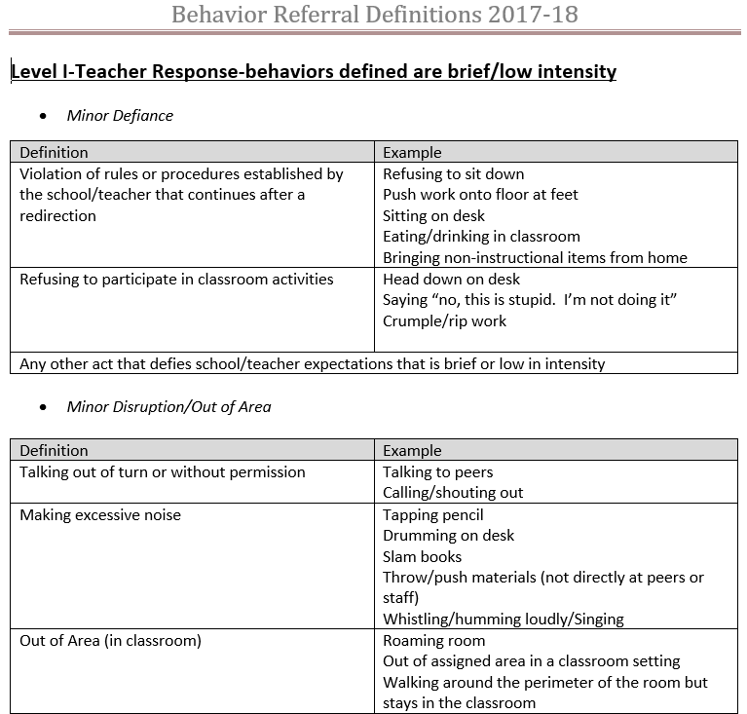



Districtwide Behavior Standards Provide Clarity
Practice #8: Standardized Behavior Guidelines and Data Collection
Setting Common Definitions Allows District to Address Responses as Well
Districtwide Guidelines Set Clear Rules, Facilitate Changes in Practice
Remove vague language that allows too much discretion and provide specific examples of infractions
Break the vicious cycle of escalating punishments for repeating the same behavior, allowing educators to address the problem
Focus on addressing behavior, not on punishment, allowing educators to tailor interventions
Full list of Des Moines Public Schools’ behavior referral definitions available in the Appendix
Source: Des Moines Public Schools, Des Moines, IA; EAB interviews and analysis.

Slide 27
More Office Referrals Does Not Mean More Suspensions
Practice #8: Standardized Behavior Guidelines and Data Collection
Improved Reporting Showcases Dramatic Change in Use of Discipline
Streamlined Behavior Code Leads to a Surge in Reports…
52.7%
Districtwide increase
in discipline referrals
…But a Decline in Punitive Action
8.6%
Districtwide decrease
in suspensions
“Did we have a sudden upsurge of bad behavior? I don’t think so, we just now have a meaningful way of tracking it. […] Before, we knew we wanted less of something, but we weren’t really sure of what exactly. Now we have a better idea of the supports schools need.”
Jake Troja, Director of School Climate Transformation, Des Moines Public Schools
Source: Des Moines Public Schools, Des Moines, IA; EAB interviews and analysis.

Slide 28



Streamlining Data Reveals Opportunities to Improve
Practice #8: Standardized Behavior Guidelines and Data Collection
New Guidelines Give Meaning to Commonly Reported Numbers
Knowing Where Problems Are Allows Administrators to Begin Solving Them
Revealing Problem
Identifying Cause
Devising
Solution
High rates of defiance among transient student population
(30% mobility rate across district)
Expectations only taught at beginning of year, meaning incoming students don’t know them
Schools required to have specific plan to teach expectations to transient students
Districtwide Example
Better Data Collection Kickstarts Improvement Efforts
High referral rates around recess in some elementary schools
Students were often poorly supervised by aides who couldn’t manage them well
Schools change master schedules to allow teachers to supervise recess directly
Schoolwide Example
Source: Des Moines Public Schools, Des Moines, IA; EAB interviews and analysis.

Slide 29
Managing Behavioral Disruptions in Early Grades
Reversing the Rising Frequency and Intensity of Student Misbehavior
1
2
3
4
Prevent Misbehavior Through Early Intervention
Create Conditions for Positive Classroom Behavior
Promote the Social Emotional Well-Being of Students and Teachers
Enhance Support for Higher-Needs Students
Transition Program for Incoming High-Risk Kindergarteners
Universal Behavioral Screening to Identify Students in Need of Support
Teacher Home Visit Program
Trusted Adult-Student Relationship Mapping
Self Regulation-Friendly Classroom Audit
Expanded Time for Free Play
Districtwide PBIS Implementation
Standardized Behavior Guidelines and Data Collection
Direct Instruction of Key Social-Emotional Skills
Embedded SEL Routines for Adults
Teacher Burnout Coping Supports
Trauma-Informed Perspective of Student Behavior
Cross-Functional Behavior Health Intervention Team
Cognitive Behavioral Support for Students with a History of Trauma
Reintegration-Focused Alternative Classroom

Slide 30


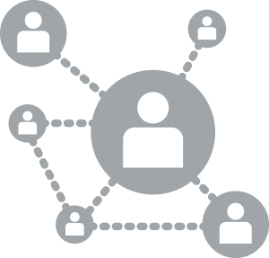
Archived Webconferences
Available On Demand at eab.com
Narrowing the Third Grade Reading Gap
Mitigate Summer Slide with Engaging Summer Programming
Embracing the Science of Reading
Develop and Implement Schoolwide Expertise in Science-Based Reading Instruction
Redesign Small Group Instruction to Target Student Skill Deficits
Closing the College Access Gap
Creating a Culture of High Expectations and Building Student Confidence
Supporting More Informed Post-Secondary Choices
Removing Non-Academic Barriers to Application and Matriculation
Meeting the Career Readiness Imperative
Strategies for Integrating and Scaling Early Career Exposure
Boosting the Quality and Frequency of Career Decision Support
Aiding Transitions to Careers through Professional Skill Development
District Communications and Safety Collaborative
Lessons to Improve Your District’s Image and Strengthen Community Relationships
Teacher Recruitment Collaborative
Ideas and Tools for Improving the Recruitment and Hiring of Teachers in K-12 Districts

