Slide 1
Narrowing the Third
Grade Reading Gap
Embracing the Science of Reading to Improve Student Outcomes
Mitigate Summer Slide with Engaging Summer Programming
District Leadership Forum

Slide 2
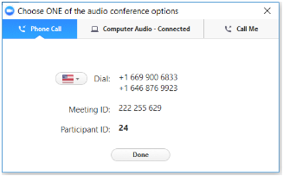
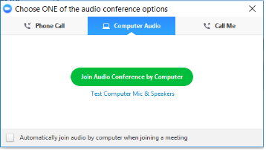
Audio Options
Using Your Telephone
Using Your Microphone and Speakers
If you select the “Phone Call” option, please dial in with the phone number and access code provided.
If you select the “Computer Audio” option, please be sure that your speakers or headphones are connected.

Slide 3


Using Zoom
Mic and Video Controls
Asking a Question
Click the mic and camera pictures until they have a red line indicating they are both off.
To ask the presenter a question, type it into the Chat panel and press send.

Slide 4
EAB: Making Education Smarter
2007
1,300⁺
1,200⁺
Who We Are
Year founded
College and university members
Dedicated
EAB Staff
Identify proven best practices for the most critical challenges facing education leaders
Provide customized, on-demand research to help members meet their immediate needs
Help leaders engage key stakeholders and accelerate progress on key initiatives
How We Serve
Introducing the District Leadership Forum
2017
100
28+
Year founded
Member districts
States represented

Slide 5




Narrowing the Third Grade Reading Gap
Embracing the Science of Reading to Ensure All Students Can Read
1
2
3
4
Develop and Sustain Schoolwide Expertise in the Science of Teaching Reading
Aid Teachers in Implementing Science-Based Instruction
Redesign Small Group Instruction to Target Student Skill Deficits
Mitigate Summer Slide with Engaging Summer Programming
Science of Reading Professional Development
Train the Trainer Sustainability Plan
Grassroots Pilot Success Models
Principal Literacy Champions
Instructional Materials Selection Tools
Science-Directed Literacy Look-For
Video-Based Teacher Observations
Literacy Implementation Evaluations
Skills-Based Grouping
Cross-Classroom Intervention Specialists
Camp-Style Summer Literacy
Online Video Enrollment Campaigns
Summer School Attendance Incentives
Parent-Facing Literacy Nudges
Source: EAB interviews and analysis.

Slide 6






Reading Systems Remain Disconnected From Science
Science Has Had Little Impact on What Happens in Schools
Leadership
District
School
School Board
Out-of-School Literacy Support
?
Instructors
Teachers
Literacy coaches
Reading specialists
Summer learning
Afterschool programs
Family literacy engagement
Pre-kindergarten
?
?
Science of Reading
?
?
Interventions
Instructional Materials
Differentiated instruction
MTSS/RTI
Intervention programs
?
Curricula
Core program
Culturally relevant materials
Assessments
Screeners
Diagnostics
Summative
Source: EAB interviews and analysis.

Slide 7

Upcoming Webconferences
Narrowing the Third Grade Reading Gap Series
 | Tuesday, March 26 3:00 – 4:00 p.m. ET
Develop and Implement Schoolwide Expertise in Science-Based Reading Instruction Join us to learn strategies to develop districtwide support for and ongoing implementation of science-based reading initiatives. This webconference will focus on building principal knowledge and teacher expertise and highlight ways to transfer practitioner knowledge into classroom action. | Wednesday, April 10 3:00 – 4:00 p.m. ET
Redesign Small Group Instruction to Target Student Skill Deficits This presentation will introduce proven ways to enhance the effectiveness of small group instruction and intervention. We will discuss how to reorganize student reading groups around skill deficit rather than broad reading levels. We will also discuss how teachers can support students across grade levels to maximize teacher expertise. | Thursday, April 18 3:00 – 4:00 p.m. ET
Embracing the Science of Reading
This presentation is designed to build school and district consensus around the importance of a science-based approach to reading instruction. We will explore the most up-to-date research on reading instruction and will discuss how brain imaging has provided a clearer understanding of how students learn to read.
Register for these upcoming webconferences here: Narrowing the Third Grade Reading Gap Webconference Series

Slide 8



Summer Slide a Common Occurrence
Summer Break Leads to Learning Loss for Most Students
Reading Momentum Decreases in Summer Months
JUNE
JULY
AUGUST
SEPTEMBER
School Year Ends
School Begins
1 Month
average decline in student performance between spring and fall
Crucial Foundational Skills Often Forgotten During Summer Months
45%
25%
Of 1st -3rd grade students see decline in decoding skills
Of 1st -3rd grade students see decline in fluency skills
Source: Mraz, M. and Rasinski, T.V., 2007, Summer Reading Loss; RAND Education/Wallace Foundation, 2011, Making Summer Count: How Summer Programs Can Boost Children’s Learning; EAB interviews and analysis.

Slide 9
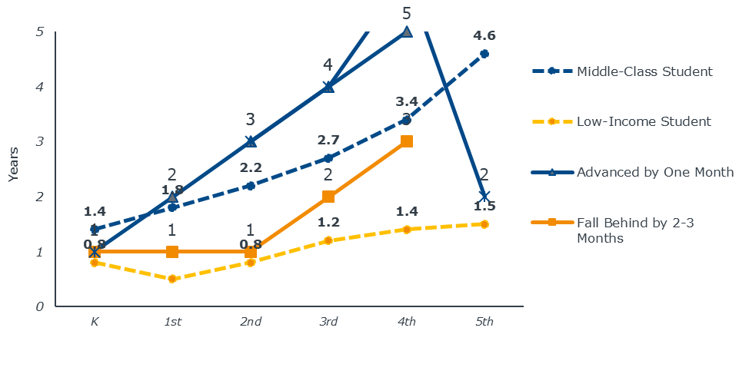
Slide and Cumulative Loss Greatest for Low-Income
Summer Slide Contributes to Growing Achievement Gap
Low-Income Students Fall 2.5 to 3 Years Behind Their Middle-Class Peers by Fifth Grade
summer
summer
summer
summer
summer
After 6 years, disadvantaged students behind their more affluent peers in reading by the equivalent of nearly three grades
Largely Due to Inequitable Access to Literacy Skills Practice Over Summer
61%
Of low-income families have no children’s books at home
18%
Of low-income students attend summer learning and remediation programs
to gain guided practice on skills¹
As compared to 29% of middle income students who attend summer learning and remediation programs.
Source: U.S. News & World Reports. 2018. Is Summer Breaking America’s Schools? ; National Center for Education Statistics. 2018. The Summer After Kindergarten: Children’s Experiences by Socioeconomic Characteristics; The Campaign for Grade-Level Reading. 2011. Research: Early Literacy; The Annie E. Casey Foundation. 2010. Early Warning! Why Reading by the End of Third Grade Matters; EAB interviews and analysis.

Slide 10
Teachers Spend Too Much Time Playing Catch Up
All Students Lose Valuable Instructional Time as Teachers Reteach Material
The Problem
The Consequences
The Losses
66%
3-4 weeks
10%+
Of teachers report spending time re-teaching previous skills
On average are spent reteaching old content at the beginning of the year
Of the school year lost to covering old material forgotten over the summer
Key Instructional Consequences of Summer Slide
Instructional Time Stretched Thinner
All Students Negatively Impacted
Teachers already struggle to cover grade-level content in one year without additional time lost to review
Student supports focus on old
material rather than supporting new knowledge acquisition
All students lose valuable new learning time when teachers have to reteach content from previous year
Students who are still behind even after reteaching will likely continue to fall further behind throughout the year
Source: National Summer Learning Association, Summer’s Influence on Teaching and Learning All Year; EAB interviews and analysis.

Slide 11



Typical Summer School Leaves Much to be Desired
A Missed Opportunity for Summer Learning and Enrichment
Common Characteristics of Underleveraged Summer School
Remedial Nature Associated with Stigma
Half Day Schedule Inconvenient
Inexperienced Instructors
Summer school is typically stigmatized and viewed by students and parents alike as a form of punishment for lagging performance throughout the school year
Half day programs reduce attendance rates as parents often do not have child care coverage for the second half of the day
Selection of instructors often limited by availability and union rules, not by qualifications for the job or success in teaching literacy
Source: EAB interviews and analysis.

Slide 12



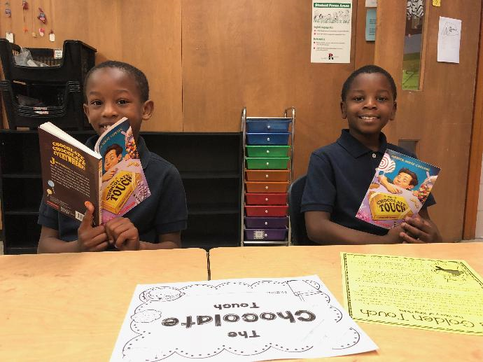
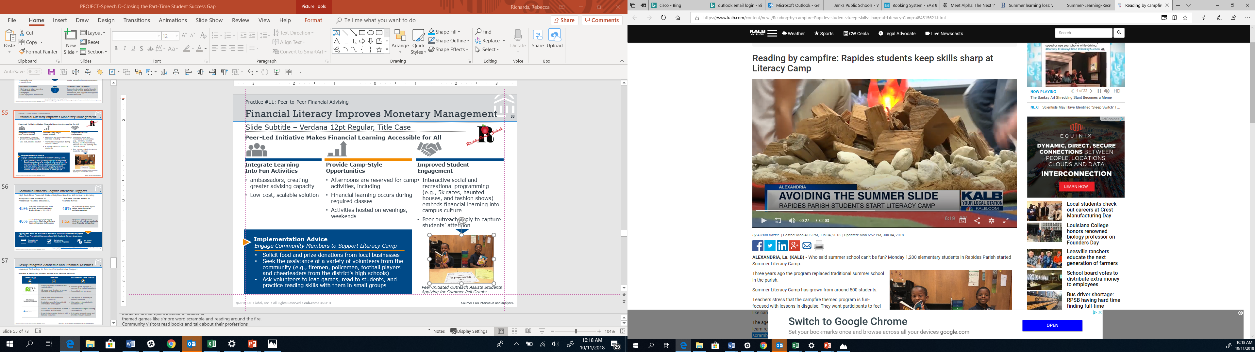


Disguise Literacy Learning in Fun
Practice #11: Camp-Style Summer Literacy
Camp-Style Summer Program Creates Excitement for Learning
Intensify Literacy Focus in Summer Learning
Integrate Learning Into Fun Activities
Embrace a Camp-Style
Theme Throughout
1
Repurpose summer programming to focus primarily on improving student literacy
Focus on writing, reading, and vocabulary workshops in morning activities
Disguise literacy learning with themed games, such as “s’more word scramble” and “readings around the fire”
Reserve afternoons for fun activities, including “camp spotlights” with local professionals who discuss careers and value of reading
Remove stigma by referring to students as “campers” and school as “camp”
2
Align summer curriculum to the school year’s with emphasis on foundational skills
3
Recruit strong and experienced literacy teachers from district as summer teachers
4
If possible, extend length to full day and provide transportation
Profiled Institutions:
Rapides Parish Schools, LA and Grant County Schools, WV
Source: KALB News. 2018. Reading by campfire: Rapides students keep skills sharp at literacy camp; EAB interviews and analysis.

Slide 13
Quality Instruction Key to Summer School Success
Practice #11: Camp-Style Summer Literacy
Recruiting Strongest Reading Teachers Improves Student Learning
“We paired teachers with groups of students based on student needs. We spotlighted the students who were struggling with foundational skills, even if they were good readers but just needed extra support with a particular skill. It was wonderful practice for the kids, and they loved it.”
DeEdra Bolton, Former Superintendent
Grant County Schools, WV
“We hired the strongest literacy teachers to teach over the summer. We gave teachers a curriculum and the foundational tools to be successful in supporting their students in reading. When we gave them those resources, they flew.”
Alana Cohen, Curriculum Director
Rapides Parish Schools, LA
Source: EAB interviews and analysis.

Slide 14


Literacy Camp Model Increases Student Engagement
Practice #11: Camp-Style Summer Literacy
Engaging Camps Improve Attendance and Mitigate Summer Learning Loss
Increase in Rapides Parish summer school attendance after transforming to literacy camp
90%
Attendance rate for students recommended for summer school as reported by Rapides Parish Schools and Grant County Schools
96%
Pre-Implementation
Summer 2018
Of Grant County students successfully avoided summer slide
“By making it fun and tying everything back to the love of reading, kids are excited to come, their parents are all on board, and we’ve had a great turnout…Our kids who come to literacy camp are coming back at the start of the school year more prepared than when we started this. Even the ones with low proficiency scores are not scoring nearly as low as they were.”
Alana Cohen, Curriculum Director
Rapides Parish Schools, LA
Source: EAB interviews and analysis.

Slide 15

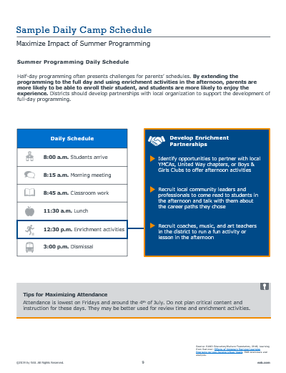
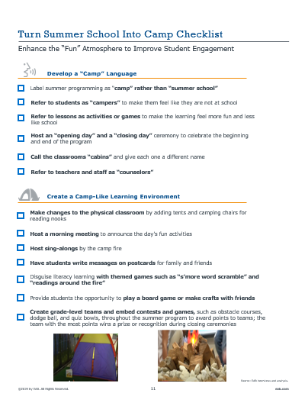
Toolkit Resources to Redesign Summer Learning
Sample Schedule
School Transformation Ideas
Sample daily programming schedule and ideas for afternoon enrichment activities
Ideas for changing the atmosphere of the school to excite students about being at camp
Source: EAB interviews and analysis.

Slide 16


Summer School Benefits Limited By Low Attendance
Too Few Students Attend Enough to See Impact from Instruction
Minimum Days of Student Attendance to Positively Impact Learning
Getting Students to and Through Summer Remains
a Challenge
20
10%
Instructional Days
Of students recommended for summer programming enroll on average¹
Improvements between 14% and 23% of typical annual gains
30%
Extending Summer Learning Schedule Increases Likelihood of Sufficient Attendance
Of students who enroll never attend a day of summer programming on average
RAND’s Formula for Summer Programming Success
75%
27-30 days
Of summer programming
x
=
75%
Average
attendance rate
20 days
Of student
attendance
Attendance rate for students who attend summer programming
As measured by 125+ EAB interviews with practitioners and experts across country.
Source: RAND Education/Wallace Foundation, 2018, Learning from Summer: Effects of Voluntary Summer Learning Programs on Low-Income Urban Youth; EAB interviews and analysis.

Slide 17

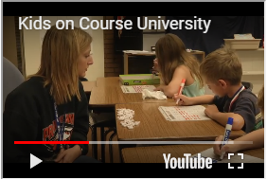


Video Marketing Campaign Increases Enrollment
Practice #12: Online Video Enrollment Campaigns
Show Parents the Benefits of Students Attending Summer Programming
Videos Show Parents First-Hand the What and How of Summer
Use Videos to Inform and Engage Parents
Show parents what a flyer cannot – what the student experience looks like
Provide student and parent testimonials about the benefits of the experience
Release Video in Winter to Promote Early Enrollment
Share video during winter parent conferences for recommended students
Market program to parents before they make other summer childcare plans
Post to frequently visited webpages for greater visibility
Profiled Institution:
Cedar Rapids Community
School District, IA
Video Marketing Drastically Increases Enrollment
300%
Increase in enrollment after one year of video campaigns
89%
Of attendees reduced, eliminated, or reversed summer reading slide
Source: KCRG-TV9. 2017. Test scores show summer school program in Cedar Rapids worked; Cedar Rapids Community School District. Kids On Course University; EAB interviews and analysis.

Slide 18

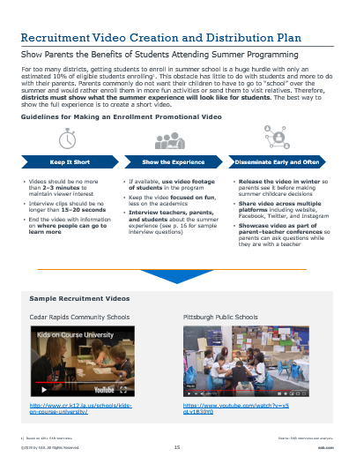
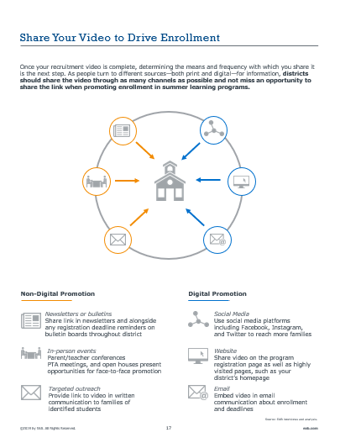
Toolkit Guides Video Creation and Dissemination
Video Creation Directions
Video Distribution Guidance
Guidelines for creating video including length, content, and release timing
Suggestions for how to share the recruitment video digitally and not digitally
Source: EAB interviews and analysis.

Slide 19






Once Enrolled, Incentivize Summer-Long Attendance
Practice #13: Summer School Attendance Incentives
Excite Students about Attendance Through Positive Rewards
Promise of Prizes from Camp Store Spurs Continued Attendance
Students Choose and Save Up for Camp Store Items
Campers are rewarded with “bucks” for attendance as well as embodying the camp motto – work hard, be nice, have fun
Small toys
School supplies
Books
Tickets
Students visit the camp store once
a week to redeem dollars for a prize or can save their dollars for a larger prize later
Multiple Approaches to Stocking the Camp Store
Allocate some funding
in budget
Profiled Institution:
Pittsburgh Public Schools, PA
Partner with community organizations for donations
Attendance Improves Within
One Year
Increase in perfect attendance from summer 2016 to summer 2017
Increase in regular attendance¹ from summer 2016 to summer 2017
Day increase in average camp attendance in
2 years
25%
27%
5
Source: Pittsburgh Public Schools.2017. Summer Dreamers Academy Summary Report for 2017; EAB interviews and analysis.
Regular attendance is defined as 20-27 days.

Slide 20


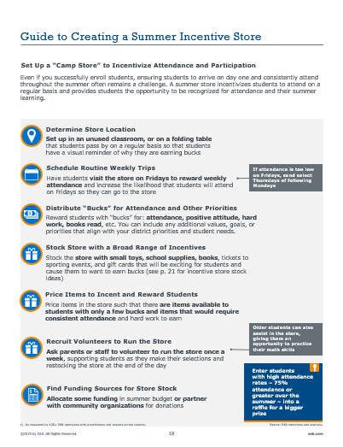
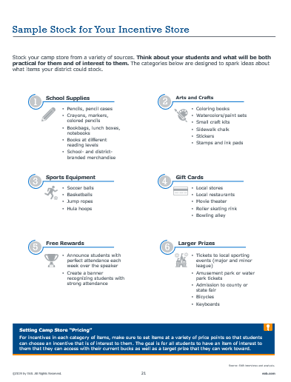
Toolkit Provides Incentive Store Playbook
Steps for Establishing Store
Sample Store Stock List
Guidance for establishing incentive store, including location, logistics, and pricing
Suggestions for different items to stock in store that will excite students and be practical too
Source: EAB interviews and analysis.

Slide 21


Sometimes Poor Participation Rates Are Unavoidable
Despite Best Efforts, Some Students Unable to Attend Summer School
Many Parents Have a Will, But Not Always a Way to Get Kids to Summer Programming
Low-Income Families More Likely to Face Barriers to Program Enrollment
Parent Response to Afterschool Alliance Parent Survey¹
Percent of low-income parents support public funding for summer learning programs
High summer mobility
90%
Lack of childcare availability for the remainder of day for half-day summer programs
67%
Percent of low-income parents reported that they would enroll their child in summer learning programs if they could
Limited transportation
Working Parents Struggle to Find Time to Read to Kids
“I want the best for my child, as any parent does. My son’s teacher tells me that he is behind in reading and recommends that I read to him every day over the summer. She gave me a list of summer books and the school gave us a library card, but it’s so hard to find the time to go.”
2nd Grade Parent, California School District
N= 30,000 households.
Source: Afterschool Alliance. 2010. Just 25 Percent of U.S. Children Attend Summer Learning Programs, According to “America After 3PM, Special Report on Summer”: EAB interview and analysis.
Notes:
http://www.afterschoolalliance.org/press_archives/AA3PMNationalNR_052510.pdf

Slide 22
Enable Parents to Reinforce Literacy in Simple Ways
Practice #14: Parent-Facing Literacy Nudges
Text Parents Light-Lift Tips to Support Literacy Development in Summer
Tips-by-Texts Parent-Facing Initiative Helps Prevent Summer Learning Loss¹
Three Step Process to Engage Parents in Reinforcing Literacy
A Text Messaging Field Experiment to Promote Literacy (2017)
Harvard University randomized control trial in Blackstone Valley Prep Mayoral Academy finds that texting parents suggestions of ways to reinforce literacy in everyday activities over the summer helps to mitigate summer learning loss in early elementary grades
1
Update Parent Contacts
Request and update parent
cell numbers every 6 months
to account for frequent change in numbers
2
Develop Grade-Level Literacy Text Message Prompts
Organize grade level teachers to create a list of suggested actions for parents to reinforce literacy in the day-to-day
Even Among Minority and Low-income Student Populations
3
Establish Plan for Rollout
Demographics of 1st-4th Grade Research Participants at Blackstone Valley Prep Mayoral Academy
Send roughly 2 texts per week,
a total of 18 texts
Frame texts as helpful prompts
for reinforcing literacy during
daily tasks (i.e., grocery shopping)
44%
50%
Of participating students were Hispanic or African American
Of participating students qualified for free- and reduced-price lunch
Sample text messaging
prompts available in the Appendix.
N=183 1st-4th grade students
Source: Kraft, M. & Minti-Nussbaum, M. 2017. Can Schools Enable Parents to Prevent Summer Learning Loss? A Text Messaging Field Experiment to Promote Literacy Skills; EAB interviews and analysis.

Slide 23




Practice #14: Parent-Facing Literacy Nudges
Use Texts to Share Literacy Knowledge with Parents
Key Components of a Successful Parent Text
Principles for Effective Summer Literacy Messages
Begin with a Call for Urgency
Convey information about summer learning loss at the start of the summer to prompt parental summer support
Hi [first_name]! Did you know that kids who read 4+ books over the summer fare MUCH better on tests in the fall than their peers who read 0-1 books?
Prompt Teachable Moments in the Day-to-Day
Send a series of opportunities for parents to reinforce grade-level literacy skills in everyday activities
Tip: Next time you are at the grocery store, point out the first letters on each box item you buy and connect that letter with a sound
Offer Literacy Resource Links
Share links to free, but relevant literacy websites and apps to facilitate out-of-school learning
Resource: Here is a free fun app for students to practice vocabulary [link]
Tips for Increasing Parent Engagement with Texts
Keep messages short
Provide an opt-out option
Source: Kraft, M. & Minti-Nussbaum, M. 2017. Can Schools Enable Parents to Prevent Summer Learning Loss? A Text Messaging Field Experiment to Promote Literacy Skills; Bergman, P. & Rogers, T. 2017. The Impact of Defaults on Technology Adoption, and Its Underappreciation by Policymakers; EAB interviews and analysis.

Slide 24


Texting Provides Promise for Summer Support
Practice #14: Parent-Facing Literacy Nudges
Equipping Parents with Grade-Appropriate Content Critical for Success
Parents Satisfied with Text Messaging Prompts
Significant Boost in 3rd and 4th Grade Reading Scores
90%
Of parents reported finding the text messages valuable
3rd and 4th grade students in treatment group had statistically significantly higher fall reading scores on STAR and STEP compared to control group
Summer Communication
Creates Spill-Over Effect
Slight Increase in 1st and
2nd Grade Reading Scores
31%
Of parents shared text message recommendations with other parents
1st and 2nd graders in treatment group had a slight uptick in fall reading scores on STAR and STEP compared to control group
Lessons Learned
Authors concluded that a greater emphasis on foundational literacy skills (i.e., phonemic awareness and phonics) for younger students would have likely yielded comparably significant results
Source: Kraft, M. & Minti-Nussbaum, M. 2017. Can Schools Enable Parents to Prevent Summer Learning Loss? A Text Messaging Field Experiment to Promote Literacy Skills; EAB interviews and analysis.

Slide 25
Narrowing the Third Grade Reading Gap
Embracing the Science of Reading to Ensure All Students Can Read
1
2
3
4
Develop and Sustain Schoolwide Expertise in the Science of Teaching Reading
Aid Teachers in Implementing Science-Based Instruction
Redesign Small Group Instruction to Target Student Skill Deficits
Mitigate Summer Slide with Engaging Summer Programming
Science of Reading Professional Development
Train the Trainer Sustainability Plan
Grassroots Pilot Success Models
Principal Literacy Champions
Instructional Materials Selection Tools
Science-Directed Literacy Look-For
Video-Based Teacher Observations
Literacy Implementation Evaluations
Skills-Based Grouping
Cross-Classroom Intervention Specialists
Camp-Style Summer Literacy
Online Video Enrollment Campaigns
Summer School Attendance Incentives
Parent-Facing Literacy Nudges
Source: EAB interviews and analysis.

Slide 26
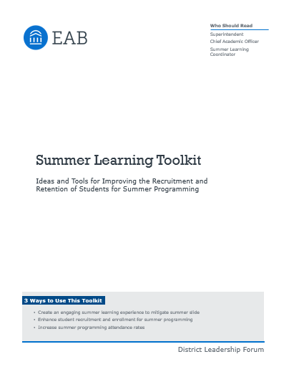


New Resource Being Added to Library
Coming Soon: Summer Learning Toolkit
Questions About Today’s Presentation?
Jenny Taylor
Consultant
jtaylor@eab.com
202-266-5448
Additional Resources Available Online
K-12 Student Success
Resource Center
On-Demand
Research Library
K-12 Student Mental Health and Wellness Resource Center
Summer Learning Toolkit available at eab.com
Source: EAB interviews and analysis.

Slide 27
Upcoming Webconferences
Narrowing the Third Grade Reading Gap Series
 | Tuesday, March 26 3:00 – 4:00 p.m. ET
Develop and Implement Schoolwide Expertise in Science-Based Reading Instruction Join us to learn strategies to develop districtwide support for and ongoing implementation of science-based reading initiatives. This webconference will focus on building principal knowledge and teacher expertise and highlight ways to transfer practitioner knowledge into classroom action. | Wednesday, April 10 3:00 – 4:00 p.m. ET
Redesign Small Group Instruction to Target Student Skill Deficits This presentation will introduce proven ways to enhance the effectiveness of small group instruction and intervention. We will discuss how to reorganize student reading groups around skill deficit rather than broad reading levels. We will also discuss how teachers can support students across grade levels to maximize teacher expertise. | Thursday, April 18 3:00 – 4:00 p.m. ET
Embracing the Science of Reading
This presentation is designed to build school and district consensus around the importance of a science-based approach to reading instruction. We will explore the most up-to-date research on reading instruction and will discuss how brain imaging has provided a clearer understanding of how students learn to read.
Register for these upcoming webconferences here: Narrowing the Third Grade Reading Gap Webconference Series

Slide 28

Upcoming Webconferences
Managing Behavioral Disruptions in Early Grades Series
 | Wednesday, April 24 3:00 – 4:00 p.m. ET
Create Conditions for Positive Classroom Behavior This webconference will provide strategies to help districts and schools change the classroom environment and schedule in order to provide students with a better learning environment and more opportunities for unstructured play. We will then discuss how to overcome common pitfalls of PBIS implementation and standardize behavioral expectations across a school and district. | Thursday, May 9 3:00 – 4:00 p.m. ET
Promote the Social Emotional Well-Being of Students and Teachers This presentation will provide strategies districts and schools can implement to support the social-emotional needs of both students and teachers. By selecting the right SEL curriculum to meet district and school needs for students, as well as implementing SEL practices for adults, districts and schools can create more supportive environments for both students and teachers. | Wednesday, May 15 3:00 – 4:00 p.m. ET
Enhance Support for Higher-Needs Students This webconference will teach strategies that districts can employ to support students who have greater behavioral needs, including students with a history of trauma. We will look at multiple aspects of supporting these students, including trauma-informed care, support teams, and strategies for reintegration into the classroom. | Thursday, May 23 3:00 – 4:00 p.m. ET
Prevent Misbehavior Through Early Intervention
Districts across the U.S. are experiencing a noticeable increase in disruptive behavior among elementary students. Join this presentation to explore the frequency of disruptive behaviors, current approaches to address them, and strategies to prevent these behaviors from arising in the classroom.

