Slide 1
Institutional Risk Management at [YOUR SCHOOL NAME]
Independent School Executive Forum

Slide 2
Instructions – DELETE AFTER READING
How to use this slide deck:
Begin by reading through the slides
Add school-specific information
Review notes included in “notes section” of PowerPoint. These provide speaking points and additional detail that will assist you in presenting this slide deck.
Orange boxes:
Orange boxes mean that you will need to add school-specific information
Follow the instructions in the box to ensure that this presentation is specific to your school
Delete the orange box once the information has been added

Slide 3
Today’s Plan
Objectives and Agenda for Risk Management Session
Agenda
Objectives
Introduction
Objective 1:
To establish a shared language around risk management
Background information on the importance of risk management
Risk management compared to crisis management
Benefits of institutional risk management (IRM)
How we adapted IRM for [YOUR SCHOOL]
Objective 2:
To develop a shared understanding of what constitutes a comprehensive risk management process
Add school name here
Role of the Board
How the board can support the IRM process
How the Risk Management Committee will include the board in the process
Objective 3:
To clarify the board’s role in the risk management process

Slide 4
What’s Institutional Risk Management?
Introduction to IRM
Breadth of Risks Necessitates Approach that Moves Beyond Crises
Key Elements of Risk Management
Full view of organization’s risk exposure
Clear, predetermined criteria for assessing risks
Risk treatments designed by area experts
Continual monitoring, assessment built into process
Ongoing communication with stakeholders
Comprehensive Risk Management Process
Build Infrastructure to Manage Risk
Assess, Prioritize Risks
Develop Risk Treatments
Implement, Monitor Treatments
Engage representative school stakeholders; develop structured risk management process
Identify all risks; use objective, predetermined criteria to prioritize risks
Design procedures, protocols for addressing risks, implementation steps
Implement treatments, measure impact, effectiveness
Ongoing, Iterative Process
Source: EAB interviews and analysis.
Notes:
Notes:
Given all of the risks that independent schools face today, we need a more comprehensive, inclusive approach to risk that moves beyond crises.
This involves a few key elements, including:
Understanding the full breadth of our school’s exposure to risk
Having objective criteria for assessing these risks
Designing treatments to both prevent and respond to each risk by people who have the expertise to do so
Monitoring these treatments on an ongoing basis to make sure they’re effective
And continually communicating this work with your school community
We’ve laid out these key elements as components of a comprehensive risk management process on the bottom half of the slide.
As you can see, the first step is to create the infrastructure needed in order to set up this process, which is then laid out as:
Assessing and prioritizing risks,
Developing risk treatments, and
Implementing and monitoring these treatments.
These last three steps will be continually revisited as schools engages in the risk managing process on an ongoing basis.

Slide 5
Crisis Preparedness Is Not Risk Management
Introduction to IRM
Easily Conflated, Two Approaches Marked by Important Differences
Risk Management Is Different from Crisis Management
 | Complete understanding of institution’s risk exposure | Risks prioritized in relation to school’s context | Mitigation, response protocols designed by experts with greatest knowledge | Ongoing monitoring, drills keep protocols, appropriate responses top-of-mind | Key stakeholders kept in the loop as appropriate
Crisis Preparedness
Risk Management
risk management
| noun |
/ risk ˈ man-ij-muhnt/
Coordinated activities to direct and control an organization with regard to risk.
Source: EAB interviews and analysis.
Notes:
Notes:
Oftentimes, independent schools are focused on crisis preparedness. We’ve broken down the key elements of risk management in the table below to show you the limitations of crisis preparedness in comparison.
While both crisis preparedness and risk management help you to design effective policies and response protocols, encourage continued drills, practice, and monitoring, and keeping stakeholders informed, crisis preparedness falls short in several key ways.
First, it doesn’t allow you to have a complete understanding of your institution’s risks, because it simply doesn’t focus on every type of risk that could impact you.
It also doesn’t involve prioritization of risks, which is essential when it comes to figuring out how you’ll allocate your school’s resources.
And while schools are often consulting with outside safety experts or legal counsel, they are often overlooking the expertise within the institution to help identify and mitigate the broader array of risks that threaten the school.

Slide 6
Schools Confront More Than Just Crises
Introduction to IRM
We Must Handle Mundane, Everyday Challenges that Pose Risks
Student Health, Safety
Severe food allergies, athletic injuries endanger student well-being while on campus
Campus Physical Safety Routine activities become dangerous without appropriate planning, maintenance, vigilance
Food Allergies
Slip and Falls
Athletics
Drop Off/Pick Up Procedures
Employee Disputes
Data Security
Community Conflict
Increasingly litigious employees, parents threaten schools with lawsuits
Technology Threats
Evolving student, school IT usage bring new vulnerabilities to sensitive information, reputations
Parental Grievances
Social Media
Source: EAB interviews and analysis.
Notes:
Notes:
We’ve typically focused on just a few risks, when in fact the risk landscape is so much larger. This process will allow us to better track and manage all those risks.
We’ve grouped just a few of the types of risks that you deal with regularly at school, starting with student health and safety. You have to think about everything from students’ food allergies to the latest concussion protocols for student athletes.
You also have sprawling campuses to maintain to protect your community from everything slip and falls to incidents during student pick-up and drop-off.
There are a whole host of new threats that arise as your schools and the world around you becomes more high-tech: everything from securing sensitive data from breaches to your students’ use of social media.
Then there are the threats you deal with from community conflict and greater litigiousness, whether it’s an unhappy employee who is being exited who is threatening to sue you or an issue that arises with a disgruntled parent.
And to be clear, this is far from a comprehensive list….

Slide 7
Why Engage in Institutional Risk Management?
Introduction to IRM
Why We Are Beginning the IRM Process at [YOUR SCHOOL]
Add school logo here
Institutional Risk Management Will Benefit Our School
IRM supports our school’s mission by tying all risk responses to institutional goals, values
IRM will help keep the school functioning at the highest possible level by anticipating risks across all functions of the institution
By proactively identifying possible risks to our school we will be able to respond to risks quickly and efficiently
Add school mission here
Notes:
NOTE: It will be helpful for you to add some color about your school in particular and illustrate that this is a process adapted to the needs of the school.
IRM will help keep students, faculty, staff, and school functioning at the highest possible level
The IRM process

Slide 8
Moving Towards Risk Management
Introduction to IRM
Our Institution’s Current Risk Management Process
Place the blue box over your school’s current location on the IRM process continuum, based on your Institutional Risk Management Maturity Assessment results
Add school name here
Risk Management at [YOUR SCHOOL]
Crisis Preparedness Formal process limited to identifying, addressing crises
Informal Approach No formal process, with risk addressed by few
Risk Management Comprehensive process in place to address broad array of institutional risks
Risk Management Next Steps
1
Step one
Add detail here about the next steps you have planned for the risk management process at your school.
Draw upon any preliminary planning you have done, recommendations from the Maturity Assessment, and Risk Committee meetings to outline your next steps.
2
Step two
3
Step three
Source: ISEF, Institutional Risk Management Maturity Assessment; EAB interviews and analysis.
Notes:
Notes:
Most schools fall somewhere on a continuum between having no formal approach to managing risk and comprehensively managing risk, often focusing mainly on crisis preparedness.
We used the Institutional Risk Management Maturity Assessment to assess our schools current approach to risk

Slide 9
[School Name’s] Risk Management Team
Add school name here
Role of the Board
Proper Risk Management Requires School-Wide Involvement
Risk Management Committee
NAME, POSITION
NAME, POSITION
NAME, POSITION
NAME, POSITION
NAME, POSITION
NAME, POSITION
NAME, POSITION
NAME, POSITION
NAME, POSITION
NAME, POSITION
NAME, POSITION
NAME, POSITION
Risk Management Committee Details
How often does the Risk Management Committee meet?
Who does the Risk Management Committee report to?
Fill in your school’s specific information here.
Who makes up the Risk Management Committee?
How often does the Risk Management Committee meet? Who do they report to?
NOTE: If your school has not yet created a risk management committee, then delete this slide

Slide 10
Extend Board Role to Include IRM
Role of the Board
Core Practices for Board Governance Apply to Role in Risk Management
Key Principles of Good Board Practice…
…Translate into Principles of Good Board Practice for Risk Management
Board acts as guardian of school’s mission, vision, strategic goals
Board supports risk management prioritization for school’s sustainability
Board ensures operation in compliance with laws, regulations to minimize exposure to legal action
Board supports school in enacting policies, protocols to minimize lawsuit risks
Board recognizes its primary focus as long-range, strategic
Board maintains oversight, not direct involvement, in risk management operations
Source: NAIS, "Principles of Good Practice-Board of Trustees,” 2017; NAIS, “Major Responsibilities of Independent School Boards,” No Date; EAB interviews and analysis.
Notes:
Notes:
On the upper left-hand side of this table, you can see several key functions of the board and how they translate into principles of good board risk management practice.
For example, the board recognizes its primary role as “long-range and strategic,” which means that it does not engage in daily operations when it comes to risk management, though it does maintain oversight.
Depending on your board’s current level of involvement at the school this can also provide a reminder of where their energy is best spent in service to the school.

Slide 11
Principles for Board Involvement in IRM
Role of the Board
Board Support, Oversight Necessary for Successful Risk Management
The Board of Trustee Involvement
Contribute to Risk Register
Receive Updates
Provide Oversight
Add group name here
You will be asked to participate in a risk identification workshop
During this workshop we’ll ask for your thoughts on potential risks to the institution
CFO provides [GROUP NAME] with regular risk management updates
We will share information [ADD HOW OFTEN]
Use influence to support IRM process, encourage school-wide participation
Ask critical questions to further Risk Management Leadership thinking
Add timing of updates here
Include who will receive updates (we recommend giving updates to the audit committee)
Include how often the board can expect updates (annual updates are recommended)
Source: EAB interviews and analysis.

Slide 12
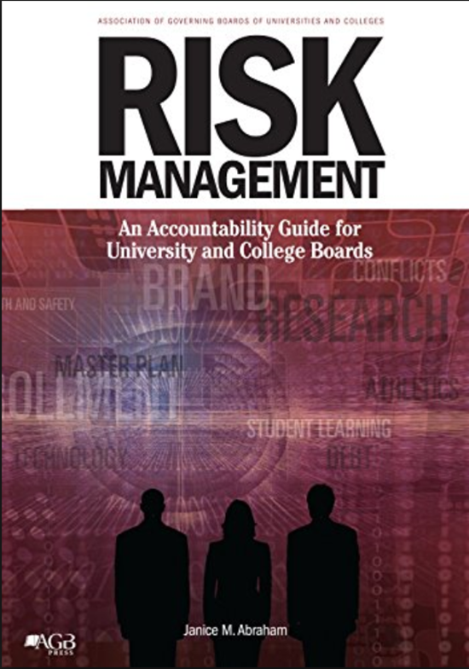
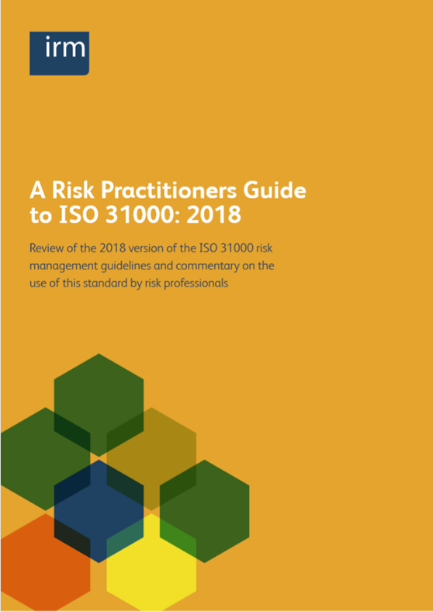
Additional Resources
Looking for Some Risk Management Reading?
Risk Management: An Accountability Guide for University and College Boards
Janice Abraham, United Educators
Outlines the best role of college and university boards in risk management
Includes additional guidance on how to build a comprehensive risk management process
Useful to better understand risk management for education
A Risk Practitioners Guide to ISO 31000: 2018
Institute of Risk Management
Industry standards for risk management
Includes information on risk management principles, framework, and process
Provides a background in the risk management process

Slide 13
Contact Us With Any Additional Questions
Add headshot here, if available
Add headshot here, if available
Contact Name Title
contact@email.org xxx-xxx-xxxx
Contact Name Title
contact@email.org xxx-xxx-xxxx

