Slide 1
Engaging Alumni in Student Career Development to Create Two-Way Value
Innovative Strategies from the UK, US, and Canada
The Ross Group

Slide 2


Spotlight on Employability
Higher Ed Institutions Increasingly Accountable for Graduate Employability
2017 UK Graduate Stats
New Regulatory Framework for Higher Ed Emphasizes Graduate Outcomes and Employability
(April 2018)
22%
of graduates not employed in high skilled job six months after graduation
15%
of graduates not employed in high skilled job three and a half years after graduation
Too Many Students Left with Debt for Too Little Payback
(November 2018)
31%
of graduates overqualified for job
Source: Higher Education Leavers Statistics: UK, 2016/17 – Summary, https://www.hesa.ac.uk/news/28-06-2018/sfr250-higher-education-leaver-statistics-activities;“One in three graduates overeducated for their current role,” Office for National Statistics, 29 April 2019, https://www.ons.gov.uk/news/news/oneinthreegraduatesovereducatedfortheircurrentrole “Too many students left with debts for 'too little payback”, BBC News. 5 November 2018; https://www.bbc.com/news/education-46073769;
Notes:
It’s not news to you all that the spotlight is on graduate employability in higher ed. Presumably, this is why you are all interested in this research topic in the first place! Just wanted to call out a few pressure points here.
First, you’re facing new requirements under the new regulatory framework that came out of the Office for Students last year. Plus, you’re facing growing public concern about the return on investment (ROI) associated with higher ed. As in the US, UK universities are expected to assume greater responsibility for students’ post-graduation outcomes.
In the UK, we’ve largely succeeded in opening up access to universities, with more than half of young adults now going on to higher education. And the unemployment rate for UK graduates is at a mere 5% the lowest it’s been in almost 40 years (https://www.prospects.ac.uk/prospects-press-office/graduate-unemployment-rate-lowest-in-39-years-as-skills-shortages-boost-prospects).
But the problem we’re seeing in the UK is more around underemployment. Some stats listed here on the left. In 2017, 22% of grads not employed in jobs that require degrees 6 months after graduation. 3.5 years after graduation, 15% of grads still not in high skill jobs. 31% of grads are overqualified for their jobs.
To prove our value in higher ed, we need to do a better job of getting our students into jobs that require university degrees.

Slide 3







Universities Play a Pivotal Role in Career Prep
Student Career Preparation Ecosystem
Students’ Career Preparation Needs
Resources Marshalled for Student Career Preparation
Direct access
to employers, internships, and jobs
Access to
University Courses and Faculty
Insight into industry needs and desired skills
Relationships with Employers across industries
University
Guidance on
job-searching and networking strategies
Affinity and goodwill developed with Alumni
Source: EAB interviews and analysis.
Notes:
Fortunately, there’s at least one solution that can move the dial on the student employability problem, and that’s leveraging your alumni to enhance student career development. And this really is a mutually beneficial relationship.
To improve their career prospects, students need access to employers, insight into various industries, and guidance on how to search for jobs and network. On the other hand, alumni are looking for volunteer opportunities for professional development purposes, they want the chance to strengthen their own personal networks with university staff, and thy are eager to give back to students.
So it’s the university’s job to facilitate these mutually beneficial relationships through programming and events.

Slide 4
How are UK and Irish Universities Currently Connecting Alumni and Students?
Do You Have Institutional Programming Connecting Alumni and Students?¹
Percentage of Survey¹ Respondents Offering Different Types of programming
EAB’s UK Alumni Career Engagement Survey: Views from Heads of Alumni Relations at Leading UK Universities; N=23
EAB’s UK Alumni Career Engagement Survey
Notes:
At the start of our research, we sent out a survey to the Ross Group members about their alumni-student career development programmes. Many of you participated, thank you for that.
91% of survey respondents reported that they do have programming that engages alumni in student career development, which was very encouraging. This slide shows the breakdown of the different types of programmes and events that survey respondents offer.
The most common among respondents was industry-focused and networking events, with 87% of respondents reporting they offered these events. The least common were alumni-led city or workplace tours, with only 35% of respondents offering them.

Slide 5
Surface-Level Contentment
Alumni Relations Officers Reveal Programmatic Issues and Concerns
Outward Appearances Suggest Success…
…But Deeper Reflection Reveals Anxiety
90%
Have institutional programming to connect alumni and students¹
I think our programmes are doing okay, but we really don’t know the impact
76%
Agree that current programming help increase alumni engagement¹
Alumni relations is not understood, and under-resourced”
62%
Agree that current programming helps graduate outcomes¹
You can have the best programmes in the world, but they’re useless if we can’t get people to participate”
EAB’s UK Alumni Career Engagement Survey: Views from Heads of Alumni Relations at Leading UK Universities; N=23
Source: EAB’s UK Alumni Career Engagement Survey; EAB interviews and analysis.
Notes:
We were encouraged to see that many of you responded positively about your programming. On the left, nearly all of your have programming that connect alumni with student. 76% agree that your programming helps increase alumni engagement, and 62% agree that programming improved graduate outcomes.
However, our research conversations yielded a slightly different story. When we started to dive a bit deeper, many institutions voiced concerns. Some common concerns we heard on the right.
“I think our programmes are pretty good, I know some students have benefited from them… but I actually don’t really know the larger impact.”
In addition to concerns about understaffing, we were told that the alumni relations office has a difficult time collaborating with other units on campus, like the career office.
Finally, another common theme was that programmes lacked enough participation by both students and alumni.
Over the next few slides, I’m going to dive a bit deeper into the four main problems that surfaced in our conversations.

Slide 6


Students Don’t Know What they Don’t Know
Problem 1: Students Unaware of the Full Range of Career Options
Universities Fail to Adequately Highlight Career Options
A Major Obstacle
“About one in three graduates end up being “mismatched” to the jobs they find after leaving university…These mismatched graduates face poorer prospects and lower earnings than their peers who embark on careers that are a better fit for the knowledge and skills they have acquired through three or four years of study. It suggests that traditional careers advice isn’t working.”
Sarah Steed
The Guardian
75+%
of recent grads don’t know what positions are the right fit for them
46%
of recent grads don’t know what to do with their major or course of study
Source: Robert J LaBombard, “‘I don’t know what to do with my major’ and other reasons college grads can’t find good jobs,” CNBC, 15 December 2016; Sarah Steed, “Too many graduates are mismatched to their jobs. What’s going wrong?” The Guardian, 25 January 2018; EAB interviews and analysis.
Notes:
The first problem is that students are simply don’t know what to do with their degrees, and we aren’t going a great job of fixing this.
Some stats on the left from GradStaff. 75% of new grads don’t know what positions are the right fit, and 46% of recent grads don’t know what to do with their major. Quote from the GradStaff CEO on the right. Students not knowing what careers they can pursue is a major obstacle for them landing jobs.
As the CEO says, universities have this information in the form of alumni data. But the problem is that we aren’t effectively getting this information into the hands of students.

Slide 7

Workplace Exposure Necessary for Real World Prep
Problem 2: Students Need Workplace Experience Before Graduation
Universities Not Meeting Demands for Students to Have Workplace Experience
Employers Increasingly Demand Graduates Have Workplace Experience…
14 August 2018
49%
of decision makers prefer to see experience from a relevant apprenticeship or previous position on a candidate’s CV
Employers favour work experience and apprenticeships over degrees, claims poll
…but Universities Not Keeping Up With Demands
93%
of university students want access to work experience, placements, or internships
47%
of university students have undertaken work experience, placements, or internships
25%
of students say there are not enough links between university and businesses
Source: National Centre for Universities and Business, Student Employability Index 2014; http://www.ncub.co.uk/reports/student-employability-index-2014.html; A-level results: Employers favour work experience and apprenticeships over degrees, claims poll, 14 August 2018, https://www.independent.co.uk/news/a-level-results-2018-employers-apprenticeship-university-degree-poll-a8490771.html
Notes:
Second problem is that students are leaving university lacking some major skills that employers are looking for. Show on the top here, employers are increasingly asking for grads to have some level of work experience. . Largely because they want to makes sure employees have basic workplace skills, like timeliness, professionalism, and business etiquette—things that students without work experience usually lack.
However, stats at the bottom show that universities are not keeping up with the demand for workplace experience. 93% of students wants access to work experience, placements, or internships….but only 47% of students of have actually undertaken those things.
Alumni can be a fantastic resource for getting students jobs and internships. But either we are not leveraging the relationships enough and facilitating connections for students.

Slide 8



A Missed Opportunity
Problem 3: Making Student-Alumni Connections Often No One’s Job on Campus
Alumni Relations Well-Primed to Lead the Way but Often Underutilised
Alumni Relations Has Potential to Enhance Student Employability…
…But Efforts Fail Due to Lack of Strong Leadership on Campuses
Has access and relationships with a robust and diverse network of alumni eager to help students
48%
of UK alumni leaders don’t collaborate with other campus units¹
Maintains alumni employment data including location, employers, job titles, university major, etc.
“We’re trying to encourage campus to work more and more with our office… [there’s an] urban legend on campus that you can’t ask alumni relations for anything because they’re not going to give you donor information, causing them to create their own shadow databases, and work outside of us. But really- we’re here to help!”
Tracy Krahl, AVP of Communications and Engagement
DEPAUL UNIVERSITY
Can share best practices in engaging alumni for volunteering opportunities
EAB Survey of UK Universities; N=23
Source:; DePaul University, Chicago, IL; EAB interviews and analysis.
Notes:
The third problem is a lack of leadership and centralisation around alumni engagement activities. Shown on the left, alumni relations has key attributes that make the office a natural leader on these initiatives. They have access to a robust alumni network and alumni employment data, and they understand the best ways to engage alumni to volunteer.
But on most campuses, collaboration between alumni relations is rare. 47% of our survey respondents said alumni relations rarely or only occasionally collaborate with other units. The quote from DePaul University here illustrates this problem. There’s a misconception that alumni relations is very protective of alumni information and only cares about giving. This results in units avoiding collaboration with alumni relations and instead engaging alums on their own.
This a missed opportunity to share information and best practices across offices. And there’s no opportunity for units to collaborate on innovative programming.

Slide 9



If You Build It, Will They Come?
Problem 4: Students, Alumni Participation Difficult to Secure
Programming Less Effective Due to Insufficient Participation
Lack of Student Participation Leads University to End E-Mentoring Scheme
Typical Approach to Alumni Volunteer Recruitment
Hogwarts University¹ sought to expand traditional mentoring programme into an online e-mentoring platform
Sends generic “help wanted” message to all alumni with lowest-common-denominator appeal to duty
Institution successfully generated interest among alumni but failed to adequately market the programme to students
Send three follow-up reminders asking that interested alumni go to website to sign up
Institution shuts down platform due to lack of student participation, leading to dissatisfied alumni
Results in random sampling of alumni who already tend to engage or have little value to contribute; first-timers leave disappointed at having wasted time
Typical drop-off rate between student registration and attendance at alumni engagement events
50%
Pseudonym.
Source: EAB interviews and analysis.
Notes:
Final problem we heard is that even when you have great programmes that engage alums in student career development, they aren’t as effective as they should be due to low participation from students and alums.
One story from a UK school on the left that we pseudonymed as Hogwarts University. Hogwarts wanted to expand their traditional mentoring programme to an online e-mentoring programme wit the hopes of reaching more students. They had a lot of interested alums who were excited about the prospect of being mentors. But, they didn’t do a great job spreading the word among their students. So during the programme pilot, a ton of alumni had signed up to be mentors, but very few students. Ultimately, the pilot failed and they had to shut down the programme—which made their alumni very unhappy.
Of course this an extreme story, everyone has a story like this. But, we heard that most schools on average see a 50% drop-off rate from students who register for an event and students who actually attend.
Moving to the right, the common problem with getting alumni to participate is slightly different. Some schools struggle to get enough alumni to volunteer, but the more common problem we getting the most desired alumni to volunteer—whether the desired characteristic be their career/industry, skill set, or donor potential. On the right, the typical approach to alumni volunteer recruitment.
Schools send out a general blast to alumni to volunteer for specific events or programmes. Because these emails often go ignored, you end up sending 3 more reminders for alums to volunteer and sign up. This results in a random sampling of alumni who may not be best suited to your volunteer opportunity. We’ve heard some comical anecdotes that often results from this strategy. An orthodontist attends a networking event ready to counsel pre-dentistry students, but finds only humanities PhD candidates; or a social work student doesn’t find anyone to talk to and is sold a life insurance policy by an alum who is a financial services professional.

Slide 10
Engaging Alumni in Student Career Development
Strategies to Improve Student Employability and Alumni Engagement
I
II
III
IV
Driving Student Employment Through Career Exploration
Instilling Employable Skills in Students Through Alumni Expertise
Elevating Alumni Relations’ Leadership Role for Student Employability Activities
Maximising Impact through Marketing, Communication, and Assessment
Strategy 1
“This Could be You!” Career Showcases
Strategy 2
Developing Impactful Networking Engagements
Strategy 3
Choosing the Right Mentoring Scheme
Strategy 4
Embedding Workplace Skills in Students
Strategy 5
Leavening the Curriculum with Real World Experience
Strategy 6
Facilitating
Workplace Experience
Strategy 7
Raising the Profile of Alumni Relations
Strategy 8
Supporting Faculty Engagement Activities
Strategy 9
Developing Cross-Campus Partnerships
Strategy 10
Boosting Student Participation
Strategy 11
Recruiting Best-Fit Alumni to the Right Programmes
Strategy 12
Evaluating and Communicating Impact
Notes:
Here’s our roadmap for today.
We’ll tackle 12 strategies across the four main categories you see here (3 per section).
Each strategy will include a couple of different practices from institutions across the UK, US, and Canada.
First, Driving Student Employment through Career Exploration. This section covers strategies that increase student awareness of different careers available to them, including networking events and mentoring schemes.
Next, Instilling employable skills in students by leveraging alumni expertise. Here, we focus on making students are gaining the right skills by brining alumni into the classroom and leveraging alumni to help students get internships and job placements.
Moving to section three, Elevating Alumni Relations’ Leadership Role on Student Employability Activities. This section includes tactics for raising the profile of alumni relations on campus, as well as creating connections with other campus units to develop and refine student employablility initiatives that engage alumni.
Finally, Maximising Impact through Marketing, Communication, and Assessment. Here we will provide strategies for increasing student and alumni participation in employability engagement programmes and evaluating programme success to ensure effectiveness.

Slide 11
Driving Student Employment through Career Exploration
1
Section
Notes:
Let’s dive into our first section. Driving Student Employment through Career Exploration

Slide 12

Driving Student Employment through
Career Exploration
Three Main Challenges
Potential Solutions
1
Students unaware of the multitude of careers available to them with their degrees
Strategy 1: “This Could be You!” Career Showcases
Students lack opportunities to network with professionals and gain deeper insight into various industries
Strategy 2: Developing Impactful Networking Engagements
2
Alumni relations officers are unsure how to differentiate and maximise the potential of mentoring schemes
3
Strategy 3: Choosing the Right Mentoring Scheme
Source: EAB interviews and analysis.
Notes:
First, some road mapping for this section. On the left of this slide, three sub-challenges that students and institutions face that inhibit student career exploration, mapped to the three strategies we will walk through in this section.
The first challenge is the one we’ve already touched on—students are simply unaware of the industries and jobs they can use their career for. Strategy 1 is about improving student awareness of careers and industry by showcasing alumni careers.
The second challenge is that students often lack the opportunities to network with alumni from different industries to explore specific careers and sectors. Strategy two provides examples of impactful networking engagements that enable students to gain deeper insight into specific industries.
The challenge is geared toward universities rather than students. The vast majority of schools in the UK, US, and Canada have a mentoring scheme that connects alumni with students to provide career guidance. But the problem we heard in our phone conversations is that many schools are unsure which type of mentoring scheme best aligns with their goals, staffing levels, and resources. Strategy three will lay out the different types of mentoring schemes and provide guidance on choosing the one that best fits your institution.

Slide 13


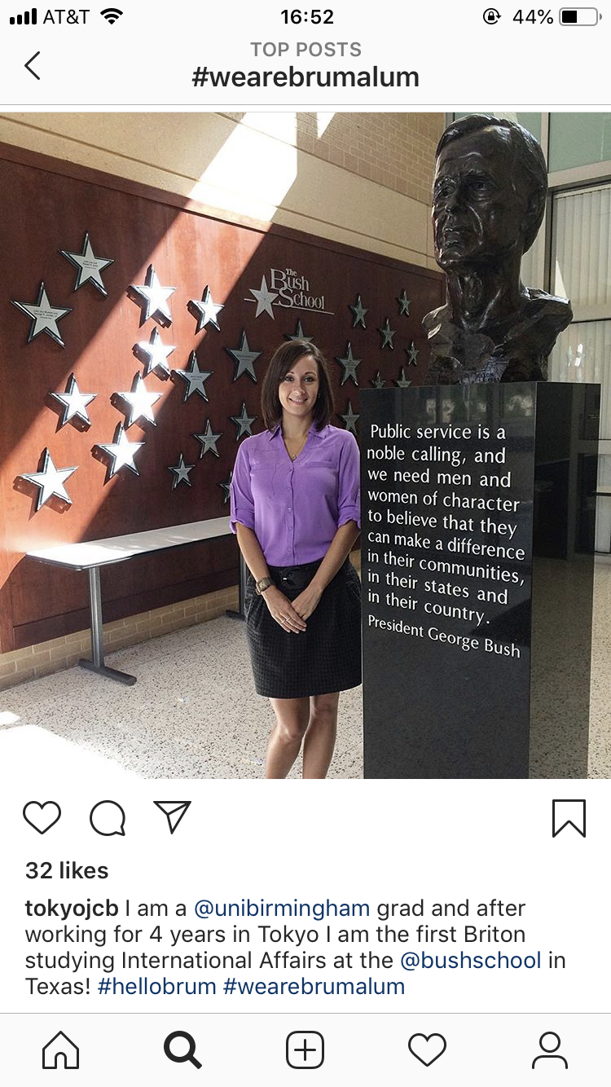
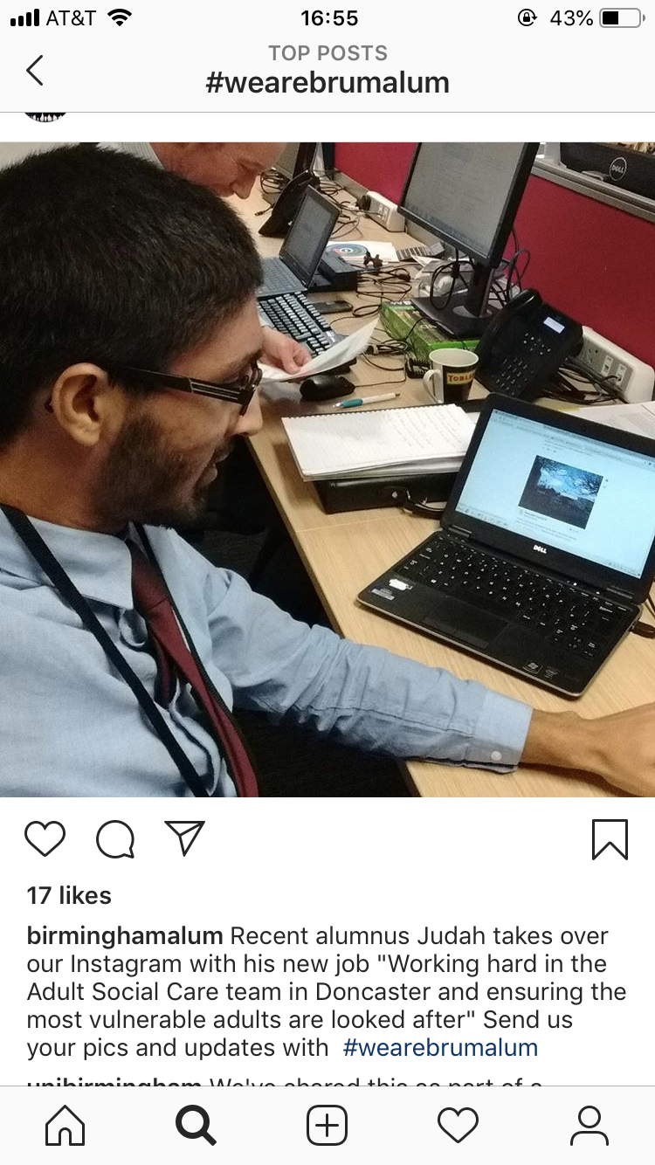
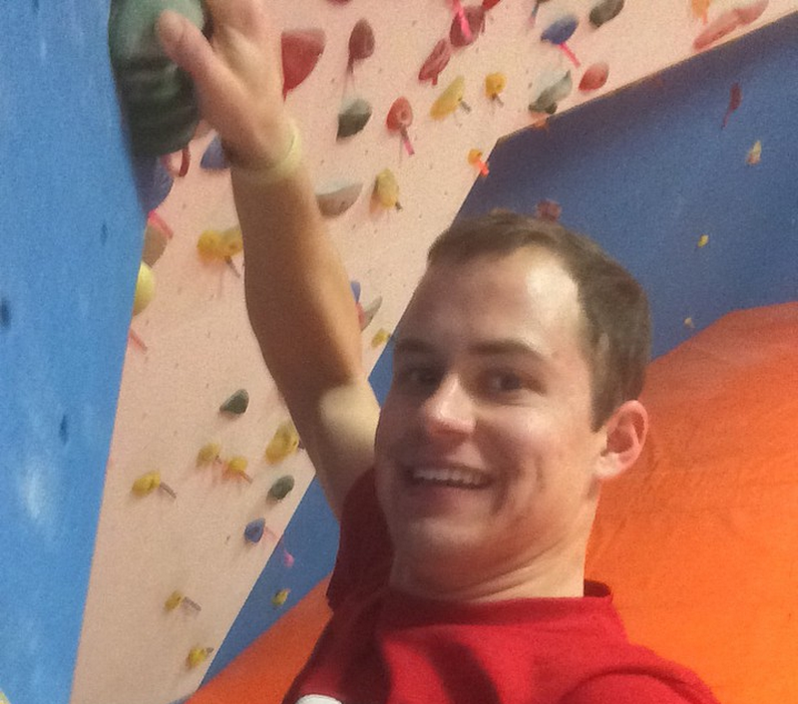
Quick Wins
Strategy 1: “This Could be You!” Career Showcases
Low-Cost, Low-Effort Ways to Highlight Alumni Careers
Instagram Takeovers
Workplace Selfies
Alumni featured on RPI Instagram to highlight interesting job and career paths; alumni content receive 3X more likes and 10X more comments than regular content
University of Birmingham's “We Are Brum Alum” campaign encourages alumni to share selfies of themselves in their workplace on Instagram and twitter along with #wearebrumalum
Image credit: RPI.
RPI alum scales a climbing wall at Google
Source: Instagram, “#wearebrumalum”; Rensselaer Polytechnic Institute, Troy, NY; University of Birmingham, Birmingham, UK; EAB interviews and analysis.
Notes:
The first strategy is Alumni Career Showcases. There are a couple of ideas here that we consider “quick wins.” These are low-cost and low efforts ideas you can easily implement on your campus to showcase alumni careers to students.
On this slide, two similar ideas that engage students where they are most comfortable—on social media.
First, Instagram takeovers. Many schools in both the US and the UK experimenting with these. Schools ask alumni to write a short blurbs about their career and snap some photos of their workplace, and posting it on the institution Instagram page. Here’s a snapshot of an RPI alum scaling the climbing wall at Google. This has been successful for RPI, with alumni contenting getting a much higher level of activity than their normal content.
On the left, another interesting idea is alumni workplace selfies. Similar to the Instagram takeovers, except this tactic allows many alumni to join in at once by taking a selfie at their place of work and post it to their own pages under a specific hashtag. The University of Birmingham developed a campaign and the “we are brum alum” hashtag and asked their of themselves in their workplace on Instagram and twitter

Slide 14


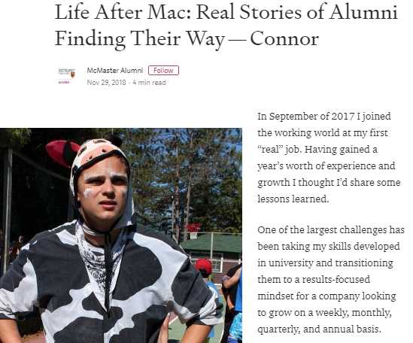
More Quick Wins
Strategy 1: “This Could be You!” Career Showcases
Low-Cost, Low-Effort Ways to Highlight Alumni Careers
Business Card Display
Alumni Case Profiles
Susquehanna University asks alumni to share business cards for admissions display to showcase careers; average yield is 400 business cards (300 never-before engaged alumni)
Unlike typical interview-style case profile, McMaster University’s “Life After Mac” profiles are alumni stories written in first-person to provide students with authentic insight into their career journeys
Oh, the Places They’ll Go
“We tell them that the goal of the programme is to show the power of a Susquehanna education by explaining to students all the places they can go in their future.”
Becky L. Deitrick,
AVP of Alumni, Parent & Donor Engagement
Source: McMaster University, Hamilton, ON; Susguehanna University, Sellinsgrove, PA; EAB interviews and analysis
Notes:
Two more quick wins on this slide. On the left, Susquehanna University asks their alums to mail copies of their business cards to the alumni office for a spring semester display. The business cards are organised by major in a large display in the student center. The display demonstrates unlikely connections between majors and occupations and visualises how liberal arts graduates will apply their degrees in a variety of settings, some of which are unconventional.
Moving to the right, alumni case profiles. Most universities we spoke with collect alumni case profiles and use them for a variety of reasons; for example, the admission office uses them to recruit prospective students, deans put alumni success stories on their academic dept website, etc. Typically these profiles have a Q and A format, where alums answer questions about their job, career path, major at university, etc. McMaster University put a different spin on this by asking alumni to write a lengthier stories detailing their journey from student to new grad to successful alum. These have been very popular with students since they give an authentic look into the lives of alums.

Slide 15

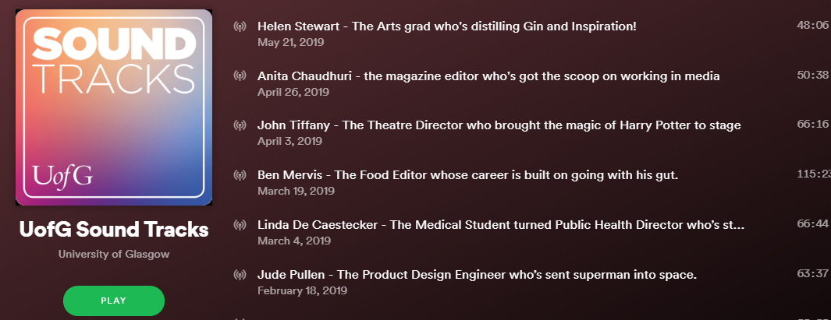

On-the-Go Engagement
Strategy 1: “This Could be You!” Career Showcases
UofG’s Podcast Shares Alumni Stories with Busy Students
Screenshot of ‘Soundtracks: Sound Advice to Keep Your Career on Track’ Podcast on Spotify
Impressive First Year Results
13
Episodes over two series
2,000+
Downloads in under one year
Allows students to engage with alumni “on-the-go”
90
Student attendees at a ‘live podcast’ event
Relatable and informative content, referring to alumni “side hustles,” and tips for “big city living”
Source: “Sound Tracks Podcast,” University of Glasgow, Glasgow, UK; EAB interviews and analysis
Notes:
Moving to something slightly more time intensive. The university of Glasgow had seen major success with Instagram takeovers—we will get to their story later today. Due to this success, and because students seemed to really engage in the digital space, they decided to create digital content that would go beyond a one-time touchpoint like an alumni takeover.
So this past year, Glasgow developed a podcast with the clever title, “Soundtracks: Making Sure Your Career is on Track”. The podcast is hosted by one alumni relations and one careers service staff member who interview well-known alumni or ones with interesting career journeys.
Some benefits of the podcast shown on the left hand side of the slide. First, students don’t have to show up to a career event. They can listen to a podcast while cooking or at the gym. Next, it engage students in the digital world, a world they are very familiar with, making it more likely for them to engage. Finally, Glasgow makes sure the podcast speaks student language and is relatable.
On the right, impressive results since the podcast launched. Since September, there have been 2,000 downloads. A few months ago they ran a live event of the podcast with an alumni who owns a gin company, which had a turnout of 100 students (90% of attendees were students, 10% were alums).

Slide 16


Not Your Average Career Panel
Strategy 1: “This Could be You!” Career Showcases
Institutions Innovate on Typical Career Panel Format and Themes
“Make it Happen Fortnight” Allows for Focused Industry Shopping
“What it Takes” Career Series Focuses on Themes With Gen-Z Appeal
8-day event featuring 40 alumni across eight industries, with each day dedicated to a different industry
Evening events involve alumni panel discussions followed by a Q&A and networking session
Condensed format enables students to easily shop across industries and job types
Annual event typically attracts
600+ students
Topics go beyond typical industry themes to appeal to Gen-Z, including:
  What it Takes to be a YouTuber
  What it Takes to Develop Your Own Online Brand and App
  What it Takes to Be a Female Leader
Monthly or bi-monthly career talks open to students and young alumni (i.e., within three years of graduation)
Varied formats include TED-style talks, panel events, and interactive workshops
Source: Engaging for Excellence: Generating alumni support for higher education 2018, CASE, 2018, https://www.case.org/system/files/media/file/Engaging_for_excellence_2018_final.pdf; University of Sussex, Falmer, UL; EAB interviews and analysis.
Notes:
The final idea under strategy one are alumni career panels. Most schools do some variation of alumni career panels. Here we’ve called out two schools with unique takes on the average career panel with great success.
Starting with the university of Sussex on the left. Most institutions have career panels that happen sporadically throughout the year—faculty of law will hold a panel one month, a few weeks later faculty of education with hold something similar. What’s different about Sussex is that they condense career panels into a major 8 day series featuring 40 alumni across 8 industries. The main benefit with the condensed format is that is allows students to “industry shop” and compare different sectors all at once.
This annual event typically attracts between 600 and 700 students, so its been very popular on campus.
Moving to the right, the University of Westminster’s also experimented with a unique career panel series. Their “What it Takes” series entails monthly talks open to both students and young alumni with varies formats, from TED-style talks to interactive workshops. What makes Westminster’s career services interesting is that they deviated from the typical “industry” themed talks and instead came up with interesting topics that appeal to generation Z.

Slide 17



Networking Engagements, by the Numbers
Strategy 2: Developing Impactful Networking Engagements
Majority of UK and Irish Universities Offer Networking Engagements
Percentage of Survey¹ Respondents Offering Industry- or Career-Focused Networking Events
Typical Examples of Networking Engagements
Lunch with an Alumni
Workplace Visits
Departmental Career Panels
Yes
No
EAB’s UK Alumni Career Engagement Survey: Views from Heads of Alumni Relations at Leading UK Universities; N=23
Source: EAB’s UK Alumni Career Engagement Survey
Notes:
Moving to strategy 2 - Developing Impactful Networking Engagements. This strategy is about creating opportunities for students to network with alumni face to face to gain a deeper dive into specific industries.
87% of respondents on our survey said they offer industry- or career-focused networking events. Some typical examples we heard on the rights—lunches with alumni, workplace tours, and department career panels.
This strategy will cover networking engagements that we found to be “next-level” or innovative ways to network students and alumni

Slide 18




Dining with Alumni
Strategy 2: Developing Impactful Networking Engagements
DePaul’s Industry Dinners Connect Successful Alumni with Students
Elements of “Dinners on DePaul” Programme
Keys to Successful Industry Dinners
Leverages alumni knowledge
and career paths to help students break into specific fields
1
Collaborate with the career center and development office to identify most sought-after fields and prospective donors to select valuable alumni hosts
3-5 mid-career professionals host 15-25 students
2
Ensure a casual environment (e.g., lax dress code) to attract varied student populations and maintain student comfort
3
Time dinners carefully, consider hiring cycles for students and avoid busy times in the industry
20+ dinners annually at South Loop or Lincoln Park campuses
4
Plan alumni recruitment around touches from development. DePaul found that dinners served as a useful final touch with a donor, just before soliciting a gift
Major Gift Officers nominate prospects or donors from their portfolios to serve as dinner hosts
People were so happy and so excited that they got jobs [through the programme], they would let us know and brag about the programme.”
Tracy Krahl, AVP of Communications and Engagement
DEPAUL UNIVERSITY
Source: DePaul University, Chicago, IL; EAB interviews and analysis
Notes:
The first idea here comes from DePaul University.
Each year, DePaul University offers 20+ dinners as part of its Dinners on DePaul series. Each dinner features three to four alumni in a specific career field and 15-25 students who are interested in learning more about them. Past dinners focused on accounting, non-profits, entrepreneurship, digital media, and counseling. DePaul pointed to several anecdotes of students finding mentors in alumni volunteers and getting help jobs.
On the right, we noted four keys to success for DePauls. First, collaboration is vital. Alumni relations works with the career center to organise dinners around desired fields, and works with advancement to identify alumni prospects.
Second, DePaul recommends keeping the environment casual so that students feel comfortable engaging with the alumni hosts
Third, schools should consider the timing of dinners so they coincide with student hiring cycle and avoid busy times of year for alumni
Finally, alumni relations should plan dinners around touches from the development team. Gift officers view these dinners as excellent cultivation or stewardship opportunities; this one-time volunteer ask has become a popular penultimate touch before asking for a gift. One English graduate student met an alumna who works in the publishing industry, who, in the end, published her book.

Slide 19



Career Exploration on Alumni’s Home Turf
Strategy 2: Developing Impactful Networking Engagements
Ripon’s Career Tours Develop Student Networks and Cultivate Prospects
Ripon College’s Career Discovery Tours in Brief
Alumni Host Checklist
Students travel to a city to tour alumni workplaces and gain exposure to diverse industries
Alumni relations strategically chooses alumni hosts based on donor capacity
Networking connections may later yield internship and job offers
Interesting job
AND
High-capacity donor
OR
High-capacity, non-engaged prospect
OR
Highly rated legacy prospect
By the Numbers
9
11-16
120+
7
Tours over six years
Students per tour
Total alumni participants
Fully-scheduled days
Source: Ripon College, Ripon, WI; EAB interviews and analysis
Notes:
The next idea comes from Ripon College
At Ripon, Alumni relations staff developed Career Discovery Tours. Staff recruit 12 alumni to host on average 12 on a 5-day tour of a city or metro area to tour alumni workplaces within a particular industry and develop connections.
Students visit and network with alumni hosts one at a time during the programme, learning about their places of work and developing connections that may prove valuable when they embark on their own career searches.
To build each year’s programme, Ripon takes a strategic approach to host selection. Advancement staff not only try to find alumni whose interesting jobs mean they can add something valuable to the career discussion, they also look for high net worth and development potential. Recruiting these high-capacity hosts is not just the job of fundraisers at Ripon. Alumni relations has a seat at the table through the whole process, from identifying promising candidates, to reaching out to them with an invitation, to brokering an introduction to the gift officers who will end up cultivating them.

Slide 20
Lessons Learned from Ripon’s Success
Strategy 2: Developing Impactful Networking Engagements
Ripon Targets High-Potential Alumni and High-Achieving Students
Considerations for Recruiting Students
Considerations for Recruiting
Alumni and Building Future Donors
1
Consider offering tours farther afield to attract students who can plan day-long trips to nearby cities alone, but struggle to plan trips away from campus.
1
Partner with the development office to identify high-value alumni who may wish to host students
2
Partner with programmes from other units that can cover student costs (e.g. leadership programmes)
2
Recruit alumni hosts to help build itinerary and coordinate logistics, leveraging their knowledge of the city
3
Use an online application process to recruit high-achieving students, vetting participant list with academic staff
3
Introduce hosts to development staff during the tour to create the foundation for a longer term relationship
Source: Ripon College, Ripon, WI; EAB interviews and analysis
Notes:
Ripon shared with us some key lessons they’ve learned from their 6 years of running their programme.
On the left, considerations for recruiting students. First, Ripon recommends offering tours far from campus to provide the most value for students who may not have the opportunity to travel otherwise. Second, partner with other programmes to help cover the costs of the programme. Third, making the programme competitive through an online application and vetting process.
On the right, three considerations for recruiting alums and building future donors.
First, partner with the development team to target high-value alums as tour hosts. Second, Ripon recommends asking alumni hosts to help plan the tour itinerary since they have insider knowledge of the cities. Third, alumni relations staff should introduce alumni hosts to development staff during the tours to start building that relationship.

Slide 21

Targeting Disenfranchised Student Populations
Strategy 2: Developing Impactful Networking Engagements
‘Insights Programme’ Successfully Enfranchises Disadvantaged Students
Targeted at Widening Participation Background Students
Provides career and workplace exploration
for students with less access to networking contacts and workplace experience
Seeks to equip students
with soft skills including networking, confidence, time-management, communication, and professionalism
Encourages participation through partnership with Widening Participation team, international office, and career services, ensuring a
cost-free experience
Provides Insight into Industries and Develops Student Networks
Local Insights involves a two- to five- day insight experience in central Scotland, with small groups of students visiting alumni in key sectors
Global Insights involves a week of insight experiences in key cities across the world, with small groups of students visiting alumni in global business locations
Experiences typically include workplace tours, networking events, and student projects
Impact Highlights
150%
Projected growth in programme participants by year three
66%
Percentage of alumni who were first-time volunteers
25%
Percentage of alumni who
were prospective donors
33%
Increase in student confidence in career skills after programme participation¹
Students were asked to rate their confidence in career skills on a scale of 1-4
Source: University of Edinburgh, Edinburgh, UK; EAB interviews and analysis.
Notes:
University of Edinburgh’s Insights programme is similar in scope to Ripon’s Career Discovery tour. However, except their programme is exclusively offered for “widening participation” students
The alumni relations office partners with their widening participation team, international office, and career services to target students and manage the programme. The programme is funded entirely by the alumni association, which makes it accessible for widening participation students.
In addition to creating opportunities for students with less access to networking contacts, the programme aims to provide students with soft skills and life skills like traveling, socialising, etc.
There are two variations of the programme – local insights involves a 5 day experience of alumni workplaces in central Scotland, while global insights are week-long trips to major cities around the world.
On the right, some impressive early results of the programme. In the pilot year last year, 50 students participated, but that is grow to 200 students in the third year.
2/3rd of the alumni were first time volunteers, representing a successful engagement opportunity for Edinburgh
25% of the volunteers were also identified prospects by the development team
Finally, data from a pre- and post-programme survey showed that student confidence level in their career prospects increased by a point after participating in the programme.

Slide 22
Mentoring Schemes by the Numbers
Strategy 3: Choosing the Right Alumni Mentoring Scheme
More Institutions Use Traditional Mentoring Schemes Over Online Platforms
Percentage of Survey¹ Respondents Who Offer a Traditional Mentoring Scheme
Percentage of Survey¹ Respondents Who Offer an Online, Self-Serve Platform
Yes
No
Yes
No
EAB’s UK Alumni Career Engagement Survey: Views from Heads of Alumni Relations at Leading UK Universities; N=23
Source: EAB’s UK Alumni Career Engagement Survey
Notes:
Our final strategy in section one is choosing the right mentoring scheme. Again, nearly all institutions we spoke with in the UK have some variation of a mentoring scheme, with the goal of connecting students with alumni mentors around career guidance.
78% of survey respondents offer a traditional mentoring scheme, whereas 2% offer online-self serve platforms

Slide 23

Three Types of Mentoring Schemes
Strategy 3: Choosing the Right Alumni Mentoring Scheme
 | Model #1: Traditional One-on-one Matching Scheme | Model #2: E-Mentoring Platform | Model #3: Speed Mentoring Events
Description | Institution staff manually match students with alumni; typically a year-long mentoring relationship | Students and alumni interact online through a self-serve platform | Alumni provide advice (in-person or virtually) during dedicated time-slots at one-time events
Cost | Medium | High | Low
Staff Time Requirement | High | Medium/High to implement, low to maintain | Medium/Low
Student and Alumni Reach
Advantages | Students cultivate authentic relationships and receive personalised advice | Ability to engage thousands of students and alumni under flexible arrangement | Low time-commitment encourages alumni participation and meets students’ desire to ask one-off questions
Disadvantages | Difficult to scale; requires high amount of staff time to serve a small portion of students and alums | Less personalised advice and meaningful relationships; may require significant marketing and monitoring to maximise participation | Difficult for students to receive personalised advice in short tine frame; some students and alumni crave more meaningful relationships
Typical Use | For smaller, targeted populations (e.g., widening participation, non-traditional students) or at institutions with more dedicated staff time | Institutions that want to reach a wider population and/or have less staff time to facilitate match-making | A supplement to traditional or e-mentoring schemes often employed as a way to engage specific alums for a one-time event
Source: EAB interviews and analysis.
Notes:
On this slide, we laid out the three main types of mentoring schemes across the top. Running down the left hand slide of this table are the main differences and considerations for choosing the right scheme, including costs, staff time requirement, and student reach. We also laid out pros and cons as well as typical use.
I don’t want to give the impression that you have to choose just one scheme. In fact, many schools we spoke with use all three schemes for different student populations. Based on our conversations, the general trend we’ve heard is that schools start their mentoring efforts with traditional one on one matching schemes. But many are moving toward an e-mentoring platform so they can reach a wider audience. Often, schools supplement their formal mentoring schemes with one-off speed mentoring events throughout the year.
Nevertheless, this table can help you make side-by-side comparisons between the three main types of schemes.
Let’s dive a bit deeper into each of them.

Slide 24















High Effort, High Impact Mentoring
Strategy 3: Choosing the Right Alumni Mentoring Scheme
Traditional Mentoring Schemes Best for Smaller, Specific Populations
Selection of Institutions with Traditional Mentoring Schemes
Benefits
Challenges
Students gain more personalised and targeted advice
Mentor relationships more meaningful
Staff better able to monitor mentoring relationships and assess impact
Staff can make direct connections with alumni and engage with them
Staff can ensure more targeted mentee engagement (e.g. targeting students from disadvantaged backgrounds, young alumni)
High-level of staff time required to match mentors with mentees and monitor progress
Difficult to convey responsibilities
Longer-term commitment may deter students and alumni from participating
Creates challenges when alumni volunteers are not selected, or when they outnumber interested students
Usually requires alumni to sign-up at specific points during the year, not necessarily when alumni are free and able to engage
Source: EAB interviews and analysis
Notes:
First, the traditional one on one mentoring scheme. Across the top you’ll see examples of schools that use this type of scheme.
Again, this is where the majority of schools start their mentoring scheme efforts. Students submit applications to take part in the scheme, and institution staff then manually match them with alumni based on common interests or career trajectories. Schemes vary across schools, but they typically are 6 month to year long relationships where mentors and mentees have monthly or bi monthly face to face meetings or phone calls.
Some benefits and challenges are laid out on the bottom of the slide.
Of the three options, this scheme provides students with the most personalised advice and allows them to create deep relationships with alums. It also allows for schools to directly engage with alums since instituoin staff play a large role in facilitating the relationships.
On the flip side, this scheme requires the largest amount of staff time, as staff must manually go through student applications and monitor the mentor/mentee relationships. Due to the time-intensive nature of matching, traditional schemes reach less students, on averaging serving a hundred or so students per year. Some students and alums also shy away from the longer-term nature of these relationships.

Slide 25


Mentoring on the Web
Strategy 3: Choosing the Right Alumni Mentoring Scheme
E-Mentoring Engages the Most Alumni, Students in Flexible Modality
Selection of Institutions with E-Mentoring Platforms
Benefits
Challenges
Casts a wide net and allows for organic and diverse relationships to form
Mentees able to ask targeted questions to a variety of diverse alumni
Platforms typically serve as an alumni-to-alumni networking opportunity as well
Low time commitments make it easy for users to sign-up without added pressure
Allows for engagement at any point during the year, which is well-suited toward student and alumni busy schedules
E-platforms are typically high cost and require long implementation periods
Technical glitches may frustrate users and prevent them from logging-on in the future
Lack of structured guidance may intimidate mentees
Does not proactively engage disadvantaged students who are often less likely to proactively sign-up
Source: EAB interviews and analysis
Notes:
The second type of scheme is an e-mentoring platform. Again, some examples of schools that have an e-mentoring platform.
Many schools are moving toward this type of scheme for a couple of reasons. First, online platforms can reach thousands of students and alumni. Also, after initial implementation, it requires little staff time. The platforms are essentially self-serve – students and alums are invited to sign up, and then students can reach out to whomever they like with one-off questions. This allows students to connect with many alumni from different fields. These also have the benefit of allowing for alumni to connect with other alumni. Because this doesn’t require a specific time commitment, its easier to encourage students and alums to sign up and participate on their own time.
On the flip side, some schools told us that this makes it difficult to know if the platform is yielding meaningful connections. Just because a student signs up to the platform doesn’t necessarily mean they’ve reached out to any alums. One alumni relations director told us that she anecdotally heard from many students that they were intimidated about reaching out to alumni with questions. The e-mentoring platform is also the most expensive of the schemes, with the most expensive ones costing as much as 15-20,000 pounds per year.

Slide 26



Strategy 3: Choosing the Right Alumni Mentoring Scheme
Come Meet the Professionals
Speed Networking Enables Meaningful Discussions in Low-Pressure Setting
Example “Meet the Professionals” Event
5:30 PM | Registration
5:45 PM | Welcome and Introductions
6:00 PM | Speed Networking
7 00 PM | Student Survey
7:30 PM | Refreshments and Informal Networking
Speed Networking
Small groups of students have informal, rotating 10-minute discussions with 6 or 7 alumni from a specific industry or discipline
Mobile Survey
Directly after networking and before refreshments, students participate in mobile phone survey to assess the event impact on student career discovery and level of confidence in career readiness
“Meet the Professionals” Stats
89%
~40
Of student participants discovered career paths they didn’t previously know about
Average student attendance at ‘Meet the Professionals’ event
Source: University of Manchester, Manchester, UK; EAB research and analysis.
Notes:
Moving to the third type of mentoring scheme, speed mentoring. We’ve also noticed a trend of schools in both the US and UK experimenting more with one-off speed mentoring events. These events can serve as a great compliment to a more formal mentoring scheme. It’s a great way to engage alums by getting them back to campus for a low-time commitment, fun event. Students really enjoy the chance to meet and connect with alums face to face.
We called out two great examples of speed networking. The first example on this slide comes from the University of Manchester. Manchester holds faculty-specific “Meet the Professionals” events throughout the year to give students a chance to connect you with alums who studied similar courses.
Students are organised into small groups and have about 10 minutes to quiz an alum about their career before moving on to the next alum.
One interesting element of the programme is that directly after the networking event, students are asked to participate in a mobile phone survey about their experience, as a way for Manchester to assess the impact of the event. Because it’s a quick survey right after the event, Manchester has seen more survey participation than average. Plus, the alumni relations director joked with us that students are likely to participate in the survey because they are eager to go have refreshments.
Some stats on the programme at the bottom of the slide. Notably, 89% of participants discovered career paths they didn’t previously know about.

Slide 27

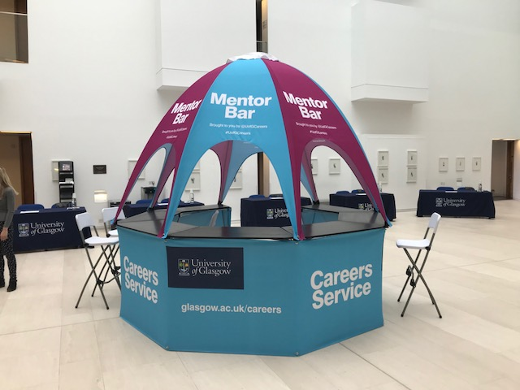




Strategy 3: Choosing the Right Alumni Mentoring Scheme
Capitalising on the Career Fair
UofG’s ‘Alumni Mentor Bar’ Embeds Alumni Engagement into Career Fairs
Picture of University of Glasgow’s Alumni Mentor Bar
Elements of University of Glasgow’s ‘Alumni Mentor Bar’
Alumni Relations sets up portable “alumni bar” at three annual career fairs
Students drop in to book 15-minute appointments with individual alumni
Fulfills students’ desire for personalised, one-on-one support
Timeslots consistently hit 100% fill-rate due to popularity of career fairs
Source: University of Glasgow, Glasgow, UK; EAB interviews and analysis
Notes:
I wanted to highlight one more successful speed mentoring programme. This one comes from the University of Glasgow.
The alumni volunteering director at Glasgow tries to embed alumni engagement opportunities into career events as much as possible. One way they’ve done this is through their alumni mentor bar. This is literally a portable bar similar to Apple’s “genius bar” concept.
A picture of it is shown here on the left.
This portable bar is set up at Glasgow’s three annual career fairs. reflected in Glasgow’s Alumni Mentor Bar set up at all major career fairs on campus. Alumni “man” the bar and students drop in to book 15-minute appointments. Because the bar is set up in a highly-trafficked student event, the appointments always have a 100% fill-rate. Students also love the chance to receive more personal, one on one support from alums.

Slide 28
Instilling Employable Skills in Students Through Alumni Expertise
2
Notes:
That wraps up section one. Three strategies for helping students explore various careers. The next section focuses on leveraging alums to equip students with employable skills.

Slide 29


Instilling Employable Skills in Students Through Alumni Expertise
Three Main Challenges
Potential Solutions
1
Students lack skills critical to success in the workplace, including resume building, networking, interviewing, and business etiquette
Strategy 4: Equipping Students with Career Readiness Skills
Curricula in industry-focused disciplines often lack workplace insight, and faculty are often unaware of
emerging trends
Strategy 5: Leavening the Curriculum with Real World Experience
2
Students lack exposure to hands-on workplace experience, making it difficult to land first jobs or internships
3
Strategy 6: Facilitating Workplace Experience
Source: EAB interviews and analysis.
Notes:
Three main challenges here. First, students simply lack skills they need to get jobs, like resume building, interviewing, and networking. So the first strategy aims to help students develop those skills.
Next, because faculty members are not always industry experts, often time academic curriculum lacks insight on key industry trends and desired skills of graduates. So strategy 5 aims to use alumni industry experts to validate curriculum and get involved in the classroom.
Lastly, graduating students have difficulty landing their first job because they usually lack workplace experience. So strategy 6 is about leveraging alumni relationships for student internships and job shadowing opportunities.

Slide 30


Online Skill Workshops
Strategy 4: Equipping Students with Career Readiness Skills
Alumni-Led Online Skill Workshops: A Lower Effort Win with High Impact
McMaster University Speed Resume Review Sessions
University of Arizona Alumni Career Lab Webinars
Alumni provide live resume feedback and advice in 15-minute increments
Typically involves 25+ alumni and 100+ students per session
Programme uses a virtual networking platform costing £2-3K per year
Sessions scheduled around alumni work schedules, with sessions running during lunch, after work (5:30 PM), and in the
evening (7 PM)
Alumni lead live, interactive webinars on important career topics
Open to current students and young alumni
Topics include:
    Job Search Strategies
    Optimizing LinkedIn Profiles
    How to Use Indeed
    Networking Tips
    Career Transitions
Webinars typically run once or twice per month
Alumni eager to participate due to low time-commitment and ability to engage students virtually
30+ archived webinars available on-demand
Source: McMaster University, Hamilton, ON; http://arizonaalumni.com/alumni-events?field_event_type_tid%5B0%5D=90, University of Arizona, Tempe, AZ; EAB interviews and analysis.
Notes:
Starting with strategy 4 - Equipping Students with Career Readiness Skills
I’m going to walk through three ideas that bridge three different modalities—online, in-person bootcamp style, and off-campus.
First, online skill workshops. McMaster University and University of Arizona are schools who are taking advantage of virtual alumni engagement opportunities to equip students with employable skills.
On the left, McMaster University’s resume review sessions. Alumni sign up for one-hour time slots to provide live, virtual resume advice to students in 15 minute increments.
McMaster made sure to strategically schedule the sessions around alumni work hours, with sessions during lunch, right after work, and late evening.
McMaster reports that alumni really love this event because it’s a tangible but low-effort way for them to impact students without having to commit a lot of time or effort
McMaster has run 8 of these sessions this past year and plans to offer more in the upcoming year because they’ve been so popular with students and alumni.
On the right, University of Arizona’s programme goes beyond just resume reviews with an interactive webinar series on important career topics that are open to both student and young alumni
Topics include strategies for job searching, LinkedIn tips, etc.
These usually run once to twice and month, and then they are archived on their website so students and alums can rewatch at any time
Alumni can come to campus to be filmed or they can be conducted remotely online

Slide 31



A Big Bang Approach to Preparing for the Real World
Strategy 4: Equipping Students with Career Readiness Skills
Colgate’s “Real World Conference” Equips Students with Post-Grad Skills
Final Year Student Needs
Colgate’s Real World Conference
Two-day event held before spring semester begins, coincides with Alumni Council meeting on campus
500 seniors registered with 100 alumni participants
20+ panels, plus industry discussions and networking events
Job search essentials
Networking techniques
Industry insights
Example Panel Topics
Creative Job Searching and Networking Techniques
First-Year Success on the Job
Questions You Are Afraid to Ask
Evaluating Job Offers and Benefits Packages
I Still Don’t Know What I Want to Do
Making the Most of Grad School
Personal Finance
On the job advice
Personal finance advice
Grad school information
Source: Colgate University, Hamilton NY; EAB interviews and analysis.
Notes:
Next idea about leveraging alums to help students gain employable skills is hosting an on-campus, bootcamp style conference for final-year students. This comes from Colgate University, but we’ve seen other universities in the US do something similar.
On the left, some examples of final year student needs – job search strategies, advice on personal finances, info on grad school etc.
To meet these needs, Colgate holds a two-day “Real world conference” before the start of the spring semester
The conference is timed to coincide with the alumni board meeting, which ensures that 50 to 60 highly engaged alumni will be on campus and available to participate in the event.
Colgate makes sure there are sessions for a variety of students ranging from the person who is just beginning to look for a job to the student who has already been accepted to graduate school. Some example sessions shown here on the bottom right.
Colgate reports that this long-standing annual event has been successful for alumni and students. For alumni, it is a chance to engage with students and provide practical advice at a time when it can make a difference for individuals. Similarly, students have an opportunity to make connections, get advice, and begin thinking about the transition to life after college.
The Real World conference has been so successful that Colgate is developing a similar event targeted at sophomores, which will take place over homecoming weekend. The goal of the new conference will be to help sophomores explore career opportunities earlier, covering topics such as internships, graduate school applications, and the recruiting process.

Slide 32

Putting Employable Skills to Use
Strategy 4: Equipping Students with Career Readiness Skills
‘City Connections’ Enables Students to Practice Networking Skills with Alums
Pre-Event
Skill Workshop
City Connections Event
Post-Event Skill Workshop
Students receive tips and training on commercial awareness, networking, and setting up or improving LinkedIn profile
Students learn about the alumni and businesses
they will visit to ensure preparedness
Students set individual personal objectives
and goals for event
Students travel and tour three alumni businesses in London during the day, learning about different roles and potential routes into the organisation
At evening reception, students apply skills from workshop to network with successful alumni
Students receive advice on following up with contacts and articulating experiences in competency based questions
Students complete post-programme evaluation questions (i.e., same as pre-programme questions) to assess impact of experience
City Connections Programme Details
Collaborative project between Development, Alumni Relations, Events, and the Faculties of Social Science and Arts and Humanities, now in its 5th year.
Programme aimed at 40 students from widening participation background (majority in second year of study)
Programme is HEAR¹ accredited
Alumni Relations completes comprehensive programme evaluation and compiles an annual report to assess institutional impact
Higher Education Achievement Report.
Source: University of Sheffield, Sheffield, UK; EAB interviews and analysis.
Notes:
Final idea under strategy 4 is off-campus event that comes from the University of Sheffield
Sheffield’s “City Connections” programme is similar to Edinburgh’s insights programme that we discussed in the last section.
This programme, exclusive to widening participation population, provides students with the opportunity to tour alumni businesses.
The reason we wanted to include this in this strategy is because Sheffield’s programme also includes an interesting skill development component, illustrated through the timeline here.
First, students attend a pre-event workshop to receive tips and training. They learn about the business they will visit and gain skills around networking, commercial awareness, and setting up their LinkedIn profile
On the day of the event, students travel and tour three alumni businesses around London. In the evening, they get to put their new skills to practice by networking with alumni and asking them questions
After the event, students participating in other workshop where they learn best practices for following up with the contacts they made. They also learn how to best articulate their experience and they complete a post-programme evaluation
The programme, now in its 6th year, has been highly successful programme for Sheffield. The has raised the confidence and aspirations of students, developed their commercial awareness, and introduced them to a network they may not otherwise have access to.
In 2018, 96% of participants answered “I feel more confident about my careers prospects” in the post-evaluation survey, which was a 76% increase from the pre-event survey. 81% also answered “I understand what skills and knowledge are required to pursue my career interests,” which was a 21% increase.

Slide 33
Embedding Alumni Expertise in the Curriculum
Strategy 5: Leavening the Curriculum with Real World Experience
Percentage of Survey¹ Respondents Who Seek Alumni Involvement in Academics
Benefits of Engaging Alumni in the Academy
Alumni often maintain strong relationships with faculty members, making it easier to engage them
In programmes where industry standards are important (e.g. business, engineering, computer science), alumni offer insight into emerging trends and issues
Guarantees students participation as they engage with alumni during class rather than extracurricular activities
Yes
No
Practices for Leavening the Curriculum with Real World Experience
Easy
Effort Required to Implement
Hard
Alumni Guest Lectures
Semester-Long Alumni Classroom Volunteers
Alumni Course Advisory Panels
EAB’s UK Alumni Career Engagement Survey: Views from Heads of Alumni Relations at Leading UK Universities; N=23
Source: EAB’s UK Alumni Career Engagement Survey; EAB interviews and analysis
Notes:
Moving on to strategy 5 – Leavening the Curriculum with Real World Experience
61% of survey respondents report that they seek alumni involvement in the academics
On the right, a few benefits of engaging alumni in the academy
First, alumni usually have the strongest ties to faculty members, which makes it easier to engage them
Second, alumni can provide insight into industry trends, which is important for programmes like business and engineering where its critical to say up to date
Finally, getting alumni into the classroom guarantees that students will participate since the engagement happens during class time
For this strategy, I will walk through the three practices shown at the bottom that vary in the degree of difficultly in implementing.

Slide 34



Strategy 5: Leavening the Curriculum with Real World Experience
“Professor For a Day” Initiative
CSU-Fullerton Brings Real World Insights into the Classroom
Inspiring Testimonials “When I first joined the College, I took a look at what I had to show potential donors to explain why they should invest in the college…What stood out were our inspiring first-generation student engineers who were driving their own educations.”
Hart Roussel Director of Development
“Professor for a Day” Schedule
Dean of College of Engineering and Computer Science invites 30 top prospective or current donors to one-time volunteer event
Guest Lecture
Each participating alumnus teaches one or two class sessions in his field
Dean’s List Luncheon
Alumni join 100+ high-performing current students for lunch
Good News: Recruitment is Easy
Yield of invitees to attendees
State of the College Speech
Dean’s speech recognises donor volunteers’ contributions
One alumnus invited to give keynote address
50%
Source: California State University Fullerton, Fullerton, CA; EAB interviews and analysis.
Notes:
The first, easiest to implement tactic is alumni guest lectures.
However, CSU Fullteron’s “Professor for a Day Initiative” take a unique twist on the alumni guest lecture.
Every year, the College of Engineering and Computer Science at Cal State Fullerton executes a “Professor for a Day” initiative that brings 25-30 alumni to campus on the same day guest-lecture courses in their field.
After spending the morning in the classroom, they then attend a lunch held in honor of the college’s 100+ Dean’s List students, whom are seated amongst them.
The folks at Fullerton shared that events like this are particularly important for a field like engineering and computer science, whose alumni want to engage academically and don’t come to social events like Homecoming, reunions, sports events, etc.
This programme is unique in that it leverages alumni to provide industry snapshots and real world examples inside the classroom while also providing students with a chance to network with alums as well. Some students even get internships and jobs after meeting alumni through this initiative.

Slide 35



Strategy 5: Leavening the Curriculum with Real World Experience
Putting Entrepreneurial Skills to Work
University of Calgary Embeds Alumni Volunteers into the Classroom
University of Calgary “Entrepreneurial Thinking” Class
Class Logistics
A Host of Roles for Volunteers
Taught by one instructor and two graduate assistants
Required course for second year business students
450 students broken into 90 teams to create business plan for new corporate or social venture
Student teams pitch concepts for over $100,000 in cash and in-kind prizes
90 business advisors that serve as:
  Industry consultants that help students refine their ideas
  Judges who evaluate student pitch presentations
Additional opportunities for guest lecturers, mentors, and networking
Skills-Based Roles Attract Different Segments¹
70%
80%
38%
Of participants never engaged before as volunteers
Of volunteers have titles suggesting major gift capacity²
Of participants are alumni; remainder are community members
Initial estimates based on preliminary review
Does not include current active prospects or donors
Source: University of Calgary, Calgary, AB; EAB interviews and analysis.
Notes:
The next idea comes the University of Calgary. Calgary went one step further that CSU Fullerton’s guest lectures by recruiting alumni to participate in a semester-long class
In fact – their 300-level entrepreneurship class for second-year business students is essentially powered by 165 volunteers of whom at least half are mid-career professionals in their 40’s.
The volunteers work with student teams to develop their business plans, help refine their concepts, and provide just in time feedback as students encounter roadblocks.
The folks at Calgary noted that alumni don’t just add value; they are what makes the class possible. The estimate it would take upwards of 12 instructors or TAs to provide what the alumni are currently doing.
This initiative has also expanded the institution’s volunteer pool with 50% of the participants never having engaged as volunteers before and 62% of the participants being drawn from the local community.

Slide 36



Staying Current with Industry Practice
Strategy 5: Leavening the Curriculum with Real World Experience
Course Advisory Panels Leverage Alumni to Validate Academic Curriculum
Internal Value
Course Advisory Panels
External Impacts
Validating the Curriculum
Benefits on Many Fronts
Networking: Alumni of Business Studies and MBA programme join virtual network of “friends of the programme” upon graduation
Subject matter expertise: Alumni present on key industry trends bi-annually, keeping academic staff current on industry news
Workplace Practice: Students pitch their work to alumni as industry experts in project-based-learning classes
Managed internships: Alumni provide students with real-life issues and seek student help with projects
AACSB¹ accreditation body considered the programme a key strength of the school
Provides bi-annual validation process for curricula in courses heavily dependent on industry practices
Offers students hands-on experience to add to their resumes
Easy to recruit alumni due to strong relationships with academic staff
1) Association to Advance Collegiate Schools of Business
Source: Bournemouth University, Bournemouth, UK; EAB interviews and analysis.
Notes:
The final idea for leveraging alumni in the classroom is to use their industry knowledge to actually help develop and check the course curriculum. This idea is the most difficult to implement, as it may be tricky to win faculty buy-in.
However, this can be especially useful for courses that are heavily dependent on current industry practices.
At Bournemouth University, about 20 alumni serve on course advisory panels for the business course and MBA course. They advise faculty members on industry trends and issues, and help develop and validate the course curriculum.
This has been very beneficial for Bournemouth in many ways.
During the business schools recent accreditation process, the AACSB accreditation body noted the programme as a key strength of the school. The advisory panel also provides a bi-annual validation process for curricula in courses heavily dependent on industry practices.
Bournemouth emphasised that this programme has run smoothly largely because the faculty manage the relationship with the alums since they already have a strong relationship. Central alumni relations has supported the programme by formalising it and setting expectation for both parties.

Slide 37
Strategy 5: Leavening the Curriculum with Real World Experience
Skills-Based Academic Volunteer Roles
EAB Recommendations for Making it Work on Your Campus
Lessons from Early-Adopter Institutions
Pick the right course:
-Choose fields that value applied knowledge and practitioner insight, like engineering, business, or public policy, and pitch as a pilot among ambitious faculty members
Build faculty interest:
-Frame programme as enrichment for students and support for professors that offer industry exposure and experiential learning
-Ask provost or deans to present at semester departmental meetings about importance of the initiative and to positively recognise participants
Minimise friction:
-Subsidise marginal expenses and/or dedicate advancement staff to handle logistics and give professors 6 months notice
-Let recalcitrant academics opt out, but ask if they have an alumnus in mind – unlocking the rolodex of alumni connections they rarely share with development
Build relationship between professor and volunteer: Introduce them in advance to open line of communication and share clear guidelines for their participation
Source: EAB interviews and analysis.
Notes:
In the US, we’ve seen a trend of schools increasingly creating academic skills-based roles for alumni volunteers. I wanted to share a couple of lessons learned from the most progressive schools, compiled by EAB’s Advancement Forum.
First, you have to be strategic about course selection. It’s best to choose courses that most benefit from applied knowledge and insight, like engineer, business, and public policy
Next, you have to win faculty support. Schools have found success by framing the initiatives as a way to enrich the student academic experience through experiential learning
Schools also recommend getting the provost or deans to present to faculty members about the importance of alumni engagement initiatives and to highlight success stories
Finally, a few ideas for minimising friction, like having advancement or alumni relations staff manage logistics and subsidising expenses

Slide 38




Exploring the Working World
Strategy 6: Facilitating Workplace Experience
Alumni Great Source for Consultancies, Job Shadowing, and Internships
Degree of Difficulty
Low
High
Type of Programme
Student
Consultancy Projects
Job Shadowing and Externships
Work Placements
and Internships
Example
Queen Mary University of London’s Q-Consult programme provides mini consultancy projects for students at London-based businesses, providing students an opportunity to can use their skills, fulfil their potential, and develop their employability
The University of Chicago’s Alumni Board Job Shadowing programme enables students to shadow alumni for 1-5 days at their place of work during winter, spring, and summer breaks, providing students with a firsthand look at the daily life in their field of interest, expand their professional network, and identify possible career paths
The University of Birmingham partners with the law firm Hill Hofstetter to offer three-month long summer internship opportunities for second and final year law students, a relationship developed through an alumnus now serving as partner of the law firm
Source: Queen Mary University of London, London, UK, http://www.careers.qmul.ac.uk/students/workexperience/items/qconsult-summer-2019.html ; University of Birmingham, Birmingham, UK, https://www.birmingham.ac.uk/alumni/get-involved/Supporting-graduate-employability.aspx; University of Chicago Alumni Job Shadowing Programme, https://careeradvancement.uchicago.edu/job-shadowing;
Notes:
The final strategy in this section is Facilitating Workplace Experience. On the slide, three different examples of workplace experience that help students become more career ready, ranked by degree of difficulty.
First, student consultancy projects. Queen Mary University of London has a very successful scheme called “Q-Consult.” For this scheme, students work in teams on 5-weel long mini-consultancy projects for a business or charity who act as the client. All projects include research, analysis, and recommendation, and students receive pre-project training from the careers staff around consultancy, project management, professional and presentation skills. Although the scheme is not exclusive to alumni business, Queen Mary reports that many of the projects are sourced through QUML alums.
Next, job shadowing and externships. University of Chicago has a successful programme created as a partnership between Career Advancement and the Alumni Board that gives students undergraduates the opportunity to shadow UChicago alums at their place of work during winter, spring, and summer breaks.
Finally, work placements and internships. Most universities have internship programmes for students. But we heard during our phone conversations that many schools don’t always leverage alumni relationships to source internships. One great example of this is the University of Birmingham, who formalised a relationships with a law firm through an alum. The firm now hosts 30month long internships for second and final year law students.
I’m going to spend the next few slides diving deeper into schools that have had success with these ideas.

Slide 39


A Structured Programme for Workplace Training
Strategy 6: Facilitating Workplace Experience
Carleton College’s Externship Programme Leverages Alumni Networks
Externship Overview
Externship Benefits
Students spend 1-3 weeks ‘externing’ with alumni over winter break
Students choose from two-options:
  Week-long job-shadowing
  Two to three week-long consultancy projects
  Students apply to specific positions created by alumni; externships awarded through competitive process
Students meet with career services prior to externship to develop learning plans
Students explore opportunities in geographically diverse areas
Students practice resume and job application skills in low-pressure environment
Provided opportunity to learn basic workplace norms:
  Prompt arrival and departure from the workplace
  How to respectfully interact with coworkers and executives
Source: Carleton College, Northfield, MN; EAB interviews & analysis
Notes:
First example comes from Carleton College. Carlton has an externship programme that blends student consultancy projects with job shadowing/externships.
programme details on the left. Students choose between either a week-long job shadowing or a 2-3 week-long consultancy project with an alumni business over winter break.
Alumni relations works with alumni employers to create job descriptions for the externships. Students apply to specific opportunities with a resume and other requested documents, and are ranked and chosen by employers in a competitive process.
Some of the benefits of the programme are listed on the right.
When applying, students practice skills like resume building and job application
During the job shadowing, students the chance to explore different parts of the country and learn basic workplace practice and business etiquette

Slide 40


Carleton’s Externships Prove Popular Year After Year
Strategy 6: Facilitating Workplace Experience
Carleton’s Success by the Numbers
Tangible Outcomes for Students
Building-block to future internship opportunities that require some workplace experience
250+
Student participants (increase from 40 students five years ago)
300
Research lab in Utah that hosted multiple externs over the years recently added internship options specifically for Carleton students
Unique externship opportunities offered in Winter 2018/19
1000+
Student applicants
Source: Carleton College, Northfield, MN; EAB interviews & analysis
Notes:
Carleton’s externship programme has seen a lot of success.
This winter Carlton offered 300 externships, with over 1000 students applying to the programme.
And the programme has created strong relationships between Carleton and alumni employers – one research lab in Utah that had hosted multiple interns just added a Carlton-exclusive internship programme.

Slide 41
Corporate Alumni Chapters Reinvent Engagement
Strategy 6: Facilitating Workplace Experience
Engaging with Alumni at Their Workplace Provides a Way In for Students
Corporate Chapters in Brief
Reimagining the concept of traditional affinity and regional chapters, corporate chapters consist of alumni who work for the same company at the same work site
Getting in Alumni Line of Site
“We’re always saying to our alumni: ‘come to this happy hour,’ ‘come to campus and see us,’ ‘come to us and do all these things.’ For once, we thought, we should go to them. It should be about them and about what the university can do for these companies and alumni in their own professional lives.”
Mollie Repetto
Executive Director, Industry Partners Programme
Temple University
These chapters then act as ‘ready-made’ communities for students to pursue internships, jobs, and mentorship with alumni and their employers
Source: EAB interviews & analysis
Notes:
I wanted to end section two with an idea about developing relationships with alumni employers, which can then lead to students jobs and internships
Across the last several years, a number of institutions in the US have started to engage alumni in the workplace through corporate chapters. Corporate chapters are just like regional or affinity chapters but what members have in common is their employer.

Slide 42


Strategy 6: Facilitating Workplace Experience
Tapping into Alumni Employers
Alumni Corporate Chapters Can Lead to Student Jobs and Internships
A Look at One Chapter’s¹
Results After Two Years
Laying A Strong Foundation “We’re playing the long game: We’ve set up multiple recruitment and internship partnerships with Microsoft. Boeing sponsors many business school events, and sends hundreds of mid-career people and executives to them. We’re created many deep relationships with alumni who have become go-to class speakers and mentors in our science and engineering college.”
Susan Vosper, Assistant Vice President for Alumni Engagement
Student Career Placements
39
Jobs and internships in FY 2014
45+
Jobs and internships projected for FY 2015
Philanthropic Gains
$35k
$25k
$30k
$12k
$12k
N/A
³
Philadelphia branch of national professional services and accounting firm
Financial literacy curriculum design project with education school
Source: Seattle University, Seattle, WA; Temple University, Philadelphia, PA; EAB interviews and analysis.
Notes:
On the slide, two US schools that have experienced success with corporate alumni chapters.
Temple University shared the results drawn from one of their chapters with us, noting that they have seen increases across the board in alumni engagement, job placements/internships, and overall giving.
While Seattle has also been pleased with their efforts, especially in terms of engaging alumni 11-25 years out, they also emphasised how they see this as a long game and are keeping the focus on engagement, rather than giving right now.

Slide 43
Strategy 6: Facilitating Workplace Experience
Developing Corporate Chapters on Your Campus
Tips from Early Adopters’ Success
Steps to Develop Corporate Chapters
Data sources to find individuals include:
Advancement database
Alumni volunteer rosters
LinkedIn analysis
Campus partner interviews
Help members form valuable intra-company connections via social, mentorship, and professional development activities
Develop university programmes that help advance company goals
1
3
Identify Champions
at Alumni-Dense Companies¹
Design Partnership Structure
Customise Win-Win Activities
Scale Through Organic Growth and New Chapters
2
4
Tailor volunteer roles to company culture
Designate senior executive or HR staffer to serve as sponsor
Advertise partnership internally through HR-facilitated
e-mails to all alumni
Advertise externally to generate interest from other companies
To meet this threshold, Temple seeks minimum of 75 employees while Seattle seeks minimum of 250 employees.
Source: EAB interviews and analysis.
Notes:
If you are curious about what goes into creating one of these chapters, we have outlined the key steps taken by Temple University and Seattle University both of whom have several robust corporate chapters.
In particular, I want to highlight steps 2 and 3. Just as each university has its own distinct culture so do companies. It is important that the corporate chapters have some flexibility in terms of organisational structure and leadership. For example, Temple found that at some companies having a C-suite executive as the group’s sponsor was very important whereas at other companies it was more beneficial to have co-leaders drawn from the middle management ranks.
Similarly, Seattle University found that it was important to develop "WIN WIN" activities that benefitted company alumni and the institution. At Microsoft for example, the chapter launched a number of student treks, which brings students to the company for a day to visit with the corporate chapters, hear key leaders talk about the organisation, and get to know alumni. Microsoft is trying to be more “Google-esque” so partnerships like this have become a big part of their talent acquisition strategy.

Slide 44
Elevating Alumni Relations’ Leadership Role for Student Employability Activities
3
Section
Notes:
Moving into our third section - Elevating Alumni Relations’ Leadership Role on Student Employability Activities
This section is about positioning the alumni relations office as the go-to practitioner for activities that connect alumni around student employability.

Slide 45


Elevating Alumni Relations’ Leadership Role for Student Employability Activities
Three Main Challenges
Potential Solutions
1
No campus champion for bringing alumni into student career outcomes
Strategy 7: Raising the Profile of Alumni Relations
2
Universities unable to take full advantage of alumni impact
Strategy 8: Supporting Faculty Engagement Activities
Organisational silos increase the difficulty of collaborating between alumni relations, career services, and other campus players who engage alumni
3
Strategy 9: Developing Cross-Campus Partnerships
Source: EAB interviews and analysis.
Notes:
Three main problems here. First, other offices on campus don’t fully understand or value the role of alumni relations. So the first step is strategy 7, raising the profile of alumni relations.
Next, on many campuses, stakeholders lack understanding about the role of alumni relations. In some cases, they even intentionally avoid communicating with the alumni relations office due to a myth that they will interfere or try to hound their alums for money. This leads to less than ideal engagement efforts, and represents a missed opportunity for alumni relations to provide support. So strategy 8 is about finding ways to support faculty engagement efforts.
Finally, the third problem is that there are barriers on campus that prevent efficient collaboration between alumni relations and key offices, like career services. So strategy 9 is about developing cross-campus partnerships with other units.
Let’s dive into the first strategy, raising the profile of alumni relations.

Slide 46

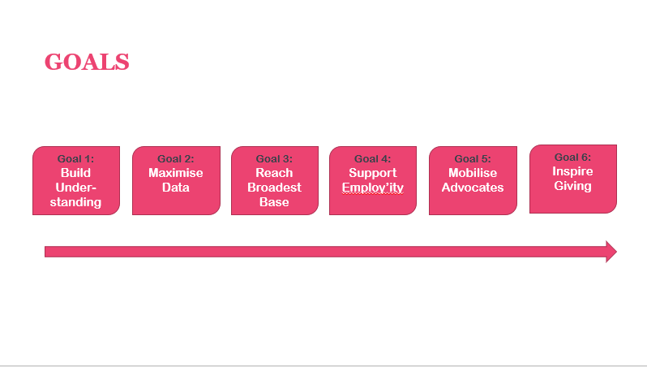
Seizing the Initiative
Strategy 7: Raising the Profile of Alumni Relations
Goldsmiths ‘Alumni Relations 101’ Roadshows form connections
Screenshot of Goldsmiths, University of London’s Introduction to Alumni Relations Presentation¹
Topics Covered in Presentation
High-level definitions of alumni
relations and engagement
Primer on why it’s important for the university to engage alumni (e.g. to benefit from their time, talent, advocacy, and funding)
Benefits of engagement to alumni (e.g. benefits & services)
Types of engagement (e.g. communications, volunteering, philanthropy)
A snapshot of Goldsmiths alumni and state of alumni database (e.g. currently only 20% of alumni job details are known)
Existing alumni programming
Visioning and goals for the future state
of alumni relations
Minor edits made by EAB for demonstrative purposes
Source: EAB interviews and analysis
Notes:
Goldsmiths University recently developed an alumni engagement strategy with 6 strategic goals, ones of which is garnering alumni support for student employability
They have a few programmes in place, but they are ad-hoc rather than a unified effort between alumni relations and other offices
The director of alumni relations realised that before they can implement new programmes, she first needed to increase the profile of Alumni Relations across the institution to gain support from faculties, and other units
So, the alumni relations has been going on a campus roadshow presenting about her office
Some screenshots of the presentation shown on the left
On the right, some topics include in the presentation.
A lot of the presentation covers very basic information - like “what is alumni engagement,” and “why do we engage alumni.” Along with the different types of engagement and programming on campus. But stakeholders at Goldsmiths have responded very positively, and this has helped garner support for the office and its mission.

Slide 47

Make it Someone’s Full-Time Job
Strategy 8: Supporting Faculty Engagement Activities
Concordia University Develops Faculty Liaison Role
Concordia University Faculty Liaison Job Duties
Liaise between the Central Alumni Relations unit and all faculties (development staff, student associations, deans).
Develop faculty-based community programming and liaise with centrally based alumni colleagues to implement these programmes and events.
Maintain regular communication with alumni volunteers in the faculties and develop meaningful volunteer opportunities.
Make significant connections with faculty student organisations and feed the student leader (and future volunteer) pipeline.
Connect with faculty volunteers and work with central Alumni Relations colleagues to develop volunteer careers.
Manage faculty network budgets.
Work with fundraising colleagues to identify, connect and engage prospects in key regions around the world and qualify these graduates in order to feed the pipeline.
Recruit, train and lead volunteers and casual staff in support of alumni initiatives.
At Concordia, this is a full-time staff position. However, other Canadian universities are seeing success in dedicating half of a current staff member’s role to this work
For a full version of Concordia’s Faculty Liaison job description, please see the online resource centre.
Source: Concordia University, Montreal, CA: EAB interviews and analysis.
Notes:
Moving to our next strategy – supporting faculty engagement activities. Remember, the problem here is that alumni engagement activities at many institutions (especially large institutions) happen at the faculty-level without the knowledge of central alumni relations.
I want to make clear that it is not a “bad thing” that alumni engagement is happening at the faculty level. Alumni often have the strongest ties to faculty members. The goal is not for alumni relations to prevent faculties from engaging alumni. Rather, it is to establish clear lines of communication between the faculties and the central office to facilitate information sharing and collaboration.
One way some schools are tackling this is by creating a faculty liaison position within their alumni relations office.
On the slide, a job description of the faculty liaison role at Concordia University.
Their main function is to create a bridge between the central alumni relations team and other campus units
They help develop and implement faculty-based programming and maintain communication with alumni who volunteer with individual faculties.
The full job description is available in the appendix of the presentation if you want to see the full list of duties.
Just a note, I know many schools are not in a position to create a new staff role. However, some schools have had success with dedicating half of a current alumni relations staff members’ time to liaising with faculty.

Slide 48


Strategy 8: Supporting Faculty Engagement Activities
Trading Information For Recognition
Scaling Stewardship for Decentralised Units and “Ghost” Volunteers
University of San Diego’s Campus Alumni Engagement Form
Key Components
Sample of Questions on Engagement Form
Alumni name, contact information, class year if known
Date, time, and location of events
Other staff, alumni, or faculty participants in programme
Description of capacity or role alumni volunteer is fulfilling
Specific requests, questions, or notes
Send e-mail three times a year after university events that engage many alumni volunteers
Thank faculty and staff for engaging alumni
Highlight how Alumni Association can support their efforts:
Arrange parking for alumni visitors
Provide appreciation gift for speakers/presenters
Send a year-end thank you note from the university to all alumni volunteers
350
94
Number of alumni volunteers discovered through form in first three years, representing 32% of annual volunteers
Unique submissions from campus units, over half from faculty
Ask units to complete Campus Alumni Engagement Form to access these benefits
Source: University of San Diego, San Diego, CA; EAB interviews and analysis.
Notes:
I wanted to run through a few other ideas for improving communication and collaboration with faculties on alumni engagement initiatives that don’t require dedicating a staff member.
On this slide, the University of San Diego’s Alumni Association developed a campus engagement form in order to gather data on faculty engagement activities that were happening without their knowledge.
The form collects information including the volunteers name, a description of the role, and the host department/unit. Of course, creating the form is a great step but you need to actually get people to fill it out.
Three times a year, the Alumni Association sends out the form to the entire university community. The staff at SDU noted that they decided to send the form at strategic times, such as right after homecoming, when events and volunteers are still fresh in people’s minds, rather than waiting until the end of the year.
One aspect of San Diego’s approach that stood out to us was how they positioned this ask. Mindful of the potential tensions or protectiveness towards alumni, they carefully thank faculty and staff for their efforts in engaging alumni. They also highlight how the university alumni association can support their efforts (arranging parking, sending thank yous, providing a year end gift, etc).
By highlighting these incentives, units want to fill out the form to ensure their volunteers get recognised. Interviewees shared that this strategy positions filling out the form as a benefit rather than a power grab, which has been very important in getting the campus onboard.
Through this process, they have uncovered an additional 350 volunteers and 94 unique roles.

Slide 49

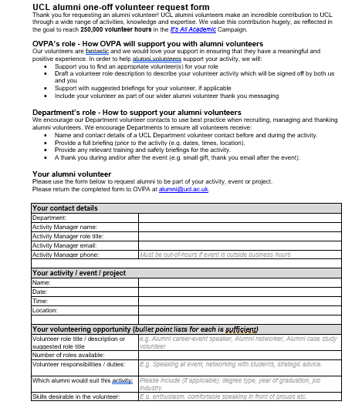
We’re Here to Help
Strategy 8: Supporting Faculty Engagement Activities
University College of London Introduces Alumni Request Form
Screenshot of UCL’s Alumni Request Form
Benefits to Faculty
Details support central alumni relations can provide for events involving alumni volunteers
Describes best practices for recruiting, managing, and thanking volunteers
Space to provide activity details, volunteer roles, and desired skills
Benefits to Alumni Relations
Ensures alumni volunteers receive sufficient information and support
Helps Central Alumni Relations track engagement activities and volunteers
Encourage faculties to think strategically about the type of volunteers they desire
Source: University College of London, London, UK; EAB interviews and analysis.
Notes:
I wanted to highlight another campus form used for a slightly different reason.
At University of College London, faculties and campus units were actually coming to alumni relations to ask for support. But the problem was that the requests were often ad-hoc and last minute, like requesting to find an alumni volunteer the day before an event.
So UCL recently created a request to formalise these requests and help department leaders think more strategically about engagement.
The form asks requesters to provide details on the proposed engagement activity, and includes information on how central alumni relations can provide support.
It also includes a brief section encouraging units to use “best practices” for recruiting, managing and thanking volunteers, including providing volunteers with all relevant information and training prior to the activity.
Thus, the request form serves as both a tracking mechanism for volunteer activities as well as a tool for encouraging best practices in engaging alumni.

Slide 50

Gathering Intelligence on What Works, What Doesn’t
Strategy 8: Supporting Faculty Engagement Activities
Bournemouth Audits Faculty Engagement Activities to Identify Best Practices
Audit Goals
Audit Timeline
1
Advance employability agenda and student experience
Faculty of Media and Communication Executive Team request an audit from central Alumni Relations
2
Understand how and where alumni are engaged and uncover best practices
Alumni relations staffs spends 4 months performing 21 one-on one-interviews with programme leaders, covering 25 courses
3
Ensure consistency of experience for students and alumni
Recorded existing activities, best practices, areas for development, and perceived barriers
4
Define “successful” alumni engagement tools and activities
Developed alumni engagement grid, best practice toolkit, and alumni mentoring programme pilot
Inform a plan for alumni
engagement at programme level to improve student experience
Briefing note presented to faculty Executive Team and disseminated across the faculty
5
Source: Bournemouth University, Bournemouth, UK; EAB interviews and analysis.
Notes:
U San Diego’s and UCL’s campus forms are relatively quick and easy ways to gather information on decentralised engagement activities.
I’m going to spend the next few slides walking through a case study from Bournemouth University, who took a more intensive approach to identifying and supporting faculty engagement.
After leaders from the Facility of Media and Communications approached alumni relations with questions around how they could better engage alumni around student career development, alumni relations decided to launch a faculty-wide audit of engagement activities
By gathering information on all current engagement initiatives, Bournemouth sought to ensure the consistency of experiences from both students and alumni and identify best practices to share with other faculties
They spent 4 months conducting one on one interviews with programme leaders, recording activities, areas for development, and challenged
In addition to mentoring programme pilot, Bournemouth produced two tangible resources that I will walk through in the next two slides

Slide 51
Mapping Out Engagement by Programme
Strategy 8: Supporting Faculty Engagement Activities
Bournemouth Outlines Faculty Engagement Activities with Key Information
Snapshot of Bournemouth University’s Alumni Engagement Grid for Faculty of Media and Communications¹
Programme | Level of Alumni & Employer Activity | Methods & regularity of contact | Reasons for engagement | Feedback Data | Typical alumni destinations | Areas for Future Development and Support from Alumni Relations
BA Honors Public Relations | Two masterclass sessions delivered by alumni (live streamed to widen access) Annual event 'Meet the Professionals’: 'speed-networking' and industry talk Annual placement and careers events take place at Level 4 and Level 6 to help students find placements and employment | Alumni engagement happens consistently across programme Contact is via the course Facebook page and LinkedIn group | To deliver guest lectures/attend faculty events To provide access to employment and placement opportunities within their place of work | No formal data collated If event is organised by Careers & Employability Team, student feedback forms are completed | PR Officer Marketing Officer Fundraising Assistant Tourism Local Government | Interested in formal mentoring programme Interested in alumni recognition award Interested in forming an advisory panel of alumni to shape course content Would value guidelines for linking with alumni
Includes details on alumni engagement activities within each faculty programme
Details the mode, frequency, and motivation for engaging alumni
Captures methods for gathering feedback data on activities
Concludes with future engagement plans and desired support from alumni relations
Recreated by EAB.
Source: Bournemouth University, Bournemouth, UK; EAB interviews and analysis.
Notes:
The first resource was an Alumni Engagement Grid for the Faculty of Media and Communication
A snapshot of the grid is included here on the slide
The first column of the grid lists all of the programmes within the Faculty of Media and Communication, like Honors Business Law
The grid captures detailed alumni engagement information for each programme, such as the methods and frequency of alumni engagement, the reasons alumni are engaged, how the programme measures success of the engagement, the types of alumni who are engaged, and ideas for future engagement and desired support for alumni relations
This grid, maintained in Excel, is a great tool for keeping track of alumni engagement activities that allows for easy comparison of programmes across the faculty
It’s also easy to update when new engagement activities are added

Slide 52
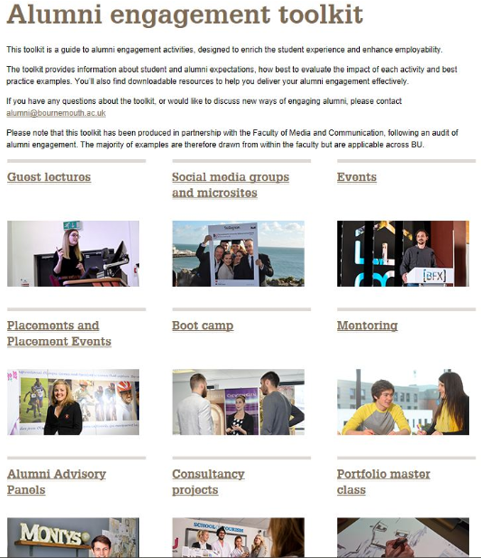




Highlighting for Faculty How to Best Engage Alumni
Strategy 8: Supporting Faculty Engagement Activities
Bournemouth Creates an Alumni Engagement Toolkit
Screenshot of Bournemouth
University’s Alumni Engagement Toolkit
Toolkit Elements
Comprehensive list of wide-range of engagement events and programmes
Student and alumni expectations
and benefits for each activity
Guidance on contacting relevant alumni for each activity
Methods to evaluate impact of
each activity
Best practice examples of each programme
Downloadable resources to enable effective alumni engagement activities
Source: Bournemouth University, Bournemouth, UK; EAB interviews and analysis.
Notes:
The second resource that came out of Bournemouth’s audit is a best practice alumni engagement toolkit shared across the institution via the school’s intranet
By analysing and assessing the faculty of media and communications programmes, Alumni Relations was able to identify best practices in alumni engagement and provide a “menu of options” for alumni engagement practices that other faculties can embed into their operations,
Beyond a menu of options, the toolkit also includes guidance on setting expectations for alumni and students, recruiting appropriate alumni, and evaluating the impact of activities.
It also best practice case studies from the Faculty of Media and communications, and downloadable resources
The audit and development of the toolkit was a time-intensive process, but Bournemouth believes this will save them a lot of time and effort in the future, as well as improve the quality of alumni and student interactions

Slide 53


Building An Alumni Engagement Community
Strategy 9: Developing Cross-Campus Partnerships
Duke Brings Together Disparate Campus Stakeholders in
‘Community of Practice’
Identify existing campus players
Appoint committee leadership
Promote knowledge sharing and collaboration
80+
previously unknown staff members identified as engaging alumni
in some way
9
leaders identified from the group to form a core
sub-committee
3+
Events proposed throughout the year to build community and engage new members
Surveyed campus about work in alumni engagement
Unearthed 80+ people across student affairs, alumni affairs, careers services, academic programmes, all working in siloes to engage and connect alumni
with students
Conducted interviews for better contextual understanding and identifying the best fit participants
12-15 leaders chosen based on survey responses, interviews, and level of engagement and interest in the community
Leaders represent stakeholders from various campus units and departments
Sub-committee manages programming and communications for the larger community of practice
Goals of the community of practice include:
  Continuous community growth
  Curation of existing resources
  Development, management, and communication of knowledge through exchange
  Gathering, assessing, and reporting data on alumni engagement
Source: EAB interviews and analysis
Notes:
The final strategy in this section is developing cross-campus partnerships. To best develop and deliver programming that engage alumni in student career development, it is critical for alumni relations to work collaboratively with other campus stakeholder.
Duke found an interesting way to bring together individuals across campus who engaging alumni. In 2016, Duke conducted a university-wide survey of student and alumni engagement. Through this survey, they identified over 80 staff across the institutions all working to connect alumni with students, but there was no collaboration between them
So, the director of campus engagement developed a “community of practice” to bring these folks together to share ideas. The group aims to improve the effectiveness of programmes and create common Duke-wide standards and best practices for engaging alumni with students.
9 individuals representing a cross-section of campus were identified within the community of practice to manage the programming and communications for the practice
The community of practice convenes at networking events throughout the year, each with its own theme and key-note speaker. Prior to these events, the leaders send out a survey to understand what the larger group is most interested in learning about. They also created a listserv and release a monthly newsletter to highlight individuals who have had success connecting alumni with students.

Slide 54






Formalising an (Informal) Strategic Relationship
Strategy 9: Developing Cross-Campus Partnerships
Edinburgh Forms Alumni Relations and Career Service Strategy Group
Strategy Group Membership
Strategy Group Remit
Development and Alumni Office
STRATEGIC DIRECTION
Collaboration on shared projects involving alumni supporting students’ employability
Head of Alumni Engagement
Director of Alumni Relations
OPERATIONAL OVERSIGHT
Oversees and monitors joint projects to ensure success
Alumni Manager, Schools and Colleges
RISK MANAGEMENT
Resolves problems that arise within joint projects
Careers Service Office
Employer and Alumni Engagement Adviser
AREAS OF COLLABORATION
  School-based alumni engagement
  Alumni-student portal
  Alumni case studies
  Support for recent graduates
  Insights programme
  Industry engagement
  Internships
Assistant Director
Assistant Director
Source: University Of Edinburgh, Edinburgh, UK; EAB interviews and analysis.
Notes:
Duke’s “community of practice” was a great tool for engaging multiple individuals across campus within different units.
This next idea is about developing a partnership between alumni relations and the career services office. For programming that engages alumni in student career development, this is the most important partnership you need to forge.
Many schools in the UK shared with us that they are starting to create stronger ties with their career services teams, typically because the two offices are starting to work on joint projects. But most of the time the relationship is still informal and ad-hoc.
After working together for nearly two years on launching an online networking platform, alumni relations and career services at University of Edinburgh decided to formalise their relationship with a “strategy group.”
The group consists of three staff members from each office, who meet regularly to review the status of current programmes, decide on additional or corrective action, address emerging issues, and identify new areas for collaboration.
The group uses a simple table created in excel to maintain information and track progress on join initiatives.
Edinburgh shared with us that the group has served as a simple way to standardise the work they were doing in collaboration with the careers office.

Slide 55

A Strategic Merger
Strategy 9: Developing Cross-Campus Partnerships
University of Richmond Combines Alumni Relations and Career Service Offices
University of Richmond’s Office of Alumni Relations and Career Services
An Emerging US Trend
“The merging of alumni relations and career services is a trend in higher education that acknowledges the strategic importance of network building and the role key stakeholders can play in preparing students for the work world. From an organisational standpoint, combining alumni relations with career services is a potential first step to adding more strategic importance and message focus to the work of stakeholder engagement.”
Ryan Catherwood
Assistant VP for Alumni and Career Services
Longwood University
In 2010, Richmond combined offices of career services and alumni services to provide additional resources for students and more deeply engage alumni
Office reports to Advancement and houses career advising, employer relations, and alumni relations
Since merger, observed notable increases in alumni participating in career services programming
Launched several innovative programmes featuring alumni, including an alumni job-shadowing programme
Created a community of students, alumni, and employers that facilitates meaningful connections, fosters relationships, and provides comprehensive career development
Source: “The golden age is coming: fusing alumni relations and career services,” Higher Ed Live, http://higheredlive.com/the-golden-age-is-coming-fusing-alumni-relations-and-career-services/ Source: “Integrating Career Services and Alumni Relations, NACE, 9-1-2018, https://www.naceweb.org/career-development/organizational-structure/integrating-career-services-and-alumni-relations/
Notes:
One final idea under strategy nine. Over the past decade in the United States, we’ve seen a trend of institutions actually combining the alumni relations and career services offices into one office. The University of Richmond was one of the first to form such a merger in the US, with several schools following suit.
For Richmond, this has led to increases in alumni participation in career programming and led to the creation of new innovative programmes
Rather than a full on re-org, we heard a few instances where schools have embedded alumni relations staff in the career services office. For example, the University of Glasgow moved an alumni relations professional full-time into the career services office.

Slide 56
Maximising Impact With Targeted Recruitment and Assessment
4
Section
Notes:
Let’s move into our last section: Maximising Impact With Targeted Recruitment and Assessment. You can have , but impact student employability

Slide 57



Maximising Impact through Marketing, Communication, and Assessment
Three Main Challenges
Potential Solutions
Students don’t show up: Students often unaware of or uninterested in the programming available to improve their employability
1
Strategy 10: Boosting Student participation
Alumni don’t show up: A lack of proactive asks and unclear volunteer opportunities results in fewer and the wrong types of alumni volunteers
2
Strategy 11: Recruiting Best-Fit Alumni to the Right Programmes
Not evaluating programmes: Insufficient programme evaluation makes it difficult to advocate for more resources and prioritise engagement activities
3
Strategy 12: Evaluating and Communicating Impact
Source: EAB interviews and analysis.
Notes:
Schools face 3 main challenges that impede programme success.
First, students are simply not attending your events or participating in your programmes. Either they are unaware that they exist, or they are uninterested. Either way, they are not showing up. So strategy 10 provides ideas on boosting student participation.
Second challenge is that schools are not proactively engaging the right types of alumni, resulting alumni volunteers without the appropriate skill set or backgrounds. So strategy 11 offers practices for targeting the best-fit alumni for your programmes
The final problem is that schools don’t know how to best assess their programmes, which makes it difficult to prioritise activities and communicate success. Strategy 12 covers ideas for evaluating and communicating the impact of your programmes.

Slide 58
The Power of Persuasion
Strategy 10: Boosting Student Participation
A Menu of Tactics Deployed to Encourage Student Participation
Recruitment Idea | Description and Examples
Offer Prizes and Incentives | Advertise prizes, food, and giveaways for programmes and events. Brunel University London deployed a sign-up campaign for their online network with prizes including an Apple watch and iPad.
Recruit Faculty Members as Pitchmen | Ask faculty members to make attendance at employability events mandatory or for extra credit, or ask them to endorse events during class time.
Leverage Highly Trafficked Events and Locations | Include information about programmes at highly attended student events or highly-trafficked location, such as career fairs, libraries, and graduation. The University of Sussex has a booth at Winter graduation dedicated to encouraging sign-ups to their online networking platform.
Target Specific Student Populations | Identify and reach out to specific student populations in most need of career development. The mentoring scheme at Courtauld Institute of the Arts specifically targets students least likely to proactively seek help, and most likely to need it (e.g., low-income, minority-status, etc.)
Utilise Social Media Takeovers | Leverage alumni social media spotlights, which typically have higher student activity, to advertise other employability programmes. University of Glasgow saw a spike in their e-mentoring platform after alumni Instagram takeovers.
Leverage High Profile Alumni | Invite famous alumni to campus to attract many students and serve as advocate for career development. Wesleyan University’s Executive in Residence programme gives students an opportunity to personally meet high-profile alumni who provide career advice.
Source: EAB interviews and analysis.
Notes:
Starting with strategy 9 – boosting student participation.
The table here shows 6 student recruitment ideas with examples from 6 different schools. I’ll just highlight a couple of them here.
First one is pretty obvious—a little bribery never hurt anyone! At Brunel University of London, student who signed up for their online network were entered for a chance to win a apple watch or an iPad. Another school told us that events that explicit advertise free food always yield a higher turnout. People always show up for free food.
Another simple idea is to simply “go where the students are.” Find out which events yield the highest student attendance and set up shop there. For example, he University of Sussex makes sure to advertise their online networking platform at their winter graduation to encourage new grads to sign up.
On the bottom, one unique tactic is to use famous alumni to attract students. Wesleyan University has been doing this for awhile with their “Executive in Residence” programme, which gives students the change to meet high-profile alums. These events always have great turnout. And it doesn’t necessarily need to be a formally programme; other schools we spoke to pitched the idea of inviting a famous alumni to give a talk on campus and plug other career services events.
The next two slides will cover two examples from the University of Glasgow, who deployed some of these ideas with great success.

Slide 59

Borrowing an Alumni “Human Book”
Strategy 10: Boosting Student Participation
UofG Attracts Students with Quirky Theme and Prime Campus Location
Impressive Student Turnout
University of Glasgow’s ‘Human Book’ Project
290
total students participated
Eight alumni experts available during one-day event in university library
Students booked 15-minute one-on-one conversations with ‘human books’
All alumni from creative, hard-to-penetrate industries (e.g., curation, journalism)
Students asked to assess event by writing a “book review” following conversation
480%
more student participants than average alumni event
12%
of total student population reached via live social media coverage
100%
positive response rate from student attendees
Typical Barriers to Participation
University of Glasgow’s Solutions
Events located in remote campus locations
Students perceive events as ‘boring’
Students required to pre-register for events
Student intimidated to approach alumni
Event located in highly-trafficked, popular student spot
Unique and interesting theme generated student interest
First-come, first-serve format encouraged walk-ins
Low-pressure environment mitigated student hesitation
Source: University of Glasgow, Glasgow, UK; EAB interviews and analysis.
Notes:
One of Glasgow’s most successful events this past year was their “Human Book” project.
This was a one day event where 8 alumni “experts” aka human books sat in the university library waiting to be “check out”
Students booked 15 minute conversations with human books to pick their brains about careers
Data on the event turnout right shown here on the right
290 students participated in just this one day event – the average turnout for a student-alumni event is 50 students, so that is a remarkable increase
12% of the total student population was also reached via live social media coverage
Glasgow success revealed some common barriers to student participation. I pulled these barriers out on the bottom of the slide, and showed how Glasgow was able to overcome them.
Alumni engagement events are not always in the prime location, making it less likely for students to be aware that they’re happening. The human book was located right in a popular university library for high visibility.
Another barrier, alumni engagement events are sometimes perceived as “boring.” Glasgow developed a quirky theme that really got student attention.
A third barrier – most alumni engagement events require students to pre-register for events. Because the typical large drop off after registration, Glasgow decided to just do away with the registration altogether and made the event first come first serve. This encourage drop-bys to just stop by sign up for a time slot.
Finally, students are often intimidated to approach alumni, so they just don’t show up. Glasgow made sure to create a low-pressure environment for mitigate student fears.

Slide 60
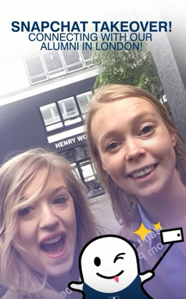
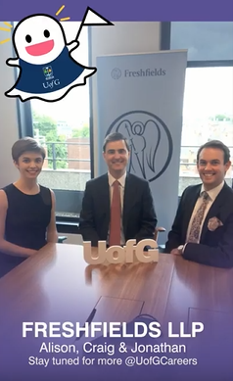
Go Where Students Are: Taking Over Snapchat
Strategy 10: Boosting Student Participation
UofG Deploys Snapchat Takeovers to Promote Mentoring Platform
Alumni Takeover UofG’s Snapchat Account
Major Spikes in Online Mentoring System
Greater Alumni Engagement
54%
16.5
total alumni volunteer hours
increase in mentoring activity on platform
120%
70%
of alumni not involved in prior volunteering activities
growth in sign-ups to mentoring platform
Two staff members interviewed alumni from variety of and sectors in London (e.g., Beatson Cancer Charity, Pinterest, Victoria and Albert Museum)
Takeovers tailored to each alumnus’ personal journey to create authentic and
relatable content
3x
more messages sent in two week period after takeovers
5
alumni participants became mentors
153, 503
total snapchat views recorded
1
alumni participant became major donor
Source: University of Glasgow, Glasgow, UK; EAB interviews and analysis
Notes:
The other success story from Glasgow came from their alumni snapchat takeovers
We discussed alumni social media takeovers in the first section as a way to highlight alumni careers
As Glasgow exemplifies, alumni takeovers—which typically garner more student views than normal content—can be a great tool for promoting your other programming
At Glasgow, two staff members facilitated the takeovers by interviewing alums from different industries around London
They worked to make sure the content was engaging and interesting for students; they also encouraged students to sign up for their online mentoring system during the takeovers
Immediately after these takeovers, Glasgow saw a 54% increasing in mentoring activity on the platform and 120% growth in sign-ups
In the 2 weeks following the takeovers, three times more messages were sent between alumni and students on the platform
Also wanted to highlight that the takeovers also had a positive impact on alumni engagement
70% of the volunteers had never volunteered with Glasgow before. 5 of the participants went on to become mentors, and 1 became a major donor.
So this truly was a win-win for Glasgow.

Slide 61


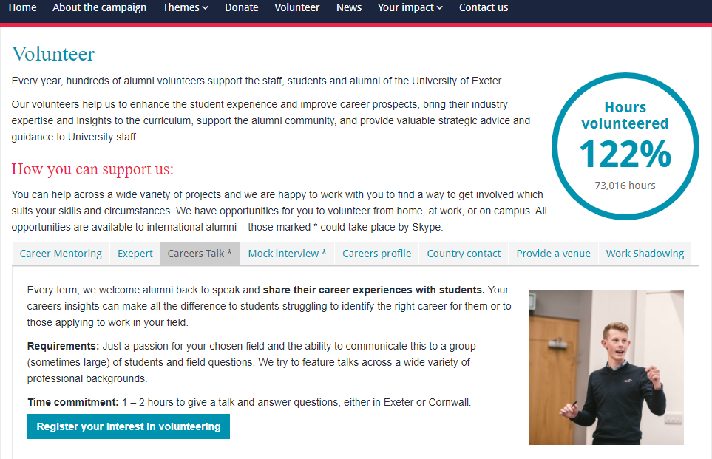
Providing a Menu of Options
Strategy 11: Recruiting Best-Fit Alumni to the Right Programmes
Exeter’s Website Clearly Defines Distinct Alumni Volunteer Opportunities
Concise introduction clearly explains impact of volunteering
www.exeter.ac.uk/exceptional/volunteer/
Highlights volunteer achievements to generate excitement
Volunteer options easy to identify and click through
Direct link for alumni to immediately express interest
Clearly states time commitment and requirements for alumni to find best-fit volunteer opportunities
Source: “Making the exceptional happen,” University of Exeter, http://www.exeter.ac.uk/exceptional/volunteer/; EAB interviews and analysis.
Notes:
Moving to strategy 11: Recruiting Best-Fit Alumni to the Right programmes
We perused many alumni relations websites during our research and noticed that many of them do not list discrete volunteer opportunities for alums. More often, they include a generic “contact us if you are interested in volunteering!” option
This creates more work on the back-end for you when alumni express interest in helping students, but they aren’t sure how they can help and you are the one that needs figure it out
Or worse, alumni don’t engage at all because they assume they have the time or skill-set necessary
One simple solution is to include clear and detailed volunteer opportunities on your alumni relations or alumni association websites
We highlighted Exeter University’s website here on the slide
Exeter’s website has an easy to click through menu of volunteering options. They include key information like requirements and time commitment, so alumni know exactly what is expected of them
It’s a very simple but meaningful way to better recruit alumni volunteers and save yourselves time

Slide 62
Choose the Right Mix for Your Campus
Strategy 11: Recruiting Best-Fit Alumni to the Right Programmes
Offer Alumni a Variety of Volunteer Options to Fit their Needs and Skills
EAB’s Alumni Opportunity Matrix¹
Volunteering Opportunities | Mentoring | Job-shadowing | Podcast
Descriptions | Participate in a one-on-one mentoring scheme, and share advice and information about your career path | Bring a current student to your workplace, to learn the ins and outs of what you do and help with small tasks | Discuss what you’ve been doing since you graduated, sharing advice, highs & lows
Modality | In-person, on or around campus | In-person, at your place of work | Virtual phone-calls
Group or Individual | Individual | Individual | Individual, Pairs
Length of commitment | Four one-hour engagements over the course of four months | One week | A few hours
Peak Times | Spring | Summer | Year-round
Requirements | Passion for your field | Approval from your workplace, ability to discuss tasks and day-to-day activities | Familiarity with Skype, conversational and casual demeanor
For complete template of EAB’s Alumni Opportunity Matrix, please see online resource centre.
An enhanced version of Carleton College’s matrix, developed in 2012
Source: EAB interviews and analysis
Notes:
To make this even easier for you, EAB created an “Alumni Opportunity Matrix” that you can populate and upload to your website
A screenshot of the template is shown on the slide
The top row serves as a list of all your alumni volunteering opportunities. The rest of the table includes information that alumni would want to know – modality, time commitment, requirements, etc. This allows alums to easily compare volunteer opportunities across multiple factors and identify the best opportunities that match their skill-set and availability.

Slide 63

Strategy 11: Recruiting Best-Fit Alumni to the Right Programmes
Taking a Cue from Successful Digital Marketers
The Case of Making Proactive Asks for Recruiting Alumni Volunteers
Status Quo Approach to Volunteer Recruitment
Optimal Approach to Volunteer Recruitment
Sends generic “help wanted” message to all alumni with lowest-common-denominator appeal to duty
The New Normal “Audiences today expect segmentation – they increasingly assume that the content you share with them will be targeted, personalised, relevant, and customised to them. If it’s not, they get confused, think you made a mistake, and/or ignore it completely.”
Andy Shaindlin Vice President, Grenzebach Glier and Associates
Query database and source names from MGO portfolios to identify alumni with optimal background for assignment
Send three follow-up reminders asking that interested alumni go to website to sign up
Choreograph invite from individual with preexisting relationship and with slightly-personalised message
Results in random sampling of alumni who already tend to engage or have little value to contribute; first-timers leave disappointed at having wasted time
Yields majority conversion of those contacted who are correct fit for the programme and for whom this is meaningful touch
Source: EAB interviews and analysis.
Notes:
The other problem with recruiting alumni is that the current approach is too passive. On the left, the typical way we recruit alums.
We send out a generic “we need help” message to the entire alumni base, and then a couple of more reminder emails since most of the time, these generic emails go unread.
So you end up with a random group of alumni—either ones who already volunteer often, or ones without the right skills
On the right is the process we need to move toward. One where we leverage an alumni database as well as our advancement portfolios to identify best-fit alums
Once we identify the right alums, we engage them with a personalised, unique message that increases the likelihood that they will respond
I know we aren’t all here yet, and lot of this will depend on how good your alumni database. Advanced technology makes this easier as well. But your alumni are expecting more targeted, personalised messages, so this is where we need to get.

Slide 64

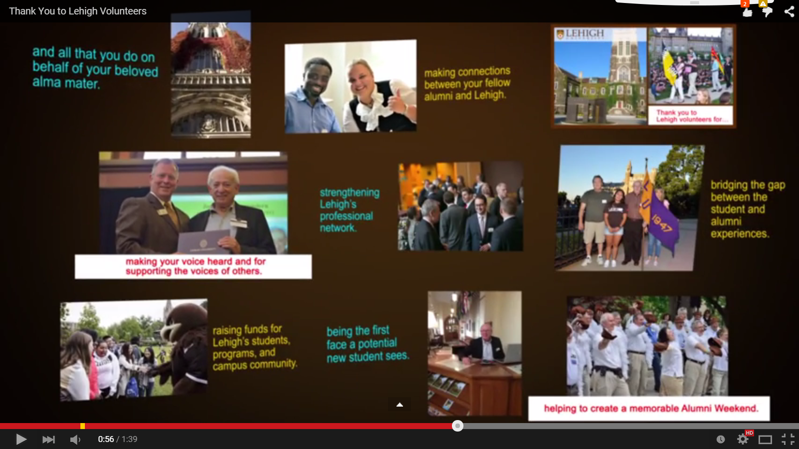


Strategy 11: Recruiting Best-Fit Alumni to the Right Programmes
Be Disciplined about Regular Messaging
Lehigh’s Recognition Schedule Communicates Impact to Entire Alumni Base
Lehigh’s Recognition Schedule¹
August
Volunteer Impact Report shared with entire Alumni Association and highlighted at exclusive reception for volunteers with President
November
Thanksgiving thank you card to volunteers
December
Holiday greeting card to volunteers
April
National Volunteer Week recognition video
Emailed to entire alumni base
Promotes upcoming volunteer events
Yields 75-100 new volunteers annually
Recognition activities change annually; only select activities shown
Source: “Thank You to Lehigh Volunteers.” Lehigh University. YouTube. 2014. https://www.youtube.com/watch?v=I11C98yPD5w ; EAB interviews and analysis.
Notes:
Another important factor to maximining the likelihood that alumni will answer volunteering asks is ensure you maintain consistent communication with your alumni base, and communicating in a variety of ways (e.g., newsletters, emails campaigns, etc).
Communicating impact of alumni volunteering on students and universities goals is a great way to encourage more volunteers.
Lehigh University developed a “recognition schedule” that communicate the impact of volunteers to the entire alumni bases as well as the broader university community.
Every year during National Volunteering Week, they release a thank-you video to the entire alumni base celebrating their alumni volunteers.
They also include a plug for current volunteer opportunities and typically get 75-100 new volunteers through this initiative.

Slide 65



Rewarding Participation
Strategy 11: Recruiting Best-Fit Alumni to the Right Programmes
UofG Focuses Alumni Recognition on Career Improvement
UofG’s Desire to Strategise Alumni Recognition…
…Leading to Career-Focused Alumni Recognition Options
Recognised that alumni volunteers were much younger than traditional donor base
Guidance on adding alumni volunteering to LinkedIn profiles
Thank you notes sent to managers for allowing alumni to take time off of work
Held a focus group to determine what young alumni wanted to get out of volunteering time with students
Mailed copy of “Certificate of Appreciation” for alumni to hang up in their workplaces
Young alumni emphasised desire to leverage volunteerism to improve their careers
Formal recognition list of alumni volunteers on website
Source: University of Glasgow, Glasgow, UK; EAB interviews and analysis.
Notes:
Alumni may read your emails and consider volunteering, but they mat still lack an incentive to donate their precious time to volunteering activities.
One way to make the decision easier for them by offering them high-impact incentives as a thank you for their time
A couple of years ago, Glasgow decided to do some research into the types of incentives would encourage more alumni to participate
Recognising that many of their alums were young, they held a focus group of young alums and learned that the primary motivation for volunteering was to improve their own careers
So Glasgow created an alumni recognition hub that includes career-focused incentives
For example, Glasgow provides guidance on adding volunteering activities to your linked In profile, and they send thank you notes to volunteers’ bosses to thank them for taking time off work.

Slide 66





Alumni Engagement in Career Development Also Helps the Bottom Line
Alumni Engaged through Volunteering More Likely to Give
Unpacking the Connection
What Does Volunteering Do?
A Snapshot of One University
Cornell University, FY 2011-2012
Enfranchises donor as stakeholder
57%
Giving rate amongst volunteers – compared to 36% from event attendees and 3% from alumni who are neither
Exposes donor to cause, personalising and sparking emotional connection
10x
Average differential in median gift size between alumni donors¹ who volunteer versus those who do not²
Fosters sense of distinctive package of contributions
83%
Of top 320 donors who give >$1M are volunteers
Wraps donor in positively reinforcing relationships and welcomes them to “inner circle”
Upgrades that Endure The annual giving of average leadership volunteer: $916 in decade before term, $3,517 during term, $2,250 in four years after term ends, and $1,148 in decade after.
Allows monitoring for impact and accountability
Source: Cornell University: Office of Volunteer Programmes, "Trustee Task Force on Volunteer Leadership." Last modified May 2013.http://www.alumni.cornell.edu/volunteerold/documents/Trustee
TaskForceonVolunteerLeadership Report.pdf ; EAB interviews and analysis.
Notes:
The good news is the engaging alumni in student career development has an added benefit. Research shows that more engaged alumni are more likely to give financially to their alma mater. Over the past decade, many advancement shops have made this connection and are trying to capitalise on it by creating more volunteering opportunities and focusing their efforts of on donor “engagement” rather than pure financial aspect.
On the left, unpacking this connection a bit. Volunteering is a great way to start a relationships with a potential donor.
On the right, some stats from Cornell University that demonstrate this connection. 57% of volunteers at Cornell also donate to the institution, much higher than the 36% of non volunteers. They also give much larger gifts.
So engaging alumni to volunteer in student career development activities also has the added benefit of potential future giving by alumni.

Slide 67
How Are We Doing?
Strategy 12: Evaluating and Communicating Programme Impact
Duke Launches Audit to Assess Alumni-Student Engagement Landscape
2014
Duke Alumni Association (DAA) launches strategic plan with goal of more effectively connecting alumni with students
December 2017
Alumni-to-Student Engagement Committee convenes with cross-section of campus stakeholders
March 2018
Conducts student and alumni surveys to identify challenges and opportunities
December 2016
DAA partners with dean’s office to conduct university-wide audit of mentoring and alumni/student engagement programmes, identifying 60 programmes
January 2018
Conducts qualitative interviews with 34 programme managers who connect alumni with students for informal advice, mentorship, internships, and career guidance
May-August 2018
Drafts strategic framework to realise the opportunities identified in audit, shares with campus partners
Strategic Framework Focused on Three Priority Areas
1
Campus Engagement
Systems to view, track, and share when alumni are on campus
2
Advising
programmes and platforms to connect students to alumni
3
Career
Processes and systems for alumni to easily post jobs and internships
For a copy of Duke’s Alumni-Student Engagement Framework, please see the online resource centre.
Source: Duke University, Durham, NC, EAB interviews and analysis.
Notes:
The final strategy for today is Strategy 12: Evaluating and Communicating Programme Impact.
During nearly all of our research interviews, assessing the impact of your programmes surfaced as a major challenge and an area of interest
I will be honest and say that we didn’t find much here. Even the most progressive schools are struggling with how to define success for their programmes
However, I still wanted to touch on a couple of interesting stories from schools who have started to make headway. First, highlighting a school that assessed student employability initiatives that engage alumni across the entire campus, followed by some ideas around evaluating individual programme impact.
The first story is another one from Duke.
Over the past 5 years or so, Duke has made it a strategic priority to better connect alumni with students for career development
In 2016, Duke conducted a major university-wide audit of student and alumni engagement to understand the current state of affairs. This is the same survey I mentioned earlier that helped develop the community of practice
Beyond the survey Duke also developed a committee who conducted qualitative interviews with 34 programme manager who connect alumni with students for career development.
Finally, they conducted alumni and student surveys to hear their perceptions of current engagement activities
This audit allowed Duke to identify gaps in their current practice and areas of opportunity
Ultimately, they put together a strategic framework with 3 priority areas: developing bettering systems to track alumni volunteering, creating mentoring platforms, and making it easier for alumni to post job and internships opportunities. This strategic framework directly resulted in the development of the community of practice mentioned earlier.

Slide 68
Duke’s Insight: These Are the Metrics that Matter
Strategy 12: Evaluating and Communicating Programme Impact
Duke Develops Metrics to Evaluate Efforts of Strategic Framework
Metric Category | Metrics
Scale of Alumni Engagement with Student Career Development | Growth in the Community of Practice Growth in programmes utilising centralised resources (e.g., volunteer portal, staff/faculty logins on alumni network) Number of alumni speakers in classrooms and student club events Number of alumni-student connections on the alumni network and other digital platforms Number of alumni mentors and advisors
Quality of Alumni Engagement Activities | Student surveys Alumni surveys Faculty/staff/stakeholders interviews
Depth of Alumni Engagement | Changes in engagement pathways over time (e.g., engaging with students leading other engagement with Duke) Retention of mentors/advisers Recent graduate engagement (e.g., students who benefited from alumni mentors giving back after graduation)
Source: Duke University, Durham, NC, EAB interviews and analysis.
Notes:
Notably, Duke also defined key metrics to measure the success of their efforts
The categorised metrics into three buckets. First, scale of alumni engagement. These are quantitative measures like the growth in their community of practice, number of alumni classroom speakers, and number of alumni mentors
Next, quality of alumni engagement. These metrics include data from qualitative sources like alumni and student surveys.
Finally, depth of engagement over time, which includes retention rates of mentors and engagement data from recent graduates.
To summarise, Duke’s strategy was threefold: understand the current state of affairs of alumni-student engagement on campus, develop a strategy for improving the current state, and create metrics to measure success

Slide 69
Assessing Individual Programmes
Strategy 12: Evaluating and Communicating Programme Impact
Four Ways to Measure Programmatic Impact and Areas for Improvement
1
Participant surveys
2
Longitudinal Tracking
Different surveys target both student and alumni participants
Includes questions allowing for both quantitative and qualitative analysis
Holds focus groups with students and/or alumni a few years after the experience
Records ways that perceptions of the experience have changed over time (e.g., do students think the experience was more or less valuable now than initial perceptions?)
3
Post-experience reflections
4
Annual alumni tracking
Students required to write reflection essays after the experience
Reflection essays include information around:
  Take-aways
  Skills gained
  Next steps
Tracks “repeat-volunteers,” who continue to participate in a particular programme on an annual basis
Track alumni who participate in other opportunities that they were not previously engaged with
Source: Carleton College, Northfield, MN; EAB interviews & analysis
Notes:
The next idea under strategy 12 is about measuring success at the programme level.
On the slide, the four main ways that schools can assess the impact of individual programmes and events. These practices specifically come from Carleton College’s externship programme, but can be applied to nearly any programme or event.
I wanted to highlight one method in particular. First, longitudinal tracking. This method is arguably the most valuable way to assess the long-term impact of employability initiatives Immediately after an event, a student may note on a survey that the information was very helpful. But the event may not necessarily lead to action on a students’ part, like applying for an internship or attending other career events. The benefit of holding longitudinal tracking—which can be done through surveys or focus groups—is that you can determine whether the skills or insight they gained through a programme or event has had long-term impact on their career readiness and employability.

Slide 70


Pinpointing “Areas of Impact”
Strategy 12: Evaluating and Communicating Programme Impact
Pre- and Post-Programme Evaluations Assess Student Development
University of Sheffield’s ‘City Connections’ Online Questionnaire
Students complete online questionnaire before and after programme to provide index of individual participant development
Students rank level of agreement with 13 total statements on five point Likert scale (i.e., strongly agree to strongly disagree)
Average difference in responses calculated by comparing the mean change in response to each statement
Also gathers qualitative feedback through focus groups and student reflection diaries
Alumni feedback gathered via online post-event survey
I am aware of the University of Sheffield alumni community and how graduates can stay involved with the University
I feel positive about my career prospects following graduation
I feel confident talking about my abilities, aspirations and interests with employers/professionals
I would be able to talk about the competitors, suppliers, customers and key trends of the career sector I am interested in an application/interview
I have a network of people I can ask for careers advice and guidance
I am motivated to do well academically
I feel confident applying for, and taking up, internships and work in London
I feel confident asking for careers advice from professionals/employers
Source: University of Sheffield, Sheffield, UK; EAB interviews and analysis.
Notes:
Wanted to dive a little deeper into the use of student surveying to evaluate programme impact.
A few schools we interviews reported using pre- and post-event surveys. We highlighted the University of Sheffield’s evaluation here because we found it to be the most comprehensive.
Sheffield uses an online questionnaire to assess the impact of their City connection programme
Before and after the programme, students are asked to rank their level of agreement using a Likert-scale with 13 total statements. Some of the statement are shown on the right.
Unlike surveys with open-ended questions, this survey allows Sheffield to calculate the mean change in response to each statement to assess overall impact. They can also look at changes in individual participant responses to track their development
To gather qualitative information, Sheffield also conducts focus groups and asks students to submit reflection diaries

Slide 71
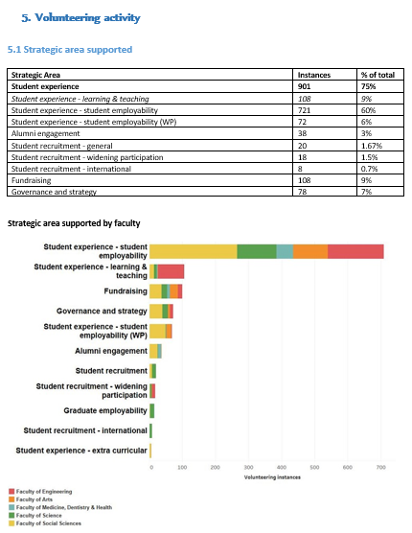
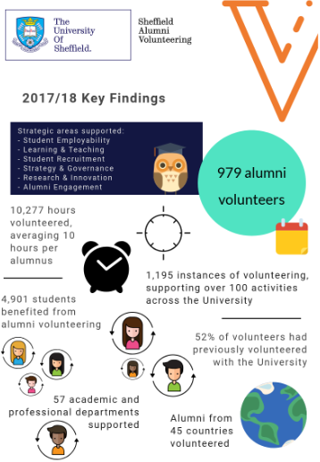

Sharing the Story of Alumni Impact Across Campus
Strategy 12: Evaluating and Communicating Programme Impact
University of Sheffield Shares Annual Volunteer Report with Campus
Screenshots of Sheffield’s 2017/18 Alumni Volunteers Report and Infographic
Report Components
Volunteer engagement and donor statistics
Top volunteers roles and activities
Volunteer statistics by faculty
Volunteer impact (e.g., alumni and student feedback, survey results)
Goals and targets for forthcoming year
Report and Infographic Audience
University Executive Board
Academic department heads
Professional services heads
Staff who lead projects supported by alumni volunteers
Prepare the Ground Before You Show Off Your Impact
“Inviting senior leaders to attend alumni engagement events can be very powerful. Even if they can only come for half an hour, they get to witness the impact these events have on students and alumni.”
Miles Stevenson, Director of Advancement, University of Sheffield
Source: University of Sheffield, Sheffield, UK; EAB interviews and analysis.
Notes:
programme evaluation is critical for ensuring they meaningfully inflecting student employability and better engaging alumni.
But you also want to make sure you communicate successes to senior leaders and the campus community at large. Especially because of those misconceptions that we discussed earlier, and to ensure proper funding of your office, it’s critical to show that your work is impacting broader institutional goals.
The University of Sheffield does this through an annual alumni volunteers report and infographic.
The report and infographic include data on volunteer and donor engagement, volunteer roles and activities, feedback from students and alums, and goals for the next year
The report and infographic is shared with the University Executive Board, academic department heads, professional services heads, and all staff who lead on the projects supported by the alumni volunteers.
While Sheffield reports positive feedback from those who receive the report, the director of advancement has one other simple recommendation: invite senior leaders to alumni engagement events. Miles makes sure to invite senior leaders to every single event, knowing that they won’t be able to come to most of them. But when they do come, they get to see first-hand how students benefit from engaging with alumni.

Slide 72
The New Rules of Engagement
Lessons from EAB’s Advancement Forum on Engaging Alumni Volunteers
Rule
Description
Examples
Offer limited-duration, tightly-scoped opportunities with clearly-communicated purpose, parameters, and endpoint
Speed networking
Career panels
Alumni career profiles
1
Make it Easy to Say Yes
Meet Them Where They Are
Create convenient and accessible volunteer roles that allow alumni to participate in their workplaces or online
Corporate chapters
Instagram takeovers
Online resume reviews
2
Develop skills-based roles, identify best-fit alumni to participate, and make proactive asks of alumni
Academic volunteer roles
Website with clear volunteer opportunities
3
Broker Smarter Matches
Embrace the “Me” Factor
Emphasise the two-way value proposition for volunteers, including professional development, recognition, and communication of their impact
Alumni recognition
Volunteer impact reports
4
Establish and deepen relationships with other campus stakeholders to underscore importance of alumni engagement with student career development
Campus engagement form
Alumni request form
Community of practice
5
Cultivate Campus Allies
Source: EAB interviews and analysis.
Notes:
I wanted to end with some lessons from EAB’s advancement forum. In their research, the Advancement Forum’s identified 5 “new rules of engagement” that institutions should adopt to better engage alumni volunteers
Each rule includes a brief description and examples that map to some of the practices we discussed today.
You’ll notice that all of these rules were incorporated into the practices that we shared today
For example – make it easy for alums to say yes by offering tightly scoped volunteer options with low time commitment. This includes things like speed networking, career panels, and alumni profiles
So you can use this as a nice summary slide for the practices we discussed today.

