Slide 1
Using Financial Aid Data to Strategically Shape a Diverse Class:
An Overview of EAB’s Financial Aid Optimization Tool
November 12, 2020
We will begin at 1:02 p.m. Eastern Time once everyone has joined!
Independent School Executive Forum

Slide 2
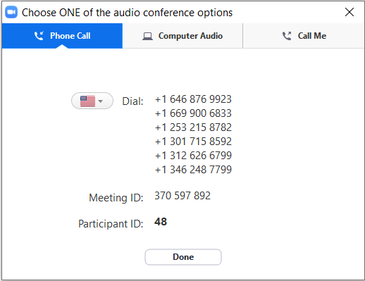
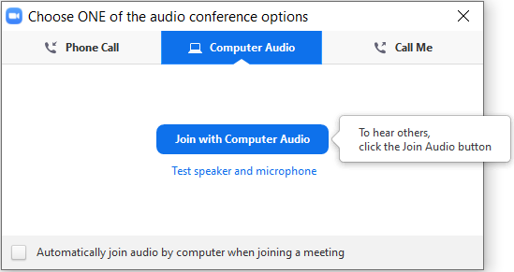
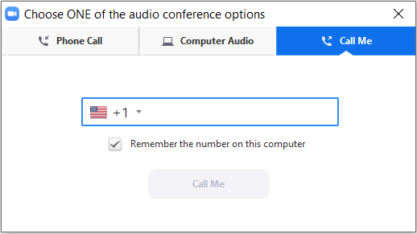
Audio Options in Zoom
Use your computer’s audio and microphone through Zoom
2
Dial in using your phone
1
X
Do not do both – it will cause feedback

Slide 3


Today’s Speakers
Sharon Rosenfeld, Director
Independent School Executive Forum
Brett Schraeder, Principal
Financial Aid Optimization Team

Slide 4





Objectives
Define How Financial Aid Is a Critical Tool for Shaping the Independent School Class
Differentiate Between Independent School and Higher Education’s Approach to Tuition Discounting
Describe How Data Plays a Key Role in Determining Whether Aid Is Helping to Meet Enrollment Goals
Be Able to Use EAB’s Financial Aid Optimization Tool to Analyze Historical Aid Data
Get Answers to Questions about Financial Aid Optimization

Slide 5


Why Focus on Financial Aid Right Now?
New interest in independent schools from public-school families during COVID-19 pandemic
Independent schools doubling down on commitment to mission, values of diversity, inclusivity
Unique opportunity to shape classes based on enrollment goals aligned to school mission, values

Slide 6





A Renewed Focus on Diversity in 2020
What We Are Seeing across the US
What We Are Seeing
at Independent Schools
Civil unrest in response to systemic racism, violence toward Black Americans
Highly publicized allegations of racism on social media, newspapers
Reckoning related to historic, current forms of racial injustice (e.g. removal of Confederate monuments)
Students and alumni demanding change to cultures, policies
Racial and Socio-Economic Diversity Have Real Benefits to Students
Research shows:
Diverse classrooms encourage critical thinking, problem solving, and creativity for all students
Diverse schools help to reduce to reduce student bias and counter negative stereotypes against students of different backgrounds
Students from diverse schools seek out similar settings later in life
Source: The Benefits of Socioeconomically and Racially Integrated Schools and Classrooms, The Century Foundation, Michelle Burris, November 26, 2019; EAB interviews and analysis

Slide 7
Tuition Remains a Major Barrier to Diversity
Independent School Tuition Cost-Prohibitive for Average Family…
$26,866
$60,600
$68,703
Average day school tuition at NAIS Schools, 2019-2020
Average 7-Day boarding tuition at NAIS Schools, 2019-2020
Median US household income, 2019
…Limiting Desired Racial, Socio-Economic Diversity
4%
7%
7%
Of students enrolled at NAIS schools identify as Latinx/Hispanic, 2019-2020
Of students enrolled at NAIS schools identify as Black/African American, 2019-2020
Of students enrolled at NAIS schools identify as Asian American,
2019-2020
Source: NAIS Facts at a Glance 2019-2020; NAIS Trendbook Excerpt, “Tuition Increasing as a Percentage of Family Income”, 2018; Kids Count Data Center, Annie E. Casey Foundation

Slide 8
High Tuition Requires More Aid, Even for High Earners
Tuition Discount Rates at NAIS Schools (2005-2006 to 2015-2016)
6.2%
21.2%
families earning $150,000+/year applied for aid in 2002-2003
families earning $150,000+/year applied for aid in 2011-2012
Source: William Daughtrey, William Hester, Kevin Weatheril, “Tuition Trends in Independent Day Schools,” Peabody College of Vanderbilt University, 2016; EAB interviews and analysis.

Slide 9


A Balancing Act: NTR and Shaping a Diverse Class
1
The Need to Maximize Net Tuition Revenue from the Applicant Pool
2
The Need to Achieve a Racially, Socio-Economically Diverse Class
Utilize price discrimination to maximize revenue per customer
Shape a diverse student body to align with school values, fulfill mission
Max NTR Point
Net Tuition Revenue
Amount of Aid Allocated

Slide 10

Independent Schools Lack Explicit Aid Strategy
Higher Ed Institutions Optimize Use of Aid to Meet Enrollment Goals
Independent Schools’
Approach to Financial Aid
Higher Education’s
Approach to Financial Aid
View financial aid as an expense to make school tuition affordable for enough families to fill seats
View financial aid as an important lever to meet enrollment goals in high-fixed cost industry
May or may not set explicit enrollment goals or develop aid policy
VS.
Annually set explicit enrollment goals and develop aligned aid policy to realize goals
Do not have the resources or data to utilize a statistical model to apply aid policies and make enrollment projections
Hire a vendor for financial aid optimization and use a statistical model to test hypothetical aid policies and project enrollment
Institutions of higher education optimize their financial aid strategy to meet enrollment goals, a process known as financial aid optimization

Slide 11
The Three Components of Aid Optimization
Higher Ed Institutions Explicit about Their Approach to Aid
1
2
3
Set Enrollment Goals
Develop Aid Policy
Employ a Statistical Model
  The university must be clear about enrollment goals, which must be specific, guide trade-offs as the university sets aid policy, and have clear timelines
  The university must develop an aid policy that helps it achieve its enrollment goals, and should delineate criteria for aid
  The statistical model allows the university to test hypothetical aid policies and project the enrolled class that would result from each
  Key Consideration:
  “What enrollment (headcount, mix of students) are we aiming for?”
Key Consideration:
“How much aid will each student receive, based on need and other relevant factors?”
Key Consideration:
“How might our class look
if we apply [any given]
aid policy?”

Slide 12




About Financial Aid Optimization at EAB
EAB’s Financial Aid Optimization (FAO) program features a team of experts that guide higher ed institutions with everything from financial aid policy development through yield management.
Three Areas of Focus:
Policy Strategy
Live Aid Modeling
Award Activity Monitoring
Based on an analysis of a college’s historical data, the FAO team identifies new market opportunities and helps to design an aid policy
The FAO team creates customizable aid models with live simulation capabilities that allow institutions to explore allocation options
As an institution awards aid, live modeling enables progress monitoring and allows for changes in aid allocation

Slide 13




Financial Aid as Enrollment Tool
The EAB Process
EAB utilizes logistical regression analysis to determine estimated probability of enrollment for each student
Next, we test every possible award each student could receive to estimate their probability of enrollment (shown along the dark blue line)
From the range of estimated probabilities, we determine the point at which net tuition revenue is maximized (the peak of the light blue line)
This leads to an understanding of where aid should be increased or reduced

Slide 14
An Example of the FAO Team’s Data Analysis

Slide 15
An Example of the FAO Team’s Data Analysis

Slide 16
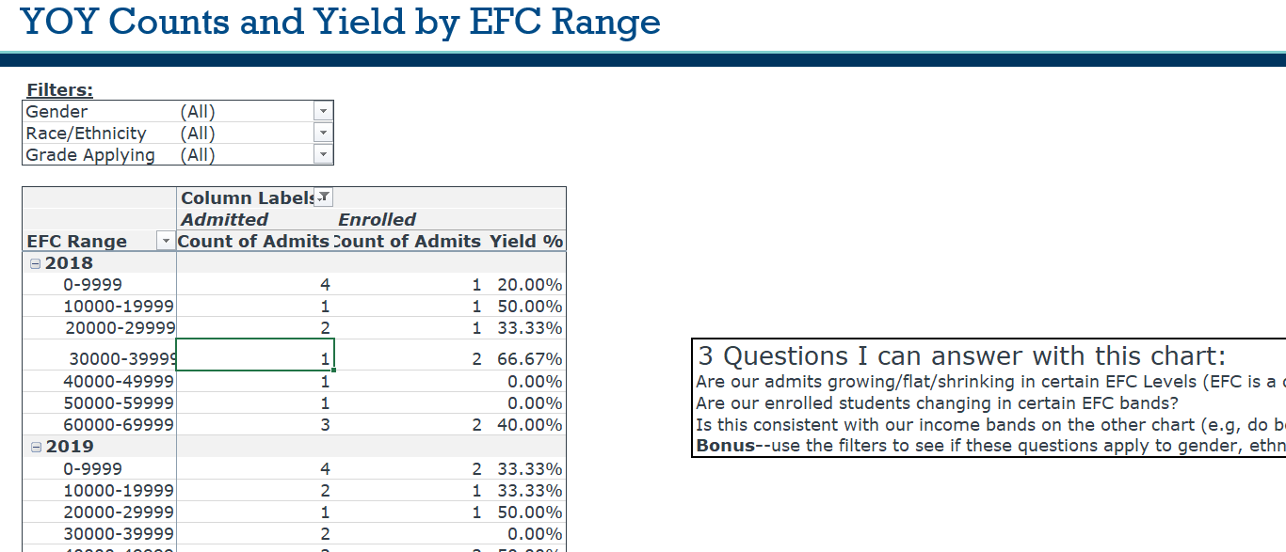
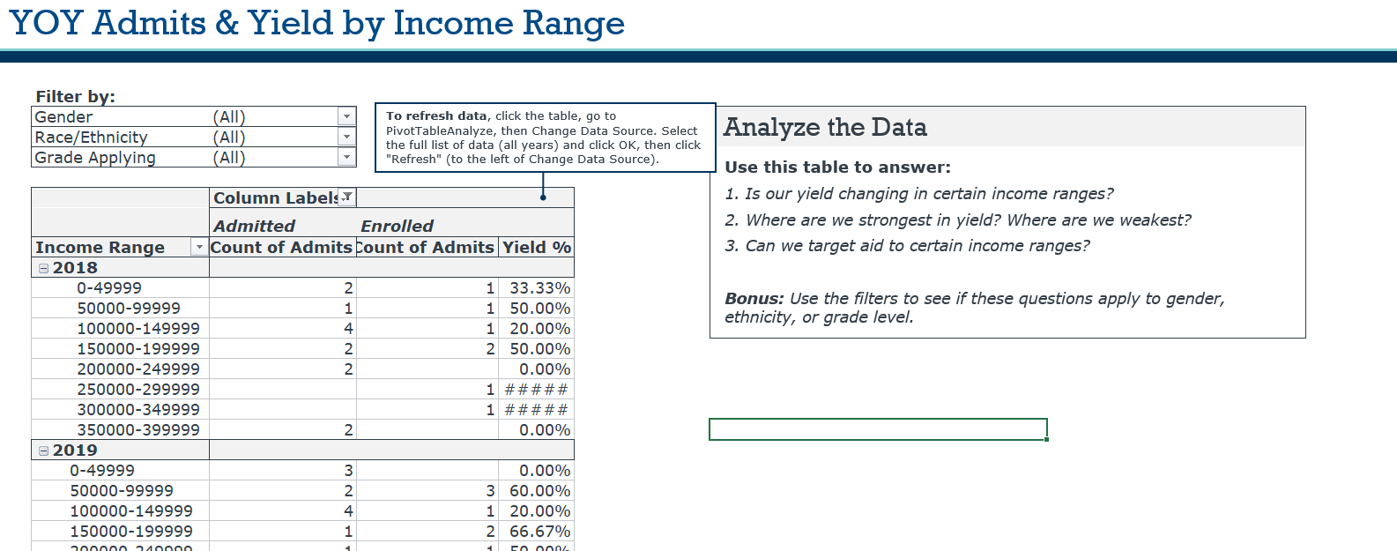
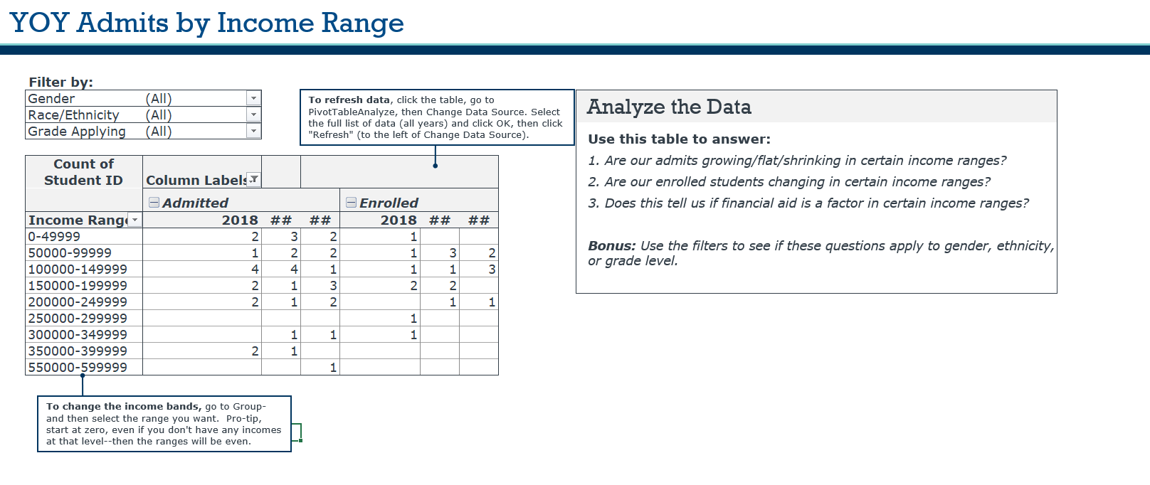



A New EAB Tool for Analyzing Financial Aid Data
Created with Higher Ed FAO Team to Help Independent Schools
New Financial Aid Optimization Tool:
Utilizes data from School & Student Services (SSS)
reports to populate tables that can be filtered by grade
level, gender, ethnicity
Illustrates to partner schools how aid awards impact
families’ decisions to enroll
Allows independent schools test out and track data to show the results of aid policy and strategy changes toward yielding specific subsets of students
Provides answers to key questions about enrollment trends, such as:
Are our enrolled students changing in certain income bands? Does this indicate whether financial aid is a factor in certain income bands?
Is our yield getting better, worse, or remaining steady in certain EFC levels?
Do we have a “gap” cliff (i.e. is there a percent of need met where yield drops way off)? Do we need to meet a higher percentage of need in certain places?
Be sure to access the How-To video created for the Financial Aid Optimization Tool here on EAB’s website.

Slide 17

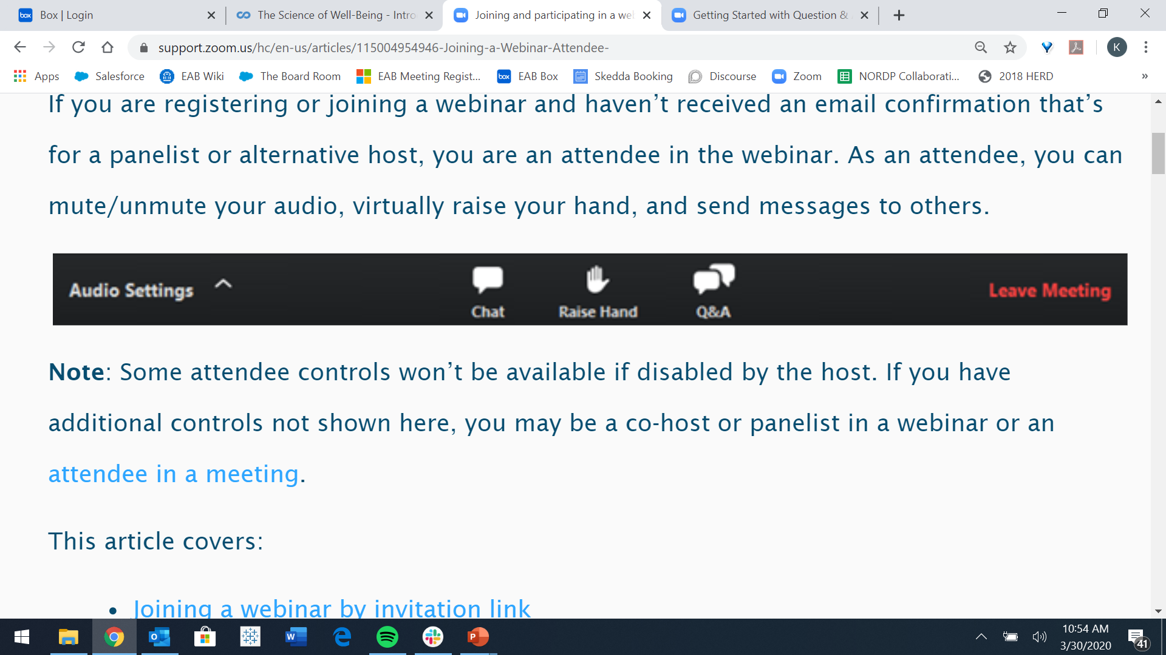
Q&A
Use Zoom’s chat feature to type in questions for us to answer related to financial aid optimization and EAB’s new data tool.
Use the Chat feature to send messages to anyone in the session
Use the Q&A feature to ask questions to (just)
the host

Slide 18

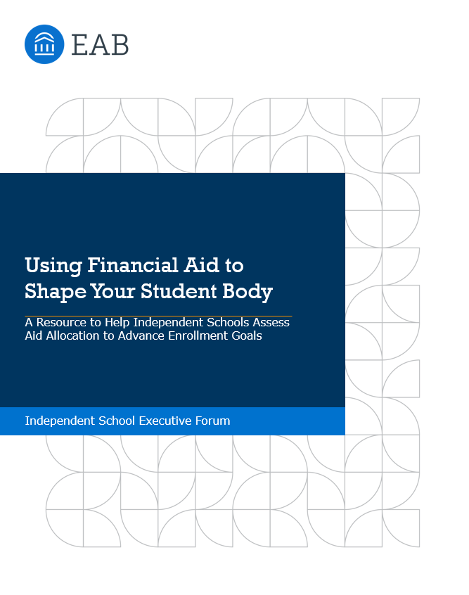
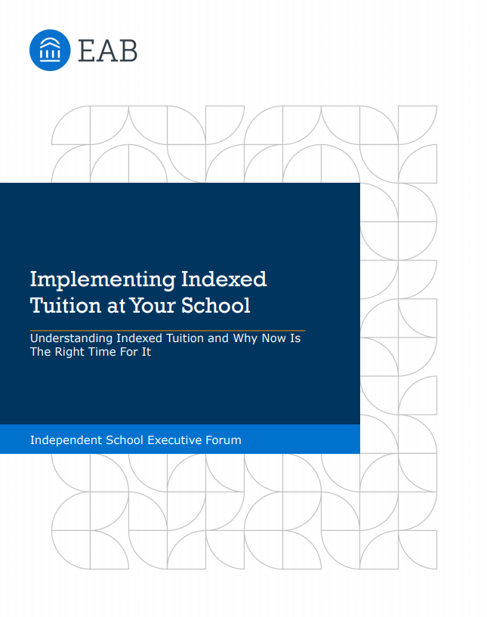
EAB’s New Financial Aid Resource Center
Check out Our New Resources on EAB’s Website
Using Financial Aid to Shape Your Student Body
Learn the principles behind financial aid optimization to use aid as a lever to enroll students to shape your desired class, as is done in higher ed
Then use the Financial Aid Optimization Tool to review your historical financial aid data to reexamine your aid policies and align them with enrollment goals
Indexed Tuition Implementation Guide
Lead with affordability to attract a broader array of families to your school
Use this resource to learn the practical considerations of putting an indexed tuition model into place

