Slide 1
Financial Sustainability
An Academic Opportunity Assessment to Ensure We Are Using Our Resources As Well As Possible
Challenging Times for Higher Education
Focusing on Academic Affairs
Timeline and Work Plan
Financial Sustainability Collaborative
Notes:
WELCOME, SETTING CONTEXT
Our institution is taking part in an academic opportunity assessment exercise created and run by EAB, a research and advisory firm that we have a relationship with.
I wanted to provide an overview of what this exercise consists of and how we our institution will be working with EAB through this process.

Slide 2
Challenging Times for Higher Education
The Economic Landscape and College and University’s Responses
1
Section
Notes:
DISCUSSION ROADMAP
There are three different areas I would like to talk about.
First – what is happening in higher education? What are other schools facing and what are they doing about it?
Second – what will we do here?
Third – what should we expect and what is the workplan and timeline?

Slide 3
A Shock for Every Higher Education Institution
As of April 15, 2020
An Unprecedented Financial Crisis Marred the Spring 2020 Term
Unanticipated Expenses Created Need for Immediate Cost Cutting
3.7%
On average, costs represented 3.7% of an institution’s annual operating expenditures¹
$7M
Median emergency cost estimates¹
41%
Of CBOs indicated their institutions had incurred $2M or more in unanticipated expenses²
N= 106
N= 273; Publics = 131; Private, Non-profit = 137
Source: EAB Survey of Colleges and Universities and analysis; Gallup and Inside Higher Education, “The 2020 Inside Higher Ed Survey of College and University Business Officers”
Notes:
FINANCIAL STRESS – SPRING 2020
There were a host of challenges that schools were facing coming into 2020 and the global pandemic, but the onset of the COVID-19 pandemic was particularly challenging to the financial situation of colleges and universities.
In the early days of the lockdown in 2020 EAB did a survey of the impact of the pandemic and the results were arresting. Once schools closed and sent students home, they found themselves on the hook for a lot of unexpected financial hits.
On average, schools refunded room and board to students equivalent to about 3.7% of their operating budgets or an average of about $7MM (or more for larger schools.

Slide 4
So, What About Our Revenues?
Where The Money Comes From
Tuition and Public Funding Are Critical
Primary Revenue Sources Public Institutions
Primary Revenue Sources Private Institutions
Source: D Startz, “Coronavirus poses serious financial risks to US universities,” Brookings; EAB interviews and analysis.
Notes:
REVENUE TUTORIAL
Given that schools have been hit with an unexpected bill on the expense side, is there enough money available to keep things going?
To answer that, let’s take a look at where the money actually comes from for colleges and universities - the largest sources of revenue are tuition and (for public institutions) state funding.
How firm is this financial foundation?

Slide 5
Looming Birth Dearth
Enrollment Revenue: Facing A Smaller Market
Population of 18-Year-Olds to Contract Sharply After 2025
Modest Decrease…
…Followed by Growth Spike…
…Met with A Sharp Decline
2017-2021
2022-2025
2026-2029
2025 Population
4.51 Million 18-Year-Olds
2021 Population
2017 Levels
2029 Population
4.17 Million 18-Year-Olds
3.86 Million 18-Year-Olds
-1%
8%
-14%
Decrease of 18-Year-Olds (2017-2021)
Growth of 18-Year-Olds (2022-2025)
Decrease of 18-Year-Olds (2026-2029)
Sources: Grawe, Nathan D., Demographics and the Demand for Higher Education, 2017; EAB analysis.
Notes:
LOOMING ENROLLMENT PRESSURES
The long-term tuition trend is not positive. Pioneering work by Nathan Grawe identified the demographic timebomb that looming over higher education – there will be fewer 18-year old high school graduates in the US as we move through the 2020s.
Demographics are, in many respects, destiny and the numbers don’t look great for higher education. The number of 18-year old Americans is forecast to shrink precipitously from 2026 to 2029, contracting by 14%. This contraction in the number of college-age individuals has deep and profound implications for every college and university.
Simple supply and demand tells us that fewer students (demand) with a constant supply of places at colleges will lead to more intensive competition among schools.

Slide 6
Undergraduate Enrollment Looking Anemic
What’s The Effect of the Pandemic?
Student Bodies Shrinking with First-time Students Down Sharply
Fall 2020 Undergraduate Enrollment
Percent Change from Previous Year by Type of Institution, US*
For-Profit 4-Year
Freshmen Hit Hardest
Private 4-Year
Public 4-Year
+3.4%
Total
Undergraduate Students
-16.1%
Public 2-Year
-2.0%
-1.4%
Fall 2020
Decrease in First-Time Undergraduate Beginning Student Enrollment vs. Previous Year
-4.0%
-9.4%
* Reporting reflects 54% of Title IV degree granting institutions with a combined enrollment of 9.2 million students.
Source: National Student Clearinghouse, as of Sept 24, 2020
Notes:
THE PANDEMIC HAS MADE IT WORSE
So what has been effect of the pandemic on schools? Looking across the US, data from the Student Clearinghouse, as of the end of September 2020 found that there were 4% fewer undergraduates across the US compared to September of 2019.
The more troubling finding is that there has been a 16% drop in first-time freshman – many fresh-faced freshman showing at our doors, eager to learn.

Slide 7
The Great Recession Permanently Cut Funding
State Funding Revenue: A Long Decline
Changes in Per Student State Funding, 2008-2017
Source: Michael Mitchell, Michael Leachman, and Kathleen Masterson, “A Lost Decade in Higher Education Funding,” Center for Budget and Policy Priorities, August 2017; Digest of Education Statistics, National Center for Education Statistics; EAB interviews and analysis.
Notes:
PUBLIC FUNDING FACING LONG-TERM EROSION
What about public funding for education? Well, if you look back through the historical record, going back to the Great Recession in 2007/8 and looked at State allocations to higher education you find that 10 years out from the onset of the crisis, 45 out of 50 states shrank the amount they provided for education funding.
As states had less money, they allocated less per student from public coffers.
(NOTE: Place the orange rectangle around your state for ease of identification of the effect on your school. Wisconsin is the only state not included as their funding formula changed, but the total was down.)

Slide 8
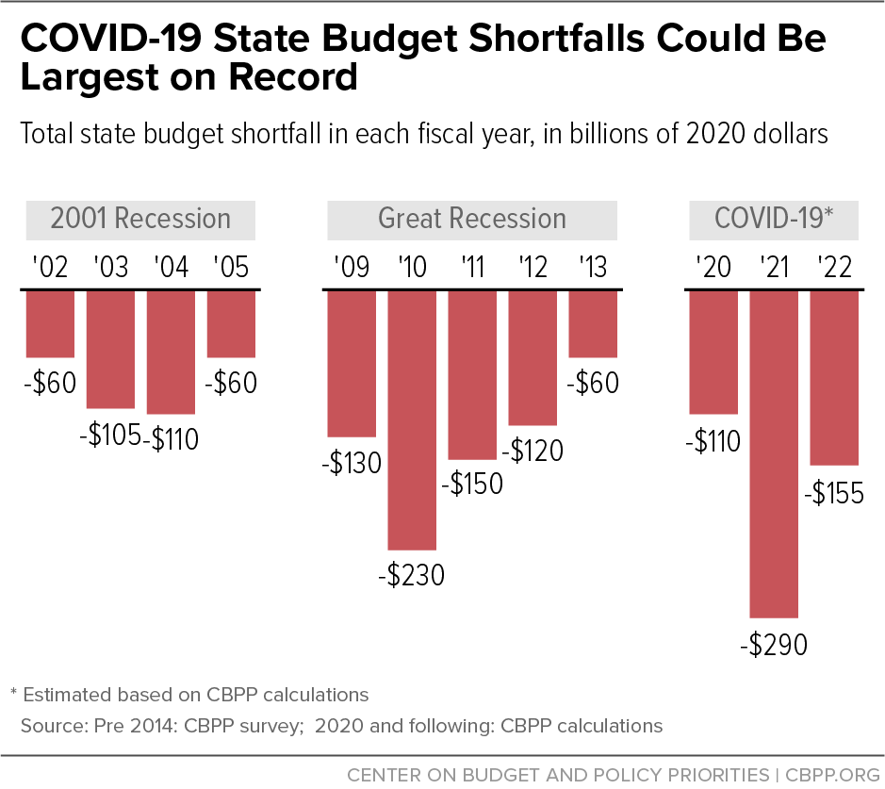
Little Hope For State Funding in Coming Years
What is the Effect of the Pandemic?
COVID-19 State Budget Shortfalls Projected to Be Largest on Record
Source: Center on Budget and Policy Priorities, ‘States Continue to Face Large Shortfalls Due to COVID-19 Effects’, Elizabeth McNichol and Michael Leachman, July 7, 2020
Notes:
THE PANDEMIC (LIKELY) TO MAKE IT WORSE
If history is any guide, we are not in for a good time in the coming years. The forecast for state budgets predicts that this coming year will see a larger budget shortfall than at the largest point in the Great Recession. State finances are in crisis and, most likely, that doesn’t bode well for higher ed budget allocations.
And, this isn’t just an issue for public universities.
Any funding shortfalls that hit public schools will force them to be more aggressive, more competitive in competing for students, making life harder for the private colleges and universities already facing a tougher time due to the enrollment issues we just discussed.

Slide 9
Operational Changes, Pay and Staff Cuts
What We are Seeing in Higher Ed – It’s Tough Out There
1
2
3
Operational Changes
Compensation
Layoffs & Furloughs
Focus staff and resources
Shift administrative staff to areas of increased need – custodial services; remote support; etc.
Eliminate bonuses, merit increases
Reduce or eliminate annual performance bonuses or salary adjustments for all or some employees
Workforce reduction
Furlough employees – reduce hours and pay
Layoff employees – eliminate positions and employment
Predominantly affecting administrative staff
Unionized workforces have been able to slow this process
Freeze Hiring
Leave administrative and faculty positions unfilled
Salary cuts
Impose across the board or tiered cuts in pay (highest compensated lose the greatest percentage)
Higher Education Employment
Number of Workers at Institutions of Higher Education, US
Early Retirement
Leave administrative and faculty positions unfilled
Reduce retirement contributions
Reduce or eliminate contributions for all or some employees
The Pandemic Effect
-337,00 Jobs Lost
Feb-Aug 2020
Source: Current Employment Statistics Data Series, US Bureau of Labor Statistics as Reported in “The Pandemic has Pushed Hundreds of Thousands of Workers Out of Higher Education”, The Chronicle of Higher Education, Oct. 6, 2020.
Notes:
WHAT ARE SCHOOLS DOING IN RESPONSE?
In short, the reaction has been relatively straightforward – schools have made operational changes – shifting staff to areas of need, freezing hiring and offering early retirement as a way to shrink longer-term compensation bills.
Schools have made compensation cuts, across both the administrative and academic sides of the house, eliminating bonus and merit increases, cutting salaries – often in a tiered way with the most highly compensated taking the largest cuts – and reducing 403b or other retirement contributions.
Lastly, schools have begun to make workforce reductions, furloughing and laying off staff to cut expenses. By and large, however, these last set of cuts – separating from current employees – has fallen disproportionately on the administrative side of the house, sparing faculty from this last set of reductions.
All told the COVID-19 pandemic has meant that higher education has seen a loss of over 330 thousand jobs across the 6-month period from February to August 2020.

Slide 10
Focusing On Academic Affairs
A Structured Review to Ensure We are Using our Resources as Well as Possible
2
Section
Notes:
DISCUSSION ROADMAP
So, with that as economic background, what are we going to be doing here?
We are planning to evaluate our teaching and learning enterprise to ensure that we are using our resources as effectively as possible.

Slide 11
Financial Sustainability Collaborative
Leading Institutions Through a Guided Curriculum
Key Areas of the Collaborative’s Academic Opportunity Assessment
The Collaborative in Brief
EAB will guide participants through an academic opportunity assessment exercise
EAB’s research teams have developed a curriculum based on more than a decade of best-practice higher education research
EAB’s subject matter experts will lead the group through a series of workshops and exercises based on each institution’s students, faculty and program offerings so that each collaborative participant will leave with an assessment of their academic opportunity
Participants: 30 college and universities; EAB will work directly with an Implementation Leader at each school
Timing: The collaborative will unfold across a five-month period starting in January 2021
Notes:
WHAT IS THE FINANICAL SUSTAINABILITY COLLABORATIVE?
To make that academic analysis happen, we are working with EAB in their Financial Sustainability Collaborative. This is an opportunity assessment exercise on the academic side of the institution, based on the best-practice research work that EAB has done across the past decade.
There are four areas that this exercise will examine – academic efficiency and program assessment will look more toward the cost side and student retention and new program launch will look to see if there is more revenue that we can generate from our existing set of academic programs.
EAB subject matter experts will lead us and 29 other schools through this curriculum and we will be working across a 5-month period to complete an assessment of our situation.

Slide 12
Sample Output
Identify and Size the Primary Financial Opportunities
Your University
Financial Opportunity
Available Savings and Revenues
Sources of Financial Opportunity
$X K
Academic Efficiency
Reorganizing academic departments
Recapturing excess faculty capacity
Reducing small and underfilled sections
Program Launch
Identify your next best program opportunity and breakeven point
Understand principles of successful program design
Student Retention
Identify barriers to retention and strategies to remove those barriers
Portfolio Assessment
Understand performance of each program against value drivers
Identify savings associated with cutting programs
Total Financial Opportunity
Student Retention
$X MM
Portfolio Assessment
Program Launch
$X MM
$X MM
Academic Efficiency
$X MM
Notes:
WHAT SHOULD WE EXPECT FROM THIS EFFORT?
Our goal is to create a ‘Revenue Waterfall Chart’, a high-level assessment that will allow us to identify the opportunities we have to save money or generate more revenue.
You can see the areas that this analysis will look at over on the right hand-side of the chart.

Slide 13
EAB in Brief
Serving Academic and Business Leaders at the World’s Premier Universities
EAB at a Glance
1,900
Educational institutions served annually
26,000
Campus leaders using EAB services
750⁺
Onsite engagements with cabinets, boards, and working groups
95%
Partners renew each year
1,350
Employees
How EAB Partners with Universities to Set Strategy and Elevate Performance
Best Practice Research Forums
Enrollment, Marketing Services
Data Analytics and Technology Services
Proven, peer-tested best practices to solve the most pressing challenges faced by academic and business leaders
Solutions that target and build relationships with prospective students through search, application and yield process
Enterprise-wide student success management system and consulting support to help students continue, graduate and achieve employment or further education goals
Academic Affairs and Enrollment
Business Affairs and Administration
Academic Affairs Forum
Serving provosts, academic affairs leaders
Business Affairs Forum
Serving vice presidents of finance and administration
Enrollment Management Forum
Serving vice presidents of enrollment management
Facilities Forum
Serving senior-most facilities executives
Student Affairs Forum
Serving vice presidents of student affairs
IT Forum
Serving chief information officers
Professional and Adult Education Forum
Serving heads of online, professional, and continuing education
Advancement Forum
Serving fundraising and alumni relations leaders
Higher Ed Strategy Forum
Serving presidents and executive leaders
University Research Forum
Serving chief research officers
Notes:
WHO IS EAB?
They are an education firm that works in three principal areas: Best practice research, enrollment services and technology services. They are ubiquitous, working with over 1900 colleges and universities across the US, including us, and EAB’s teams of experts look at the key academic and administrative areas of interest to college and university leaders - you can see them listed here: Academic Affairs, Enrollment, Business Affairs, etc.

Slide 14
EAB Research Available To Us
More Than A Decade of Research
Selected EAB Research on Academic Revenues and Costs
Smart Growth (2011)
Breaking the Trade-Off Between Cost and Quality (2014)
The New Academic Program Review (2015)
Working with Academic Leaders to Improve Space Utilization (2016)
Making the Academy Market Smart (2016)
Enfranchising Faculty in the New Budget Reality (2016)
The Instructional Capacity Playbook (2018)
New Program Launch Guidebook (2018)
Academic Vital Signs (2018)
Rightsizing the Program Portfolio (2019)
The Multidisciplinary Reorganization Toolkit (2019)
Selected EAB Research on Administrative Revenues and Costs
Playbook for Immediate Labor Savings (2020)
COVID-19 Administrative Cost Containment Playbook (2020)
The Essential Guide to Cost Containment Strategies for Higher Education
Capturing Alternative Revenues (2014)
Optimizing Institutional Budget Models (2016)
Increasing Central Fungible Dollars (2015)
Creating an Account on EAB.com
Select the “Login” link in the upper right-hand corner above the search bar. Select “Create an account.”
Use the drop-down menus to select the Country, City, and State where your institution is located.
Choose your Organization Name from the drop-down menu. Select “Go to Step 2.”
Enter your Name and Contact Information. Select “Register Now.”
Notes:
EAB’S EXPERTISE AND ACCESS TO THEIR WORK
EAB has been looking at how to more effectively oversee and run a university for over a decade. Listed here is a select list of research initiatives into academic and administrative best practices. If any of you would like to explore their work and see where EAB is coming from, please create an account and review any of EAB’s materials.
As we already have a relationship with EAB, there is no charge for accessing their library so all of us have access to EAB’s work. Instructions for how to set yourself up to be able to review their work are on the slide.

Slide 15
Timeline and Work Plan
The Work of the Financial Sustainability Collaborative and What Will Happen on Our Campus
3
Section
Notes:
DISCUSSION ROADMAP
So, how will this play out on our campus?
Let’s take a look at the workplan.

Slide 16
Key Components of the Collaborative
Five Meetings
Collaborative
Kick-Off
Realizing Academic Efficiencies
Prioritizing Academic Programs
Improving Retention and Persistence
Developing New Programs to Reach New Students
Jan 28-21
Feb 10-21
Mar 10-21
Apr 7-21
May 5-21
Five Workbooks
Weekly Office Hours
Two Check-Ins
Structured guides for gathering and analyzing data necessary to inform stakeholder conversations and decision making
Participants can sign up for 30-minute one-on-one conversations with EAB experts throughout the collaborative
Mid-point and debrief meetings between the Executive Sponsor and you EAB Strategic Leader to assess progress and identify next steps
Notes:
TIMELINE FOR THIS INITIATIVE
The financial sustainability collaborative will take place across the first part of 2021, with a series of 5 EAB-led meetings, on the dates you see here, that will review the issues outlined above.
EAB has created, and will distribute, workbooks to guide us through this process, will hold office hours through the collaborative and will be checking in with our leadership team at both the midpoint and the conclusion to provide advice and guidance.

Slide 17
The Role of the Implementation Leader
Engage Stakeholders
Spearhead Opportunity Assessment
Share Results
Secure Support
Solicit feedback from campus leaders
Motivate action from contributors across campus
Address questions and concerns about purpose and implications of collaborative
Initiate Analyses
Collect and verify relevant data
Work with institutional leaders, deans, and department chairs to promote data integrity and consistency
Consult with campus leaders on appropriate goals and thresholds
Use EAB templates and tools to conduct analyses to identify available opportunity
Initiate Conversations
Use the insight gained in the collaborative to inform discussions of next steps
Implementation Leader should support administrator’s communication to campus and provide context for decisions made
Notes:
WHO IS SPEARHEADING THIS ON CAMPUS?
Here on our campus, we have __________ designated as the implementation leader – the person responsible for overseeing and directing the work that needs to be completed to complete this opportunity analysis.
You can see the three main responsibilities of the Implementation Leader – working with various stakeholders across campus, leading our analytical efforts and sharing the final results with campus.

Slide 18
Our Expectations From this Work
Goals for the Financial Sustainability Collaborative
1
Opportunity Analysis
2
Institutional Workplan
Identify Where to Focus Our Efforts
Identify Work Required to Realize Gains
Add Specific Goals or Benefits Expected on Your Campus Here
Notes:
OUR GOALS
We have high hopes for this exercise. The goals for the financial sustainability collaborative are, at one level, relatively straightforward. First, we plan to complete an opportunity analysis to see the relative size of, and timeframe required, to realize various opportunities. Second, we want to know how much work and time will be required to realize those opportunities.
This opportunity assessment is just that – seeing what our largest options are – so that we can make better choices about where to spend time and energy.
(Add any other campus goals onto the slide and reference them.)
Thank you – any questions?

