Slide 1
Digital Transformation
Insert institutional logo here
What It Is, and Why It Matters for Higher Education
Notes:
Presentation Context:
As technology’s role in the educational mission expands, higher education stakeholders are increasingly required to speak the language of IT. This presentation is a ready-made educational tool for CIOs to engage non-technical constituents in mission-critical technology initiatives.
The content in this presentation was developed by analysts in EAB’s IT Forum as part of our 2017 and 2020 research into “Digital Transformation” on behalf of 200+ CIOs and IT leaders across North America, the UK, Ireland, and Europe. Central to the argument of the IT Forum’s best practice insights was the necessity of campus-wide engagement in digital strategy, including executive buy-in to determine and implement a cohesive integration strategic plan. Further resources related to the study can be located at http://www.eab.com/digitaltransformation
To speak to a researcher regarding this material, please contact research@eab.com, citing “Digital Transformation: What It Is, and Why It Matters for Higher Education” in the subject line.
- Ron Yanosky, Director, IT Forum

Slide 2
1
Higher Education’s Change Imperative
2
Digital Transformation: A Process of Constant Innovation
3
Opportunities for Higher Education
4
Determining Our Path Forward
Notes:
Suggested Scripting: The material covered in this presentation covers four, interrelated domains:
1) How is the world we operate in changing based on technology advances (“Higher Education’s Change Imperative”)
2) The part that digital transformation is playing in this change (“Digital Transformation: A Process of Constant Innovation”)
3) The responses that some institutions have been mounting to combat that (“Threats and Opportunities for Higher Education”), and
4) Insights and recommendations from EAB’s research to help our campus harness the opportunities of digital in ways appropriate for our institution (“Our Path Forward”).

Slide 3
Digital Innovation Transforming the Possible
What’s Happening in the World Around Us?
Technology Democratization Fueling Relentless Innovation
Tens of billions Computers
Artificial
Intelligence
Blockchain
IoT
Autonomous Vehicles
Change and Disruption
~100,000 Computers
Wearables
SOA
Cloud
PCs
Internet
Apps
Client Server
Open
Source
Mobile
Mainframe
IBM 305
RAMAC
Calculators
Source: Perkin, Neil. Abraham, Peter. “Building the agile Business Through Digital Transformation.” Kogan Page, 2017; “Future Trends: A Seismic Shift Underway,” Majesco, 2016; EAB interviews and analysis.
Notes:
Teaching Point: Technology innovation is relentless and unpredictable, and it’s accelerating every day.
Note: Depending on your campus’ familiarity with, and appetite for, digital transformation, this slide is optional. Only use if needed to depict the current environment of technology innovation.
Draft Scripting:
First, it’s important that we as a group can appreciate - and agree on - a single principle. Undeniably, the world around us is changing. And it’s changing faster and faster. In part, that’s because the technology and information available to us is expanding at an accelerating rate. As you can see here, since the introduction of personal computers in the middle of the twentieth century, we’ve seen both the rapid democratization of personal computational devices, and, more recently, a swift proliferation in the number and variety of information technologies available to us.
New technologies have built atop existing components to provide a wealth of opportunity for innovation, and from those technologies we’ve seen a deluge of data which is used to feed right back into that innovation process.
As we move forward, the pace of this relentless innovation will only accelerate. This mountain of digital change will only get taller. We’ve already seen a snapshot of how quickly this change can occur in the face of pressures like Covid-19. And that has profound implications for the people and organizations around today as they adapt to these changes.

Slide 4







Campus is Not an Island
What Does that Mean for Higher Education?
Digital Expectations Rising Among Campus Constituents...
Students
Faculty
Staff
Where can I get
on-demand service on campus?
How will I be prepared to use the latest technology in the workplace?
Why can’t I access all of the student information in one place?
Why do I have to sign on every time I want to download a resource?
Why am I not getting an immediate response to my service request?
Why don’t we have user-friendly interfaces for administration?
…Creating Digital Service Demands for the Institution
Digital First
Online self-service available on-demand and as default means of interaction
Omni-present
Seamless experience available asynchronously across multiple devices
Hyper Personalized
Individualized content and services tailored to location, situation, etc.
Source: EAB interviews and analysis.
Notes:
Teaching Point: Our students, faculty, and staff all bring (different) technology expectations onto campus
Draft Scripting:
At a human level, this technology flux is sometimes disorienting. Technology is changing what we do at work, and how we go about our daily lives. That’s true as consumers in the economy, but also as members of our campus.
For higher education institutions, these changes cannot go unconfronted. The various groups that make up our community are all exposed to changing technologies in line with the pace of innovation out in the commercial world. They access seamless, personalized content and services across multiple devices whenever they demand them. They encounter frictionless workflows that integrate across offerings. They can find the information that they want, when they want it, in the format they’re most comfortable with.
When those individuals then step onto campus, or access our services through online portals, the expectations that they carry are no different. The self-reinforcing feedback loop of new digital services creating digital service demands means that our campus is now expected to provide digital first, omni-present, and hyper-personalized experiences and services in line with commercial precedent. Because the rest of the world is using technology to innovate their work and services, we too are expected to do the same.

Slide 5
1
Higher Education’s Change Imperative
2
Digital Transformation: A Process of Constant Innovation
3
Opportunities for Higher Education
4
Determining Our Path Forward
Notes:
Suggested Scripting: With that in mind, let’s take a few minutes to pause and think a little more deeply about what we mean when we talk about “digital transformation”, and the changes that have taken place in the commercial world over the past decade or so.

Slide 6
So, What Is Digital Transformation (DX)?
Digital transformation is the process of
using digital tools—specifically data and technology—to deliver value and drive change.
The emphasis is not on specific technologies
but on the application of those technologies to core strategies or operational challenges.
The rapid scaling and widespread adoption of the solution in turn creates a culture of continuous improvement and sets the stage for further transformation.
Source: EAB interviews and analysis.
Notes:
Teaching Point: Digital transformation is the continual process of driving change with technology
Draft Scripting:
So, what do we mean when we talk about “Digital Transformation”? It’s a bit of a Rorschach Test, in that people see and mean very different things when it comes to Digital Transformation. But for our purposes, it’s helpful to try to get on the same page.
Simply put, “Digital Transformation” is using digital tool – i.e., the wealth of data and technology now available to us – to deliver value and drive change. That can be in service innovations and workflow efficiency initiatives, or in completely new-to-market products and radically reimagined business models.
The emphasis is not on specific technologies but on the application of those technologies to core strategies or operational challenges. In other words, it’s not technology for technology’s sake. Rather, it’s the leveraging of technology and digital solutions to drive improvements in the way we do things or solve existing problems.
The rapid scaling and widespread adoption of the solution in turn creates a culture of continuous improvement and sets the stage for further transformation. ‘Transformation’ can be anything from service innovations and workflow efficiency initiatives, to completely new-to-market products and radically reimagined business models.
Digital Transformation, then, is a kind of catch-all term for the ongoing innovation and technology-driven change that we see around us, with a particular emphasis on those things that significantly disrupt the status quo.
The key takeaway here, is that Digital Transformation is more than just a technology solution. Technology is a means to the end. And you know this, but technologies are constantly cycling in and out. Digital Transformation is not a list of the latest and greatest digital tools, but, again, a means to solve big problems and create widespread change.

Slide 7



New Inputs for an Eternal Process
What Does That Look Like in Practice?
Digital Transformation: Driving Change with Data and Technology
Digitization
Prepare
Digitization
Digital Transformation
Converting
Analog to Digital
Driving Continuous
Business Model and Service Innovation
Configurable
Data
Creative
Problem Solving
New
Solution
Adopted
Digital
Change
Identifying a discrete problem
Adding human intelligence
Proposing new value drivers
Technology
Tools
Ignored
No
Solution
Failed
Solution
Source: EAB interviews and analysis.
Notes:
Teaching Point: Digital Transformation is driving change with data and technology.
Draft Scripting:
To pull that apart a little bit, this here attempts to visualize that process, with a clear emphasis on the idea that we’re talking, here, about a verb. Digital transformation is something that is done, actively and reactively, to address problems that exist in the real world.
Transformation, then, starts with a problem – which you can see here in the center of the slide. It then uses available technologies and tools as part of the context for trying to solve that problem. That might be using data to provide insight to help facilitate decision-making; it might be using mobile technology to deliver a solution that was previously anchored; it might be conceiving an entirely new product to address whatever problem has been raised.
Whatever ideas and solutions are conceived, those are then “transformational” or not based on their adoption. You can invent the best solution in the world, but if nobody uses it, the impact will be minimal.
When those new solutions are successful, however, they typically create new data and information, or even new technologies, that feed back into the front end of this process. We get more data, more tools, and – most importantly - more options to provide context and possible solutions for our next problem that arises.

Slide 8






“Anytime, Anywhere” Is the New “Any Channel”
What’s a Real-World Example?
How On-Demand Streaming Changed Media Consumption
Digital Enablers
Prepare
Digitization
Digital Transformation
Digitized Information and Technology Capabilities
Driving Continuous
Business Model and Service Innovation
Netflix Lures Consumers with Frictionless Entertainment…
Digital Media
Files
Creative
Problem Solving
137M
global subscriptions to Netflix as of 2018
Why should people have to go to the cinema to watch new media and films?
Why must new episodes be tied to a weekly schedule?
Why do I have to search so hard for movies I’ll like?
Why do I have to watch commercials in the middle of my favorite shows?
Web-Based Streaming
89%
of all video streaming subscribers use Netflix
25%
of single-service subscribers only use Netflix for streaming
Predictive
Analytics
… With Some Bumps Along the Road to Success
Personal
Devices
Mail-order DVD rental service quickly overtaken by the ease of streaming.
Source: Jeff Ewing, “Market Research Highlights Netflix’s Continued Dominance Of The SVOD Market”, Forbes, December 10, 2018; “Quarterly Earnings”, Netflix, 2018; EAB interviews and analysis.
Notes:
Teaching Point: Effective problem solving can scale and transform rapidly.
Draft Scripting:
If we think about what that kind of process looks like in the real world, it’s helpful to think through an example that demonstrates quite clearly that innovative products and solutions can bring about rapid and “transformative” change. Let’s think about Netflix, and companies like them, and some of the problems that they set out to solve.
Before the emergence of these subscription services, the entertainment options that we had required viewers to fit their schedules around those of the networks that broadcast their favorite TV shows. Or, in the case of movies, they might have to pay to buy a specific title, or to rent it from a Blockbuster or other rental service. In the latter case in particular, the onus was on the individual – to go, choose a movie from what’s available, rent it, bring it home, watch it, and eventually return it to the store. The “problem”, though it may not seem like much of an issue, was that the individual was required to put in a lot of effort to access this form of entertainment. If a smoother process for access could be facilitated, users would surely follow the path of least resistance.
There were bumps along the way, and “solutions” that fell by the wayside (does anyone rent movies by mail, anymore?), but the result leveraged some of the tools that you see up here on the left, to drive the transformational outcomes that you see here on the right.
[Here would be a good time to check engagement, ask people if they can think of any other examples.]

Slide 9
Genuine Transformation Frustratingly Elusive
That Which Is Scalable Isn’t New; That Which Is New Isn’t Scalable
High Prevalence,
Low Innovation
High Prevalence,
High Innovation
Digital Substitution
New technology displaces analogue processes, without changing foundational processes
Virtual Learning Environment
Digital Transformation
Applying digital tools to solve
big problems
Widespread adoption results in meaningful improvements
Enterprise Resource Planning
Lecture
Capture
Scale
Virtual
Reality
Innovation Theatre
Pockets of excellence across campus never reach majority of students or staff
Robotic Process Automation
Internet
of Things
Adaptive
Learning
Artificial
Intelligence
Low Prevalence,
Low Innovation
Simulations
Low Prevalence,
High Innovation
Innovation
Source: EAB interviews and analysis.
Notes:
Teaching Point: In higher education, true transformation is hard to come by due to 1) barriers to innovation and 2) barriers to scale
Draft Scripting:
In higher education, however, genuine transformation is frustratingly elusive. The culprit is twofold: barriers to innovation and barriers to scale.
A lot of us find ourselves trapped in one of two scenarios – both of which are important, but neither of which are, on their own, transformative.
These two scenarios are outlined on this graph. The graph illustrates the concentration of DX initiatives universities are undertaking across the globe. One the y-axis you can see the scale of DX projects, and on the x-axis is innovation. Most DX initiatives are concentrated in the top left quadrant, or bottom right.
We’ll start with the top left. Projects in this quadrant are easy to scale across campus but aren’t the most innovative. These types of projects are what we call ‘digital substitution.’ In other words, a new technology replaces an analog way of working without significantly improving the customer value or experience. In this scenario, scale is easier to achieve because the barriers related to changing existing infrastructure, business processes, and roles and responsibilities are lower. Examples include Virtual Learning Environments, or lecture capture technologies.
Now, to the bottom right quadrant. These are projects that are highly innovative but are difficult to scale, or what we call ‘innovation theatre.’ Genuinely new approaches and technologies may pop up around campus, but they remain isolated, sub-scale, and consequently of little impact. For example, several campuses have piloted VR tools for classroom learning, but they tend to be isolated attempts led by a single technical fellow or staff member with a passion. If that person leaves – so does the innovation.
There are two big lessons here. Digital substitution and innovative pilots are great places to start. But on one hand, campuses need to move from that which is easy to that which is really transformational. Or on the other, they need to identify the path to scale out and seed pilot projects across the university.
Only then can we reach this upper right quadrant of scale and high innovation: applying technology to solve big problems that touch the majority of student and staff activities. When we move to that quadrant, real digital transformation can be celebrated at an institution.
[Now is a good opportunity for a group activity, asking attendees to provide examples of ‘digital substitution,’ ‘innovation theatre,’ and true transformation on campus]

Slide 10
On the Heels of Seismic Shifts in DX Opportunity
Pre-Pandemic DX Perspective
Post-Pandemic DX Perspective
1
DX investments can differentiate your institution in the market and expand value
DX investments are necessary to avoid falling behind the pack
DX improves the on-campus experience via interconnected applications and tools
DX should widen the access of students and staff to a digital campus regardless of geographic or financial barriers
2
3
DX can unlock a new operational end-state
DX can unlock an agile operating environment in which you can pivot between modalities, based on need
4
Add your perspective here
Add your perspective here
5
Add your perspective here
Add your perspective here
Source: EAB interviews and analysis.
Notes:
Teaching point: Our current perspective of what DX can do for HE looks different than it did before the pandemic
Editable opportunity: Fill in two additional ways the pandemic has impacted your perspective of digital transformation. Alternatively, this is also a good opportunity for group brainstorming with attendees.
Draft scripting:
I don’t think you’ll be shocked to hear me say that what digital transformation looks like NOW looked very different before the world seemingly turned upside down back in March 2020.
I’ve captured on this slide [N] observations about the evolution of the conversation on DX. The rest of this story hasn’t been written yet, so these are far from written in stone. I’ll walk through each [and then invite you to brainstorm a couple of other ideas that are specific to how the pandemic has shaped our university perspective on DX].
1) DX investments can differentiate your institution in the market and expand value: Given HE’s general sluggishness to embrace digital change, snazzy digital projects helped us stand out from the majority of institutions in a wait-and-see mode about what would stick → DX investments are necessary to avoid falling behind the pack: The great digital leap forward of 2020 – in terms of both universities’ capabilities and students’ expectations – means that digital interfaces and experiences are now table stakes
[Opportunity to pause for reflections or examples from the wider group. Prompt: virtual campus tours as a ‘nice-to-have’ becoming a necessity in 2020]
2) DX improves the on-campus experience of students and staff by deploying a web of interconnected applications and tools: More infrastructure makes life on campus easier and more seamless → DX should widen the access of students and staff to a digital campus regardless of geographic or financial barriers: Widening access to university must account for digital poverty and the need to work and learn from anywhere
[Opportunity to pause for reflections or examples from the wider group. Prompt: less focus on physical space in 2020, because of need to provide students and staff with ‘campus experiences’ from their homes]
3) DX can unlock a new operational end-state: We used to do X, now we do Y → DX can unlock an agile operating environment in which you can pivot between modalities, based on need: We used to do A, now we can do B, C, and/or D—DX enables ‘digital dexterity’ rather than linear change
[Opportunity to pause for reflections or examples from the wider group. Prompt: teaching and learning in 2020 pivoting between modalities to provide flexible options]
DISCUSSION: Add your talking points here for rows 4 and 5, or use this time to brainstorm perspectives as a group

Slide 11
1
Higher Education’s Change Imperative
2
Digital Transformation: A Process of Constant Innovation
3
Opportunities for Higher Education
4
Determining Our Path Forward
Notes:
Suggested Scripting: This mandate for change, while critical, can feel overwhelming. And we’ve just seen a few examples of why this is particularly difficult in the higher education sector. So let’s consider where this process is visible in higher education, and what opportunities these kind of technology improvements and problem-solving efforts might present for us.

Slide 12

Align Digital Projects with Institutional Goals
Technology Should Advance or Enhance Campus-Specific Value Propositions
Teaching and Learning
Research
Transmit knowledge more effectively with new and improved pedagogies
Support the pursuit of academic excellence for all students
Increase access to learning opportunities and resources for a diverse range of students and faculty
Uncover new knowledge more effectively by embracing technology
Generate sustainable sources of funding to support future research
Contribute to the development of innovative practices across a variety of fields and industries
Campus Experience
Administration
Cultivate communities of engagement across and beyond campus
Foster supportive and interactive living and learning environments
Increase student satisfaction levels with customized experiences tailored to particular needs and preferences
Increase efficiency in daily and
large-scale operations
Facilitate intuitive workflows for all customers of the institution
Develop sustainable and affordable processes across campus
Source: EAB interviews and analysis.
Notes:
Teaching Point: Digital transformation efforts have the power to improve the various value propositions of HE: teaching and learning, research, student experience, (and administration/cost models)
Draft Scripting:
At the highest level, there are four things that universities and colleges do. For us, that means four broad areas where we can look to start maximizing the value that we provide. Maximizing the value to the people and groups that we serve, and moving closer toward accomplishing our institutional goals, and delivering on the missions that we live by.
In teaching and learning, we’re looking to promote effective pedagogies, support the academic success of students, and improve access to great teaching and mentors for learners from every background.
In research, it means increasing funding, perhaps through increasing the sustainability of our activity, or improving the effectiveness of the investigations ongoing among faculty by lightening their administrative burdens.
For campus experience, we’re looking at something especially crucial for the in-person education of tomorrow. Here, we need to be thinking about how the experience we provide can more fully support and propel the goals that we set ourselves as an institution.
And finally, in our administrative work, how can we isolate pain points in our processes, and drive efficiencies in our workflows by using existing and new technologies appropriately and effectively to address our problems.
To look a little closer at some of these opportunities, it’s helpful to see what’s happening on a couple of other campuses around the world, as a reaction to, and an embrace of, the promise that digital transformation has for the world of higher education.

Slide 13

Take-Home VR Headsets…
Virtual Engagement Platforms
VR ‘Swag’ Amplifies University Brand for Geographically Distant Prospects
Wayne State Enrollment Team Gives Away Cardboard VR Headsets…
…Leading to Application and PR Ripple Effect Beyond Historical Reach
10,000
Google Cardboard headsets distributed to prospects
$2
Cost per headset
10,000+
Recruitment interactions as students explore VR content
Dismayed at diminishing returns of print collateral, Enrollment shifts spend to ‘take-home’ VR
‘Engaged’ prospects receive free Google Cardboard headset with university branding
‘I wanted any student in the world to feel like they’re sitting in a classroom at Wayne State. The app shows the heart of the classroom, the heart of Wayne State, and the heart of Detroit.’
Melissa Crabtree, IT Customer Service Director
University-produced VR app features student life, academic, and athletic experiences
Source: Wayne State University, Detroit, MI; C&IT Helps Launch Wayne State Virtual Experience App, September 24, 2018; EAB interviews and analysis.
Notes:
Teaching Point: Digital innovations can help institutions expand their reach beyond their immediate region
Note: Depending on your presentation time limit, this slide is optional. Feel free to select 2-3 snapshots from slides 13-17 to share in your meeting and delete the others.
Draft Scripting:
At Wayne State University, the marketing and recruitment teams’ small investment in cardboard VR goggles helped the institution expand brand recognition beyond their state borders, overhauling a stale marketing playbook
The marketing and recruitment teams were disappointed in the diminishing returns of print collateral in reaching, and converting, out-of-state prospects
They shifted strategy toward take-home virtual reality cardboard headsets. They branded the cardboard goggles and offered them at all recruitment events and on campus tours.
Prospects were given instructions to access a university-produced VR app that has content about student life, academics, and athletic events.
In their very first year they distributed 10,000 free Google Cardboard headsets at $2 per headset
Wayne State tracked ‘recruitment interactions’ as a measure for success: i.e., How many prospects accessed the university’s VR content using the goggles? And they saw that students weren’t just keeping the goggles for their own purposes, but actually accessing the university-branded content. The university saw over 10k interactions with their content.
A simple solution that used affordable technology to give out-of-state prospects a new opportunity to ‘see,’ ‘visit,’ and ‘feel’ campus while in their own homes. This is a great example of applying a low-tech, digital solution, to an institutional problem, to digitally transform prospects’ interaction with campus.

Slide 14




Spectrum of Catering and Nudging
360-Degree Digital Assistants
In Developing AI Assistants, Universities Strike Balance Between Catering to Students’ Wants and Nudging Them Towards Success-Oriented Behaviors
Arizona State University (U.S.)
“Sunny” answers prospects’ routine questions related to
financial aid and enrollment
University of New South Wales (AUS)
“Question Bot” flags students at risk of dropping out based on early warning signs and directs them to support
Catering
Nudging
Saint Louis University (U.S.)
“SLU”—via Amazon Echo Dots installed in every student room—provides details about campus life and community events
Lancaster University (U.K.)
“Ask L.U.” interfaces with LMS to provide academic support, e.g., playing past lectures and delivering assignment feedback
Source: Lindsay McKenzie, “Alexa, What’s the Deal With You, Anyway?” Inside Higher Ed, August 22, 2018; “Just in Time for Back to School: Updates from Alexa On Campus,” AWS Blog Team, AWS Amazon, October 23, 2019; “UNSW Steps Up to University Challenge,” Microsoft News Center, Microsoft, August 5, 2019; Arizona State University, Phoenix, AZ; Lancaster University, Lancaster, England; Saint Louis University, St. Louis, MO; University of New South Wales, Sydney, Australia; EAB interviews and analysis.
Notes:
Teaching point: AI bots can fall in the trap of being tech for tech’s sake, but have true transformational opportunity
Note: Depending on your presentation time limit, this slide is optional. Feel free to select 2-3 snapshots from slides 13-17 to share in your meeting and delete the others.
Draft scripting:
We’ve all heard of universities’ experiments with AI – from Alexa Echo Dots installed in campus dorms, to Google homes in student common areas.
AI bots can, at the baseline, answer students’ everyday questions about ongoing campus events. In this use case, AI bots are being primarily used to cater to students wants – it’s a nifty recruitment tool, it saves students’ a little bit of time from logging onto the university intranet to find equivalent information, and it answers questions immediately, at any hour (something our staff can’t always do)
The more transformational use of AI bots however, is to nudge students toward success-oriented behaviours, based on the institutional data we already have
Universities like Lancaster University, and the University of New South Wales, are experimenting with linking AI bots to the university LMS to give students individualised support and nudge them toward success
For example, if a student fails to attend lectures for several days in a row, UNSW’s ‘Question Bot’ flags them as ‘at-risk,’ and directs them to support
AI bots are a great example of how technology itself is not necessarily transformational, but how it can be leveraged to inflect real impact and change. Two uses of AI bots, with two very different goals and outcomes

Slide 15

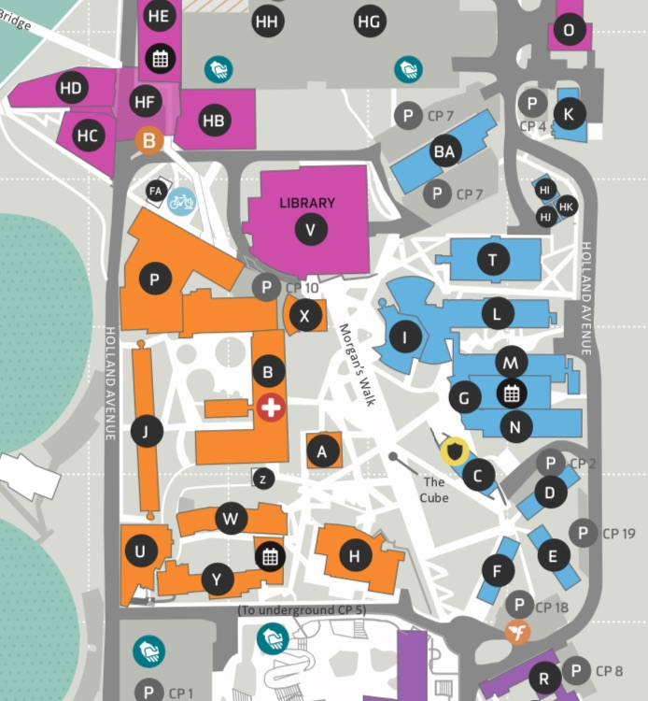


Automated Student Service Responsiveness
360-Degree Digital Assistants
Portfolio of Smart Apps Leads Students Where They Want to Go
Sample Student-Centric Features
I see you’re near the library, do you want to return your book? It’s due in 2 days.
Genie, Deakin University’s virtual assistant, interfaces with Scout, a personalized smart campus navigation and wayfinding app
Genie uses Scout GeoSensor networks and students’ personal information to provide location-based support
Looking for a quiet place to study? Why don’t you try Building A on the second floor.
Genie by the Numbers
12K daily conversations facilitated by Genie
Corner Café has $1 coffee today only!
Deakin.edu/au
25K unique student users and app downloads in first five years
Source: “Deakin Scout,” YouTube video, Deakin University, July 15, 2019; Digital Deakin, Deakin University; Matt Johnson, “Deakin’s Genie Assistant Tackles 12,000 Conversations a Day,” IT News, September 9, 2019; Deakin University, Victoria, Australia; EAB interviews and analysis.
Notes:
Teaching Point: Proactive campus redesign can put student needs at the center.
Note: Depending on your presentation time limit, this slide is optional. Feel free to select 2-3 snapshots from slides 13-17 to share in your meeting and delete the others.
Draft Scripting:
This related example helps give a sense of how far AI bots can go down the path of true transformation
At Deakin University (in Australia), the institution’s leaders have, since 2012, been working on a plan to incorporate technology into their campus experience, and to promote the institution as a leader in digital innovation. Across five areas of their Digital Plan, they’ve been making investments to promote Mobility, Flexibility, Personalization, Collaboration, and Information at the institution.
While they’re doing lots of exciting things to advance this agenda – including investing heavily in their technology architecture – let’s focus on just one of the solutions they’ve put together, and the outcomes they’ve seen.
By stepping forward as an early partner with Watson, IBM’s AI technology, they’ve managed to bring together an application they’re calling “Deakin Genie”, which is a voice- and text-activated, smart assistant that’s personalized to each of their students. It integrates academic calendars and LMS content with campus services and predictive analytics to provide direct, personalized support to every student that uses the app. Students can ask when their assignments are due, where to find a particular library book, or how to find someone to talk to about their projects, all in one Gen-Z-friendly interface.
Deakin Scout folds location services into the Genie app, using geosensor networks and students’ personal information to pre-emptively offer location-based services and support to students
So if you were a student that was strolling through the Deakin campus and it detected you were walking past the library it would say, "Hey, I see you're near the library, do you want to return your book? It's due in two days." If you walked a little bit further down, "Hey, looking for a quiet place to study? Try building A.“

Slide 16





‘Taking the Robot Out of the Human’
RPA Task Migration
RPA (Robotic Process Automation) in Brief
Sample RPA Applications
Method of training artificial intelligence or software “bots” to mimic human behavior, allowing them to perform high-volume, repeatable tasks
Reconcile employee IDs across multiple HR systems
Automate the upload of student documents
Pinpoint expired employee credit card accounts
Reconcile student coursework with graduation requirements
Automate processes for booking rooms for meetings, events, etc.
Process purchase-orders invoices
Create tagged records in student portals for communication from student services
Tasks Suitable for
RPA Implementation
High-volume
manual processes
Repetitive tasks
Tasks with multiple steps
Tasks requiring multiple digital interfaces
Select Institutions Using RPA
Source: B Duncan & K Lundy, “Robotic process automation (RPA) for colleges and universities,” Ernst & Young, December 11, 2019; N Jackson, “Robots Welcome,” Business Officer, December 2019; Carnegie Mellon University, Pittsburgh, PA; New York University, New York, NY; Rutgers University, New Brunswick, NJ; University of Melbourne, Melbourne, AU; University of Sydney, Sydney, AU; University of Texas System, Austin, TX; EAB interviews and analysis.
Notes:
Teaching point: Robotic Process Automation frees staff time for more data analysis, and other complex tasks that were previously ignored because of the manual, repeated processes staff needed to complete each day
Note: Depending on your presentation time limit, this slide is optional. Feel free to select 2-3 snapshots from slides 13-16 to share in your meeting and delete the others.
Draft Scripting:
Robotic Process Automation, or RPA, are software bots trained to mimic human behavior that can perform high-volume repeatable tasks
Specifically, on the left you can see the characteristics of processes that are prime for RPA implementation; in short: high volume, multi-step, repetitive processes
Specific to higher education, RPA can automate the upload of student documents, automate processes for booking rooms for meetings or conferences, and process purchase orders
In a nutshell, RPA can perform steps in processes that make “humans feel like robots.” Things like account reconciliation, transferring data across systems, tagging records
The University of Melbourne, a clear leader in RPA use, has seen repeated successes with their automation journey
From enrollment, to IT, and contract management, Melbourne has automated 22 processes across 5 functions, saving 10k hours of labor annually
RPA allows Melbourne to free up staff time for more data analysis, and other complex tasks that were previously ignored because of the manual, repeated processes staff needed to complete each day
Looking forward, Melbourne is creating an RPA Champions program, to manage and oversee the scaling and integration of RPA technology across campus
The program will train internal staff to identify opportunities to leverage RPA within their functions
In this way, Melbourne will be able to avoid expensive external hire, and encourage ground-up opportunities for RPA

Slide 17
Add Your Own Example of DX on Your Campus Here
DELETE AND PLACE
GRAPHIC HERE
Box Style 2 Title
Describe your campus DX project here, to add more context to the image/graphic you’ve chose on the left.
XXX
Add a statistic to show the impact of your project (e.g., $ saved, % campus impacted), and describe the stat here
XXX
Add a statistic to show the impact of your project (e.g., $ saved, % campus impacted), and describe the stat here
Notes:
Editable opportunity: Following in the style of the previous snapshots of interesting DX projects on other campuses, add in your own story of DX success on your campus. This is a great opportunity to show campus stakeholders the DX is accessible – and that it’s already underway right here, on campus.

Slide 18
1
Higher Education’s Change Imperative
2
Digital Transformation: A Process of Constant Innovation
3
Opportunities for Higher Education
4
Determining Our Path Forward
Notes:
Suggested Scripting: There are many other examples of projects large and small out there, and you may have heard of some that have piqued your interest, but now that we’ve seen what some other institutions are doing to acknowledge and embrace the possibilities of digital transformation, let’s close out by thinking specifically about our campus, and the path that we have ahead of us.

Slide 19

Tech is a Fraction of Digital Success
Why Isn’t This Just an IT Problem?
People and Culture Will Dictate Direction and Magnitude of Change
1x
AI
Leaders and Decision-Makers Must Take Center Stage
Impact of Technology Change
Cloud
Big Data
and Analytics
Internet of Things
Mobile
Blockchain
Change siloed mindsets and culture
Overcome aversion to risk and failure
Encourage iterative, collaborative work
Focus on “customer” journeys and experience
Develop shared digital ambitions and goals
Seek out IT partnership for solution building
Increase speed of campus decision-making
Competencies, Culture and Mindsets
Institutional Strategy
Work Habits and
Processes
15x
Decision-Making Speed and Governance
Impact of
Enterprise Change
Leadership and
Change Management
Experience
Awareness
IT Partnership
and Operations
Incentives,
Prioritization
and Funding Model
Compliance
and Risk Management
Source: CEB Analysts, Gartner, 2018; EAB interviews and analysis.
Notes:
Teaching Point: People and business engagement are the biggest contributor to successful digital transformation.
Draft Scripting:
Despite the importance of technology in these endeavors, this is not solely an IT problem - and no transformational solution moving forward will be a purely IT effort. Digital transformation is ultimately about changing the institution and the way that value is delivered to the people who matter on our campus. Technologies might be enablers of change, seen here as the tip of the iceberg. They provide us with the capacity to do things we haven’t done before. Yet ensuring that those capabilities are applied to the right problems, and adopted by the right individuals will take the work of everybody in this room – as well as others around the institution. That’s a campus wide initiative, not an IT project.
By thinking about the challenges we might face as a campus in this way, we can see how shared, cross-functional initiatives are the best and most promising way forward for us.

Slide 20

Embed Digital Awareness in Campus Strategies
What Should We Do to Move Forward?
“Digital Strategy” = Effective Forcing Function for Cohesive Problem Solving
How do we create buzz at the recruitment fair?
How can we address inefficiencies?
Foundational Questions for Embedding Digital Perspectives in Campus Strategy Conversations
Enrollment Management
CBO
Provost
How do emerging technologies impact our strategic goals and objectives?
What are the core values and differentiators of our institution?
Where do organizational silos hinder the creation of new solutions?
How can we improve IT’s capacity to support ongoing digital projects?
Where are we already innovating successfully, and can it work at scale?
Campus Executives Meeting: Digital Strategy
How do we incentivize instructors to experiment with pedagogy?
CIO
VP
Student Affairs
How can we support innovation across campus?
How do we put student needs at the center of
what we do?
Source: EAB interviews and analysis.
Notes:
Teaching Point: Thinking about “digital strategy” creates a shared problem-solving language and agenda for progress
Draft Scripting:
And the path forward, then, is one that embeds digital awareness in all of our campus strategies. Whether that’s the Provost trying to figure out how best to reach our off-campus learners, heads of Enrollment hoping to create a buzz at recruitment fairs, or the VP of Research looking to secure greater grant funding through improved high-performance computing architecture.
As we think through our strategic priorities and the path to meeting our goals, we must be open to the opportunities that technology advancements present us with as we solve for any issues that stand in our way.
There are five foundational questions we should be asking ourselves as we pursue enterprise-level digital transformation. These key questions correspond to a checklist of items we should pursue:
Provide Clarity Around Institutional Goals: Create a shared definition and vocabulary for digital transformation; rally campus around common objectives
Formalize a Problem Identification Process: Solicit input to identify cross-campus problems that could be solved through digital transformation
Promote Digital Ownership Beyond IT: Create clarity around investment decisions, resource allocation, and project responsibility
Build a Portfolio View of Initiatives: Uncover digital projects, reconcile overlaps and conflicts, and advocate for a coherent enterprise architecture
Normalize an Ethic of Assessment: Measure digital project returns and focus on accountability through sunsetting and scaling innovations appropriately
The real value, here, comes not from carefully documenting the projects or goals that we have moving forward. Rather, the real value lies in the perspective that it brings to existing planning processes. Emphasizing a “Digital Strategy” in our core planning serves as a forcing function for those who understand the university, its aims, and its difficulties most acutely. It ensures that we all are considering the role that technology plays in the situation at hand today, and are thinking in a way that’s open to the role that it could play in accomplishing our goals tomorrow.

Slide 21



Find Opportunities: Transformation Varies In Scope
How Should We Identify Opportunities on Our Campus?
Digital Change Determined by Size, Nature of Problems Identified
Spectrum of Opportunity
One-On-One Conversations
Dedicate staff to find problems on campus with a common solution. This can be as small as AWS buttons
Student Journey Mapping
Document student touchpoints with the institution to determine barriers in their journeys
Campus-Wide Digital Strategy
Create a strategic approach
to digital transformation that includes a shared vision and plan for the institution
Local, Departmental Change
Institution-Wide Change
Coordination Key at any Scale
Strategy
Further the central mission of the institution through digital projects
Investments
Regulate spending to minimize duplication, redundancies
Sequencing
Prioritize early projects that serve as building blocks for innovation
Source: EAB interviews and analysis.
Notes:
Teaching Point: A campus’s opportunity for digital transformation is bounded by the willingness to search for and identify problems
Draft Scripting:
With each area of the organization committed to aligning digital investments to our core value propositions, the final hurdle remains the surfacing of ideas and defining of projects to accelerate our transformation.
When it comes to finding appropriate areas of focus, there are a number of strategies to be employed. Some institutions invest in a comprehensive, campus-wide digital plan, while others begin with more focused initiatives like student journey mapping, or department-level strategies and agendas. For leaders, it’s important to speak with those doing the work, and those accessing the services that we provide to get a truer understanding of the issues faced by the institution.
Whether the direction is top down, or bottom up, transformation efforts can be made to fit different budgets and time investments. Where to start – with frontline employees and students, or campus leaders and decision-makers – is a decision for every campus.
And no matter what level we start at, co-ordination across the institution will be key to our success. Our general approach to digital strategy, our investments, and our project sequencing all need to be coherent to give ourselves the best possible chance of success in our efforts to change and innovate in the way we go about our business.

Slide 22







Campus and IT Play Key Roles in Success
What Can We Do to Support Digital Transformation?
Productive Projects Require Campus Leader and IT Expertise
Campus Leaders
IT Organization
Executive Sponsorship for Digital Ambitions
Integrated Digital Platforms
Process and Customer Journey Mapping
Future-Oriented IT Skills
Portfolio-Minded Project Prioritization
Trend and Opportunity Sensing
Digital Literacy and Engagement Campaigns
Roadmap to Support and Scale Innovation
Source: EAB interviews and analysis.
Notes:
Teaching Point: IT brings tech expertise to the table, but campus must bring problems and context
Draft Scripting:
Both organizational alignment and IT expertise are needed to fully support a digital agenda.
Senior leaders play an important role in working across campus to establish a shared understanding and identify problems (and opportunities) requiring digital solutions.
IT units must be able to respond thoughtfully and partner effectively with different areas of the institution to design, implement, and monitor innovation initiatives.
The eight capabilities on this slide—four that must be carried out at an organizational level under the purview of the senior management team, and four that are the responsibility of the IT division—are critical for success.
We’ll flesh these out in just a second, with a group activity.

Slide 23
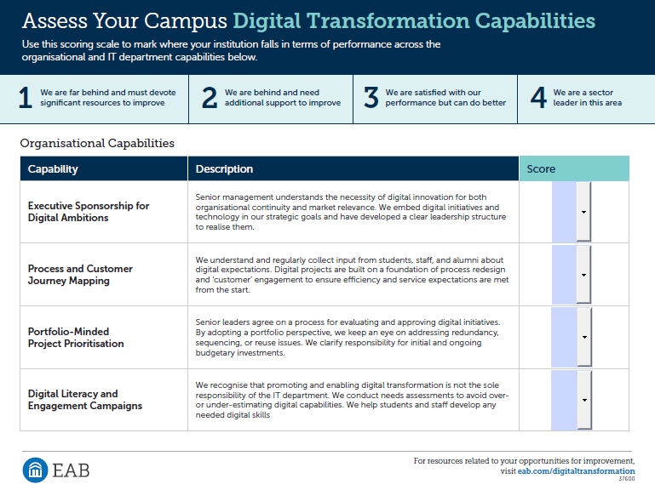
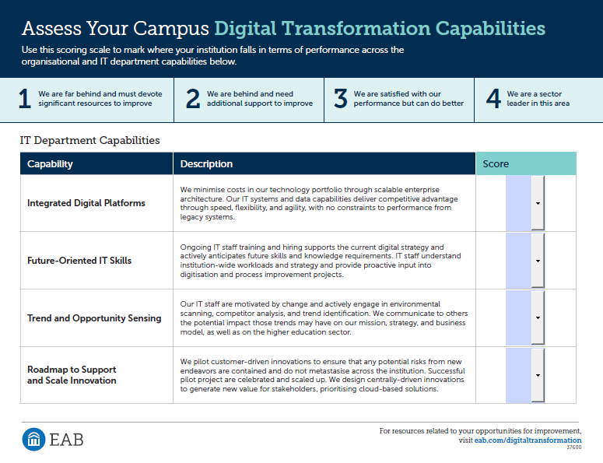
Digital Transformation Capabilities Assessment
Notes:
Group Activity:
Use this opportunity to handout a copy of the worksheet that accompanies this presentation.
The eight capabilities on this worksheet flesh out the ideas from the previous slide, defining what each capability should look like, from both an organizational and IT point of view.
There are a few different ways you can organize this activity:
1) Complete the diagnostic on behalf of your campus before the presentation. Share your diagnostic results with attendees to kick-off prioritization conversations and highlight areas of strength, weakness, and opportunity.
2) Walk through each of the capabilities as a group. Determine ratings for your campus’s level of performance for each statement based on general consensus. Use the results to guide next steps.
3) Give attendees 15 minutes to complete the diagnostic individually. Facilitate a group discussion about the similarities and differences in ratings by each attendee. Make notes of major discrepancies in ratings for follow-up in future meetings.

Slide 24
Next Steps for Our Digital Transformation Agenda
Strategy-Setting and Prioritization
Next campus leadership meeting [MM/DD/YYYY]
Use this space to include a preview of the next campus leadership meeting
Example: Review our strategic priorities and map existing digital projects to each priority area
Campus Unit DX Visioning
Meetings soon to be scheduled with individual units and departments to discuss your DX vision(s)
Use this space to include how unit- or campus- leaders should prepare for these meetings
Example: Identify 3-5 pain points or problems in your unit affecting student/staff experience
Digital Strategy Committee
Updates from campus committees
Use this space to share updates from any existing DX teams and committees
Example: First working draft of the new campus-wide digital strategy now complete
Notes:
Editable Opportunity: Use this slide to signal to campus that the conversation isn’t ‘over’ after this meeting, and that there is more to come over the next several months. The current ‘next steps’ outlined on this slide are illustrative, you should feel free to edit or replace these for the next steps that make the most sense for your campus and the stakeholders in the room.

