Slide 1
Security Incident Response Tabletop Exercises
Mobilizing Crisis Leaders to Respond to Security Incident Emergencies
IT Forum

Slide 2
1
Why Conduct a Tabletop Exercise?
2
Guidelines and Ground Rules: Preparing for a Security Incident Response Tabletop Exercise
3
Incident Response Prompt and Scenarios
4
Discussion: Lessons Learned and “After-Action”

Slide 3
What is a Tabletop Exercise?
Immersive
Provides rich, detailed description of a high-probability incident
Rigorous
Allow leaders to assess coordination, communication, and decision-making capabilities
Tabletop Exercise: Team-based simulation activities that allow leaders to practice staff and resource mobilization in response to a short-term incident
Cross-Functional
Can include a curated group of relevant stakeholders, from the president’s cabinet to divisional leadership teams
Efficient
Requires only a few hours of time and can be completed with existing staff and resources
Notes:
Tabletop exercises are regularly used by public health organizations, municipal governments, and the military to build preparedness for various incident situations. Although implementation may differ somewhat across groups and situations, tabletop exercises generally share these four characteristics, which make them extremely effective.

Slide 4
What is a Security Incident?
Key Cybersecurity Terminology
Security Incident
An event where there is confirmed harm
Not all security incidents rise to the level of security incident
Ex: User received a phishing message, opened the attached file, and installed ransomware
Security Event
An event where there is potential for harm to occur
Ex: User received a phishing message and reported it to the security team
Use of Data Breach Terminology Can Open Institutions Up to Risk
Do not describe a security event or an incident as a data breach. Misuse of the term could expose the institution to additional risk and obligations.
The term data breach¹ has a very specific legal definition and each state is subject to different data breach laws.
NIST defines a data breach as “An incident that involves sensitive, protected, or confidential information being copied, transmitted, viewed, stolen, or used by an individual unauthorized to do so.”
Source: NIST, “Cybersecurity Basics Glossary”, NIST, February 28, 2019; EAB interviews and analysis.
Notes:
Cybersecurity is a business imperative. A security incident and a resulting breach of data is a material event that we have to be ready to respond to and manage as an organization. Our stakeholders expect us to effectively manage a security incident and in many contractual agreements we have attested to performing certain controls that will be covered in this exercise.
More security event vs. incident examples
Event: a malicious third party scanned our external facing website → Incident: a malicious third party scanned our external facing website, found a flaw, and stole non-public data
Event: A malicious attacker attempts to log in as an employee → An attacker was able to successfully log in as an employee

Slide 5
Setting the Table
Accelerating IT’s Response to Future Security Incidents
Why Tabletop Exercises Are Superior to Simply Distributing a Plan
Practice Readiness and Response
Plan for the Unanticipated
Evaluate Existing Protocols
Clarify Capabilities and Responsibilities
Allow teams to rehearse high-stakes decisions in a low-stress setting
Build collective problem-solving skills
Raise novel questions that existing protocol doesn’t address
Allow leaders to compare interpretation of current policy
Identify if policies and plans rely on scarce resources or individual efforts
Assess communication practices
Accelerate decision-making on who “owns” what
Vet if teams and departments can deliver on execution
Notes:
There are four key functions of a successful tabletop exercise:
Explore how a team might react in a low-stress environment now to a high-stakes situation later, building muscle memory and sharpening collective problem-solving skills
They raise novel questions that existing protocols do not address (even where policy partially speaks to an issue, leaders can compare notes to see if they share the same understanding, assumptions, and expectations – often, they do not)
Help leaders determine if existing policies have been well-communicated, are practical or sufficient, or are overly reliant on resources or individuals that may not always be available
Vet if teams and departments really have the readiness and capability to do what will be asked of them and accelerate decision-making about who “owns” what (any coordinated effort will require contributions of staff, resources, or expertise from multiple teams and departments)

Slide 6
Components of Today’s Exercise
Intro & Ground Rules
Incident Response
Post-Incident Debrief
“Hot Wash” Discussion and After-Action
Review the purpose of the exercise
Establish rules of engagement
Recommended time: 5-10 mins
Introduction of the incident
Facilitated response discussion
Recommended time: 30-40 mins
Facilitated discussion of existing protocol
Identification of protocol vulnerabilities
Recommended time: 15-20 mins
Review lessons learned and key takeaways
Document challenges and concrete next steps
Recommended time: 20 mins
Total Recommended Time
90 minutes
Notes:
In the Welcome, Intro and Ground Rules we will:
Discuss the learning objectives for today’s exercise
Assign roles to attendees
Review guidelines for how we will engage with one another during this exercise
In the Incident Response phase:
Facilitator will introduce an incident for discussion.
Participants will discuss while facilitator poses questions to evaluate the response.
In the Existing Protocol Review phase:
Facilitator will pose a new set of questions asking participants to identify weaknesses/strengths in existing policies and opportunities for improvement
Participants will establish 1-3 concrete next steps based on identified vulnerabilities
In the “Hot Wash” Discussion and After-Action Prep:
Facilitator will lead participants to discern lessons learned and takeaways to improve readiness in the event of the incident actually coming to pass.
Finally, an after-action report is completed to document and remedy any challenges that surface during the exercise in an efficient, accountable manner.

Slide 7
1
Why Conduct a Tabletop Exercise?
Guidelines and Ground Rules: Preparing for a Tabletop Exercise
2
3
Incident Response Prompt and Scenarios
4
Discussion: Lessons Learned and “After-Action”

Slide 8
Our Goals for Today
Learning Objectives for the Tabletop Exercise
Existing Protocol Review
Role Call
Vulnerability Analysis
Invoke all protocols in place
Identify when/why we should deviate from those protocols
Highlight key roles that attendees play in incident response
Identify cross-team responsibilities
Uncover vulnerabilities in current protocols
Remedy overreliance on individuals, resources, or systems that may not be available
Suggested Participants
Key IT/security function stakeholders and incident response/emergency management personnel in place
Notes:
You may want to note that our goals are NOT to frustrate, overwhelm, or frighten anyone. None of these scenarios are out of the realm of possibility for any campus.

Slide 9
Attendee Roles
IT, Crisis Response, or Leadership Team
1
2
3
Facilitator
Participants
Observer/Evaluator
Oversee the exercise
Read the incident information, and ask targeted discussion questions throughout
Keep the group on pace
Ensure broad and representative participation
Play themselves (unless otherwise specified)
Respond to the incidents as if they’re actually happening
Take notes on quality of dialogue and decision-making, as well as group dynamics
Share observations during after-action planning
Notes:
Recommended Roles:
Facilitator: EAB Senior Expert, Chief Information Officer, Chief Information Security Officer, President’s Chief of Staff (if they do not have any formal role in incident response/emergency management), a trusted academic leader with widespread credibility, an engaged and knowledgeable trustee, a senior leader drawn from human resources, student affairs, institutional research, or another function that has broad view of the institution
Observer/Evaluator: Experienced staff member familiar with the leadership team, and comfortable providing honest feedback on decision-making, group dynamics, and efficiency

Slide 10
Ground Rules
Tabletop Exercise Rules of Engagement
1
Even though it feels odd, try to behave as though this is really happening.
4
Thinking out loud can sometimes keep others from thinking clearly. Try to take notes and only speak when you’re ready to share, unless the whole group is at a loss and you must all brainstorm together to generate ideas.
2
You’ll inevitably want more information than is provided but work with what you have. Plan for possible contingencies and state your assumptions about what you believe to be true or what you do not know.
5
Remember, a tabletop exercise is a “no-fault zone” where people can ask any question and admit uncertainty – it is a test of our plans, not of our leaders. There are no “hidden agendas” or trick questions in this exercise.
3
You may not use your smartphone to call, text, or research during the activity
6
Any additional rules or questions?
Notes:
Facilitators may establish rules regarding cell phone usage at their discretion (generally not recommended for exercises of 90 minutes or less because of time constraints)

Slide 11
1
Why Conduct a Tabletop Exercise?
2
Guidelines and Ground Rules: Preparing for a Tabletop Exercise
Incident Response Prompt and Scenarios
3
4
Discussion: Lessons Learned and “After-Action”

Slide 12
Responding to a Security Event: Part A
Thursday, October 8 @ 2PM
A security analyst has reported to the CIO that data related to [INSTITUTION] and related credentials appears to have been posted to Twitter.
The CIO has followed up with the security analyst by phone and email, collecting screenshots and URLs from the original social media post.
The President has asked for an update by the end of the day.
Discussion Questions
1
Is this a security incident?
2
Who needs to know about this?
3
What information do you need that you do not have?
4
What are the next steps?

Slide 13
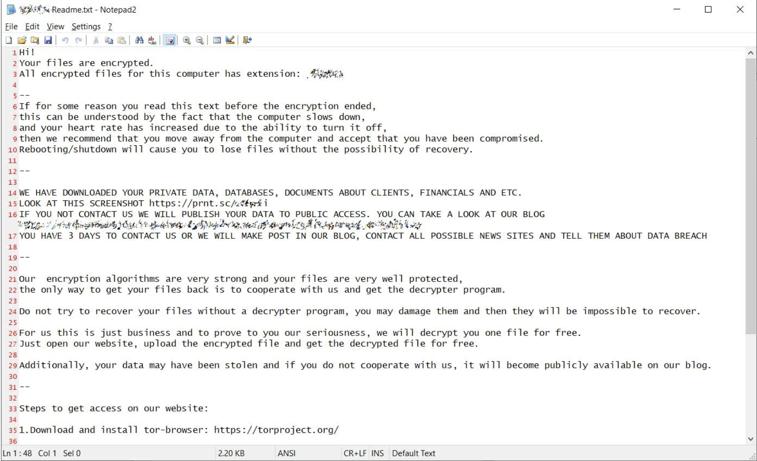
Responding to Security Event: Part B
Thursday, October 8 @ 5PM
Multiple members of the security team have reported computer problems to the Service Desk.
Each ticket is reporting a similar situation: a message has popped up on their computer with a disturbing message.
Discussion Questions
1
Is this a security incident?
2
Who needs to know about this?
3
What information do you need that you do not have?
4
What are the next steps?

Slide 14
Responding to a Security Incident: Part C
Friday, October 9 @ 10AM
Late Thursday night into Friday morning, Information Security has received multiple alerts from its endpoint detection and response system.
Internal documents have been posted online by the same account. Some of these documents include data extracts showing name, DOB, SSN, address, and other information.
Multiple partners have contacted [INSTITUTION] management asking for more details.
There is increased pressure on [INSTITUTION] to make a public statement as The Chronicle and [LOCAL NEWS OUTLET] have asked for comment.
Discussion Questions
1
Who should be notified?
2
What are our next steps?
3
What information do we need that we have not acquired?

Slide 15
Responding to a Security Incident: Part D
Friday, October 9 @ 6PM
Information Security has confirmed the source of the leaked documents to have come from [COLLABORATION TOOL]; an unknown person was able to use a remote access tool to acquire these documents.
The remote access tool and malware has been removed from mailboxes to prevent reinfection.
All infected endpoints are reformatted and files are restored using backups from [DATA RECOVERY SYSTEM].
Discussion Questions
1
What additional clean-up needs to take place?
2
What partner outreach needs to occur and by whom?
3
Do we need a proactive incident communications strategy?
4
How do we prioritize the actions we have to take?

Slide 16
1
Why Conduct a Tabletop Exercise?
2
Guidelines and Ground Rules: Preparing for a Tabletop Exercise
3
Incident Response Prompt and Scenarios
Discussion: Lessons Learned and “After-Action”
4

Slide 17
“Hot Wash” Debrief on Lessons Learned
Four Key Questions to Consider
1
What worked well in this tabletop exercise?
Conducting a “Hot Wash” Debrief
In a “round robin” format, allow every participant to share few minutes of thoughts, asking participants not to repeat one another.
Once every participant has spoken, ask the facilitator and observer to share notes.
Finally, time permitting, begin to identify specific shortcomings worth addressing (next slide).
2
What did we seem to struggle with in this tabletop exercise? What might be our areas for improvement?
3
What were the biggest discrepancies in our expectations or understandings?
4
What other perspectives were missing that should be included going forward?

Slide 18
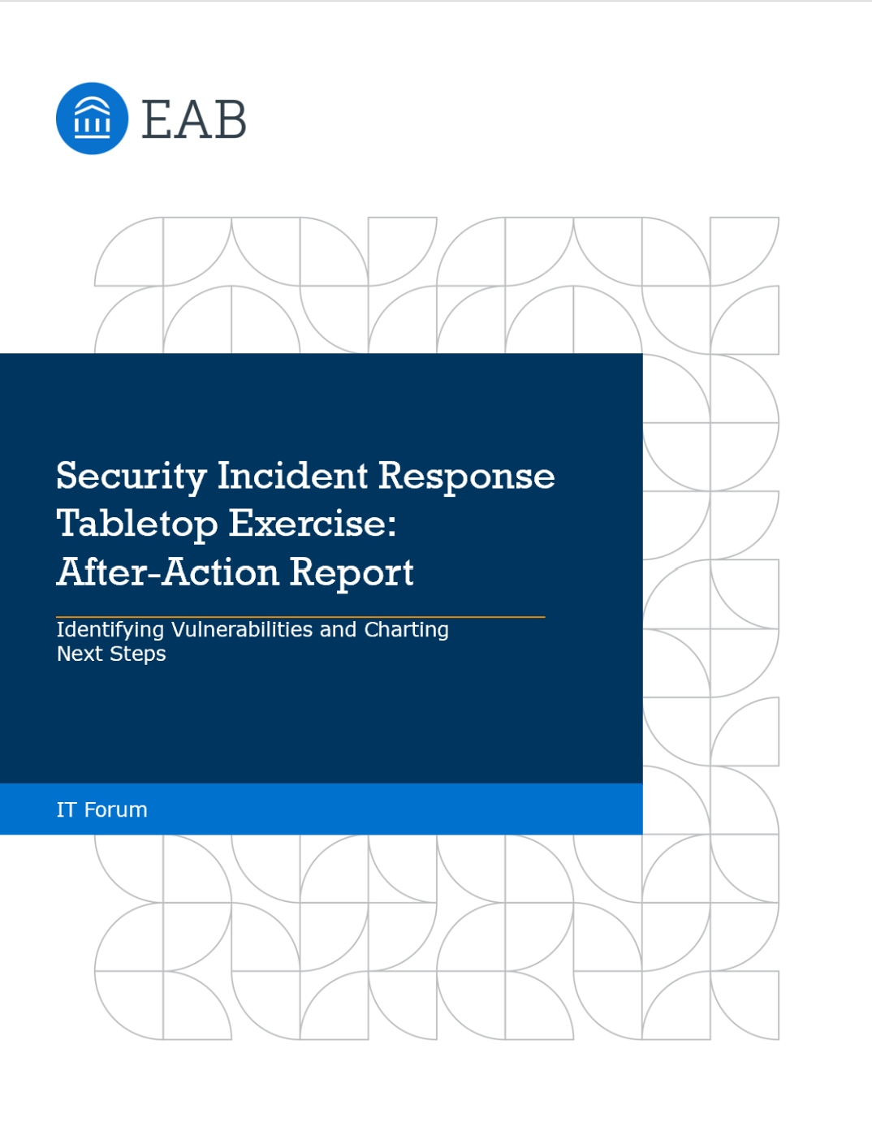
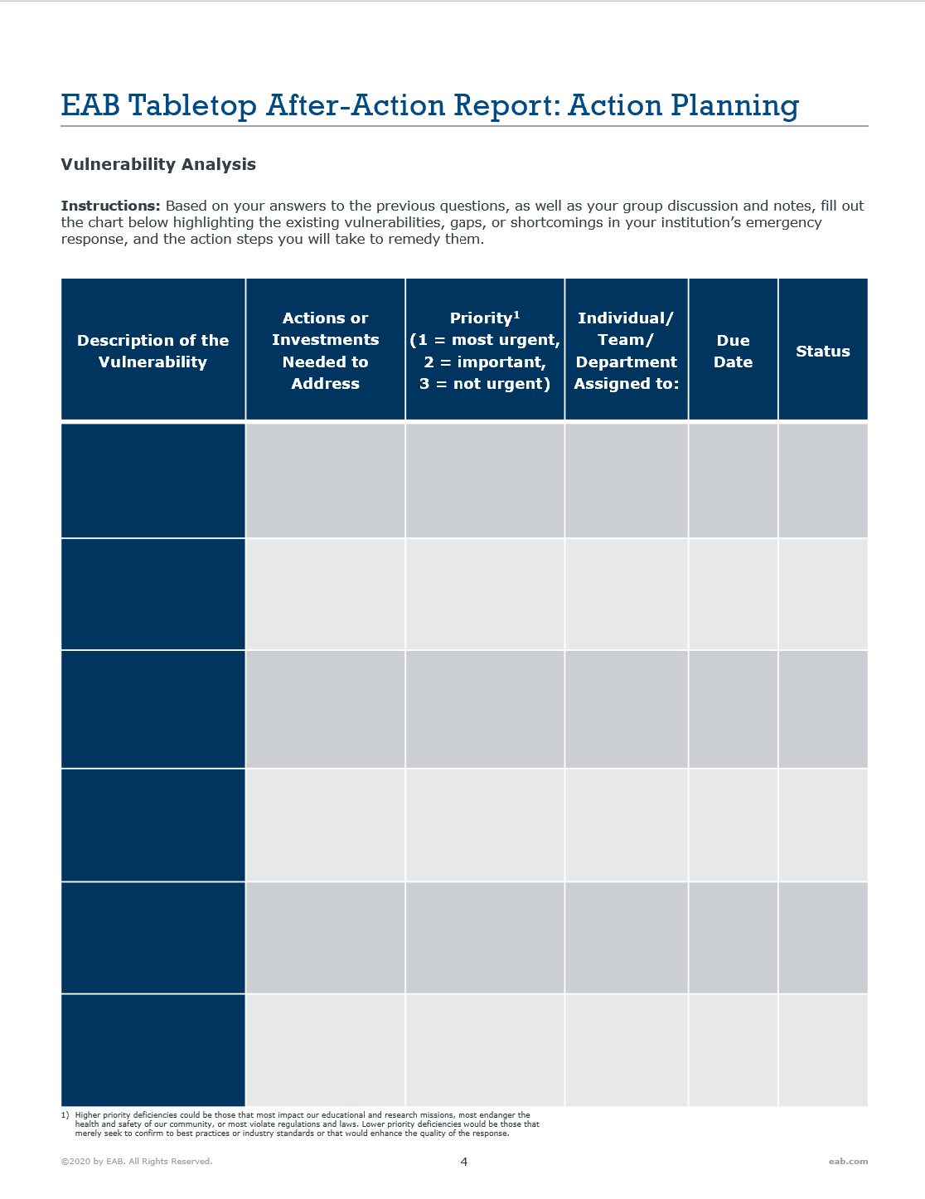
Crafting an After-Action Report
Identifying Concrete Next Steps after the Debrief
Benefits of Creating an After-Action Report
Outline vulnerabilities in existing policies and practices
Highlight areas for improvement
Articulate concrete next steps, and track progress as a team
Access the After-Action Report Template Here
For priority, use 3=most urgent, 2=important and time-sensitive, and 1=relevant and would be helpful, but not urgent. Higher priority deficiencies could be those that most impact our educational and research missions, most endanger the health and safety of our community, or most violate regulations and laws. Lower priority deficiencies would be those that merely seek to confirm to best practices or industry standards or that would enhance the quality of the response.
Notes:
Sometimes, a debrief conversation is sufficient to identify clear takeaways and next steps. But universities seeking to make the most of a tabletop will task their chief information office, chief information security officer, senior infosec leader, or another team member to prepare a formal after-action report with clear next steps and then demand updates over time on the schedule of proposed corrective actions.

