Slide 1
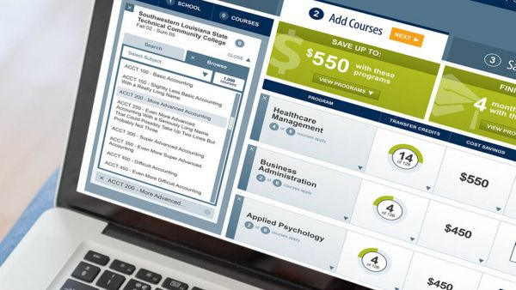
Customize header with your logo and 2-year partner logo – or preferred header.
Customize title and photo with picture of your Transfer Admissions website, or other transfer themed stock photo
Transfer Portal Advisor Resource
Insert quote showcasing value of transfer students by President, Vice President of Enrollment Management, or Director of Admissions
“Transfer students are a vital and large portion of our student community at Wichita State. Providing them a more fluid process to onboard into Shocker Nation will not only facilitate their academic endeavors, but help them plug into student life, internships and more.”
Bobby Gandu, Director of Admissions
Intuitive Transfer Gateway Answers Key Transfer Questions in Real Time
Every year, more than a 1000 students transfer to Wichita State University.
These students are a vital part of the campus community, enriching the student body while creating their own unique Shocker experience.
The transfer process, however, is not always easy.
WSU’s Transfer Gateway is a new technology designed to engage students early, keep them on track to enroll, and answer their key transfer questions in the search process:
How will credits transfer?
How long will it take to graduate?
How much will it cost?
The Gateway will enable better support for transfer students and help us more closely align with you, our two-year transfer partner!
Update with compelling transfer data and value proposition
WSU’s Transfer Gateway: Student-Facing Web Tool To Support Students Through Enrollment
Search
Application
Enrollment
Is transferring worth it?
How will my credits transfer?
What do I need to do to apply?
Major and Career Exploration
Compare majors and associated career paths, including salary and job demand
Self-Service Credit Estimation
Check how prior coursework will transfer and view progress across programs
Checklist to Enrollment
View a customized list of key events and deadlines to stay on track for application, deposit and enrollment
Update footer with your brand/color scheme
Access the Transfer Gateway online: witchita.transfer.degree

Slide 2
Customize header with your logo and 2-year partner logo – or preferred header.
Customize header value but target portal benefit to transfer process that would resonate with 2-year partners
Customize photo with your students
Portal Makes The Transfer Process Seamless
Portal Helps Students Stay On Track For Transfer To WSU, Saving Time and Money
Portal Helps 2-Year Advisors Better Support Students Seeking Transfer To WSU
Benefits for Students:
Major and Career Exploration Students compare majors and associated career paths to determine best fit
Self-service Credit Estimation Students enter prior coursework and receive unofficial credit and progress-to-degree estimates across programs
Checklist to Enrollment Students receive a customized checklist of key events and deadlines to stay on track to apply and enroll
Benefits for 2-Year Advisors:
Easy Access To Credit Estimates Show students how their credit will transfer without needing to keep track of course equivalencies
Stronger Programmatic Alignment The Portal helps ensure that course equivalencies are up-to-date, allowing us to identify and proactively close gaps
WSU Commitment To Transfer An admissions-facing dashboard provides visibility into transfer roadblocks and enables deeper support for transfer students
Update with other value propositions for advisors
Update with top 4 key questions
Key Student Questions:
How do I access the Transfer Gateway? The Transfer Gateway can be accessed from witchita.transfer.degree or from the transfer admissions page on the WSU website.
If I use the Portal, do I still need to send transcripts? Yes, the Portal provides an unofficial estimation of credit. Official transcripts are required as part of the application process and to determine final evaluations.
Can my 2-year advisor help me with the Portal? Sure! WSU has a transfer partnership with your 2-year College. Advisors have been trained on the Portal and can offer assistance.
How do I contact at WSU if I have questions on the Portal results? Neal Hoelting is your primary point of contact. He can be reached at Neal.Hoelting@wichita.edu.
Update footer with your brand/color scheme
Access the Transfer Gateway online: witchita.transfer.degree

