Slide 1
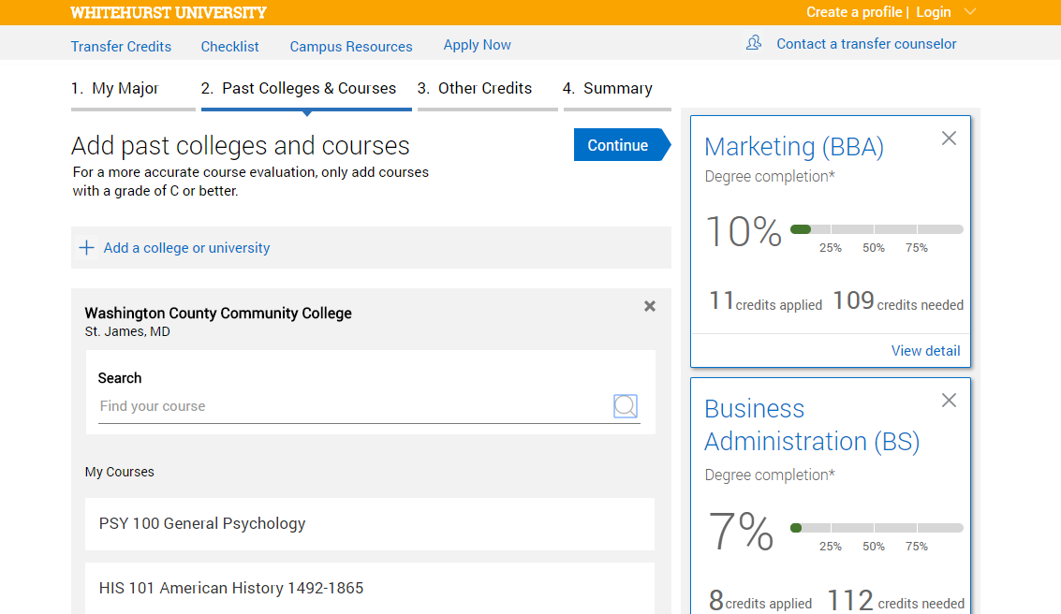
Update resource with institutional colors, logo, brand
Introducing the WSU Transfer Gateway
Technology to Improve the Transfer Student Enrollment Process
Customize tagline and summary paragraph to reflect institutional goals/objective of Transfer Portal
WSU’s student-facing, web-based technology integrates with institutional course equivalency and degree audit data to provide an unofficial credit estimation and seamless transfer process. By prompting transfer prospects to save their information, our Admissions team can provide early and intentional outreach to support the student’s journey into WSU.
Major and Career Exploration
Real-time Credit Estimation
Checklist of Deadlines and Events to Enrollment
Monitor Usage, Track Pipeline, Enable Proactive Outreach
Student-facing
End-to-end Prospect Support
WSU Admissions
Search
Application
Enrollment
Support
Is transferring worth it?
How will my credits transfer?
What do I need to do to apply?
How can I maximize my resources?
Major and Career Exploration
Compare majors and associated career paths, including salary and job demand
Pre-Application Self-Service Credit Estimation
Check how prior coursework will transfer and view progress to various degrees prior to applying
Checklist to Enrollment
View key events and deadlines to stay on track based on transitional needs of transfers
Admissions Dashboard
Monitor usage and track prospects in pipeline to ensure targeted outreach
Update with interesting transfer enrollment and retention data that is available. Other ideas include: top transfer in academic programs, average # of transfer credit, top transfer feeder institutions, # of transfer feeder institutions, Fall/Spring enrollment
WSU Transfer by the Numbers
XXX+
XXX
XXX
XXX
Number of currently enrolled transfer students
Percentage of total enrollment that are transfer students
Transfer student graduation rate
Average number of course equivalencies reviewed annually by staff and faculty
Access the Transfer Gateway online: witchita.transfer.degree

