Slide 1
Pathways to Postsecondary Success
How EAB Can Bring Together K-12 and Higher Education
District Leadership Forum

Slide 2
All my focus is on school reopening and learning recovery, plus whatever walks through my door that morning. I really hope someone else has college access figured out.
- District Leadership Forum Partner

Slide 3
Good News. We’re Here to Help.
Objectives for Today’s Session
Update the group on college access and describe why higher education could use your help reaching “non-consumers”
Overview current labor market trends relevant to students pursuing employment after graduation
Share nine resources for district leaders and school counselors to use now to support Postsecondary student success

Slide 4
1
Non-consumers include 8.3M HS graduates between ages 18-24
Reaching the Population of Higher Ed Non-Consumers
70% of this group has expressed interest in or openness to enrollment
Non-consumers are present in every state and district

Slide 5
Higher Ed Turning Its Attention to Non-Consumers
Non-Consumer Market Growing Every Year
Change in K-12 to College Pipeline (2010 to 2020)
Increase in HS Graduation Rate
+7.2%
Pandemic Likely to Increase Nonconsumption
Short-term Disengagement
+2.3M
Increase in absent students grades 8-12
Change from 2010
17%
Of seniors abandoned college plans
Long-term Barriers
25%
Of 3rd graders behind in reading catch up by end of HS
Decrease in College Enrollment Rate
-4.6%
Source: EAB Analysis of American Community Survey Data, McKinsey and Co. (2021), “COVID-19 and education: The lingering effects of unfinished learning”; EAB interviews and analysis.

Slide 6
An Untapped Pool With Great Potential
Sizing the Nonconsumption Opportunity
10.9M
4.2M
3.1M
Undergrads (2- and 4-Yr) 18-24 Years Old
Adult UGs 25+ Years Old
All Grad Students
4-Year
2-Year
8.3M
18-24-year-old Non-Consumers
32%
Of total 18-24-year-olds
Source: EAB Analysis of American Community Survey Data, NCES Digest of Education Statistics, Tables 303.50, 303.70; EAB interviews and analysis.

Slide 7
Nonconsumption Market Often Met With Skepticism
Not Our Students
Uninterested
Hard to Reach
“This is not really a population that our institution is designed to serve”
“From what I’ve seen, these people don’t want to be in college”
“It would be a major investment—in time and resources—to even locate these students”

Slide 8
Non-Consumers Are In Every Community
Nonconsumption Higher than 20% in All States, but Exceeds 40% in Some
Percent of 18-to-24-year-old high school graduates with no college experience, 2020
Nonconsumption more common in areas with lower peer, parent educational attainment
States with more poorly-ranked K-12 schools have larger non-consuming populations
20-25%
25-30%
30-35%
35-40%
40%+
Source: EAB analysis of American Communities Survey data; EAB interviews and analysis.

Slide 9
Non-Consumers Are More Familiar Than You Think
What are Non-Consumers Doing?
What are They Like?
Living at Home
Similar in Income to College Bound Peers
60% Live with parents or grandparents
$77K Median HH Income for Non-Consumers
$86K Median HH income for College Goers
Not Starting Careers
Racially, Ethnically Diverse
Majority Male
16% Black/African American²
27% Hispanic
48% White³
59% Male
1 in 3 Not working¹
59% Male
Most Want to Attend College, but Experience Barriers
Quotes from HS grads choosing not to pursue college, Pennsylvania Senior Exit Survey 2020-2021
“I didn’t want another year of online school. Online school has taken a significant toll on my mental health.”
“The college process was much harder than I thought. I felt like I had no clue what I was doing.”
“My mom isn’t working right now and I’m worried about money”
Excludes those not working due to disability
Non-Hispanic population
Non-Hispanic population
Source: Report, The School District of Philadelphia, Oct. 2021, (link); EAB analysis of American Communities Survey data; EAB interviews and analysis.

Slide 10
Greater Inclination to Enroll than We Assume
“Do You Plan to Enroll in College in the Future?” (18-24-Year-Olds Not in College), 2021
A ‘Hard No’ from a Few
But Most are Open to College
2.5M
38%
5.8M
30%
Plan to Enroll in the Future
Not attending because:
Not Interested
Not attending because:
“College is a waste of money”
“Working full-time”
“I don’t need a degree to get a good job”
32%
“Disruption/uncertainty from the pandemic”
Undecided
“Couldn’t afford it”
“Don’t know what to study”
Online survey conducted by Intelligent.com of 1,250 Americans 18-24 not currently enrolled in higher education, Jan. 2022.
Source: EAB Analysis of American Community Survey Data; Intelligent.com, “1 in 3 Recent HS Grads Skipping College Because It’s a ‘Waste of Money’”, Feb. 1, 2022, (link) ; EAB Interviews and Analysis.

Slide 11
Significant Number “Melting” Before Fall Start
Summer Melt Drives Nearly a Quarter of Nonconsumption
Majority of Non-Consumers are Recent Applicants
21-25%
253K - 310K
61%
Of 8.3M non-consumers
Seniors Accepted, but Not Enrolled Each Year, 10% of First-Time Attendees
Of 18-24-year-olds who had never attended college before said they applied to college in the past year.¹
Applied
Estimated¹ for Pre-Pandemic years
Accepted
Didn’t Enroll
Source: NCES, High School Longitudinal Study of 2009, 2013 Update, (link); WICHE, Knocking at the College Door 10th Edition, 2020 (link); EAB Analysis of Community Population Survey data; IPEDS Fall First-Time Enrollment Figures; EAB Analysis of the 2020 American Community Survey; Intelligent.com, “1 in 3 Recent HS Grads Skipping College Because It’s a ‘Waste of Money’”, Feb. 1, 2022, (link) ; EAB Interviews and Analysis.
Estimated by applying HSLS proportions to estimates of HS graduates and estimates of college enrollment in 2020
ACS Estimates for 2020

Slide 12
How Progressive Institutions Are Closing the Gap
Four Key Steps in Identifying and Enrolling Non-Consumers
Identify Your Competition
Explore labor market data, CBO¹ intel to identify what students are choosing instead of you
Eliminate Legacy Barriers
Deploy targeted support to streamline enrollment and reduce summer melt
1
2
3
4
Locate Your Nonconsumption Population
Invest in data-sharing and K-12 partnerships to size local market
Appeal Directly to Non-Consumers
Craft program portfolio and student experience with these students at the center
Community-Based Organizations

Slide 13
Questions for Discussion
How closely are you monitoring college matriculation among your graduating classes?
Are you engaged in any data-sharing or re-enrollment campaigns with local campuses?
Do your dual or concurrent enrollment programs lead to matriculation?
Would your community agree that college is worth it?

Slide 14
2
46% of middle skill, 31% of high skill occupations subject to “degree reset”
Understanding Labor Market Shifts Impacting Career Success
50% of jobs held by HS diploma holders at risk automation
More than half of Gen-Z aspire to run their own business within 10 years

Slide 15
Value of a Degree Continues to Rise
Economic peak
Degree-holders
99%
of new jobs created require a 2 or 4-year degree
7x
Recession trough
projected growth of jobs for degree holders in the next 10 years
Non-degree holders
TIME
+47%
+72%
+44%
Benefits Beyond the Degree
Likelihood of having health insurance through employment
Likelihood of having a retirement plan through employment
Likelihood of reporting health to be very good or excellent
Sources: Georgetown University Center for Education & the Workforce. America's Divided Recovery: College Haves And Have-nots, 2016; U.S. Bureau of Labor Statistics, Occupations that Need More Education for Entry are Projected to Grow Faster Than Average, 2021; EAB interviews and analysis.

Slide 16
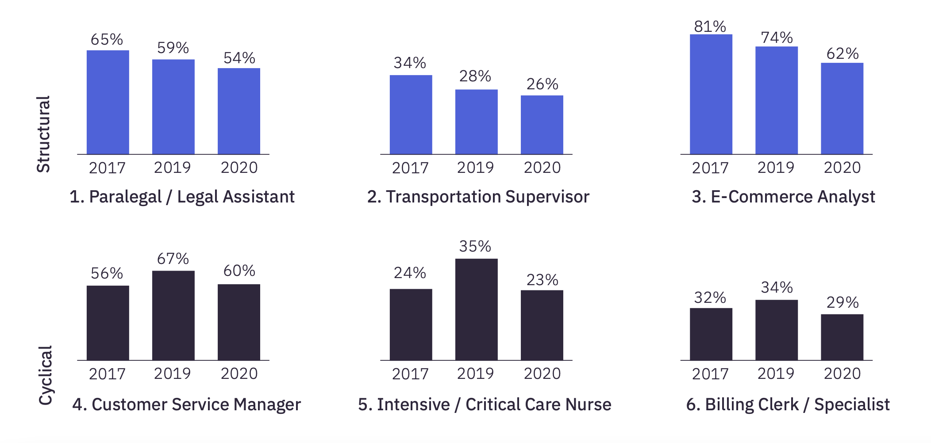
Yet Labor Shortage Creates Enticing Alternatives
Companies Are Expanding the Avenues to Well-Paying Work
Percentage of occupations experiencing material ”degree resets,” 2017-2019
46%
31%
“Mid-skill” occupations
“High-skill” occupations
Not All “Degree Resets” Will Last
% of job listings requiring a BA+, 2017-2020 (EMSI/Burning Glass)
Structural Resets
Clear decline in jobs requiring a degree, based on proven performance of alternative hires.
Cyclical Resets
Degree resets driven by labor shortage. Resilience of shift unlikely or unknown.

Slide 17
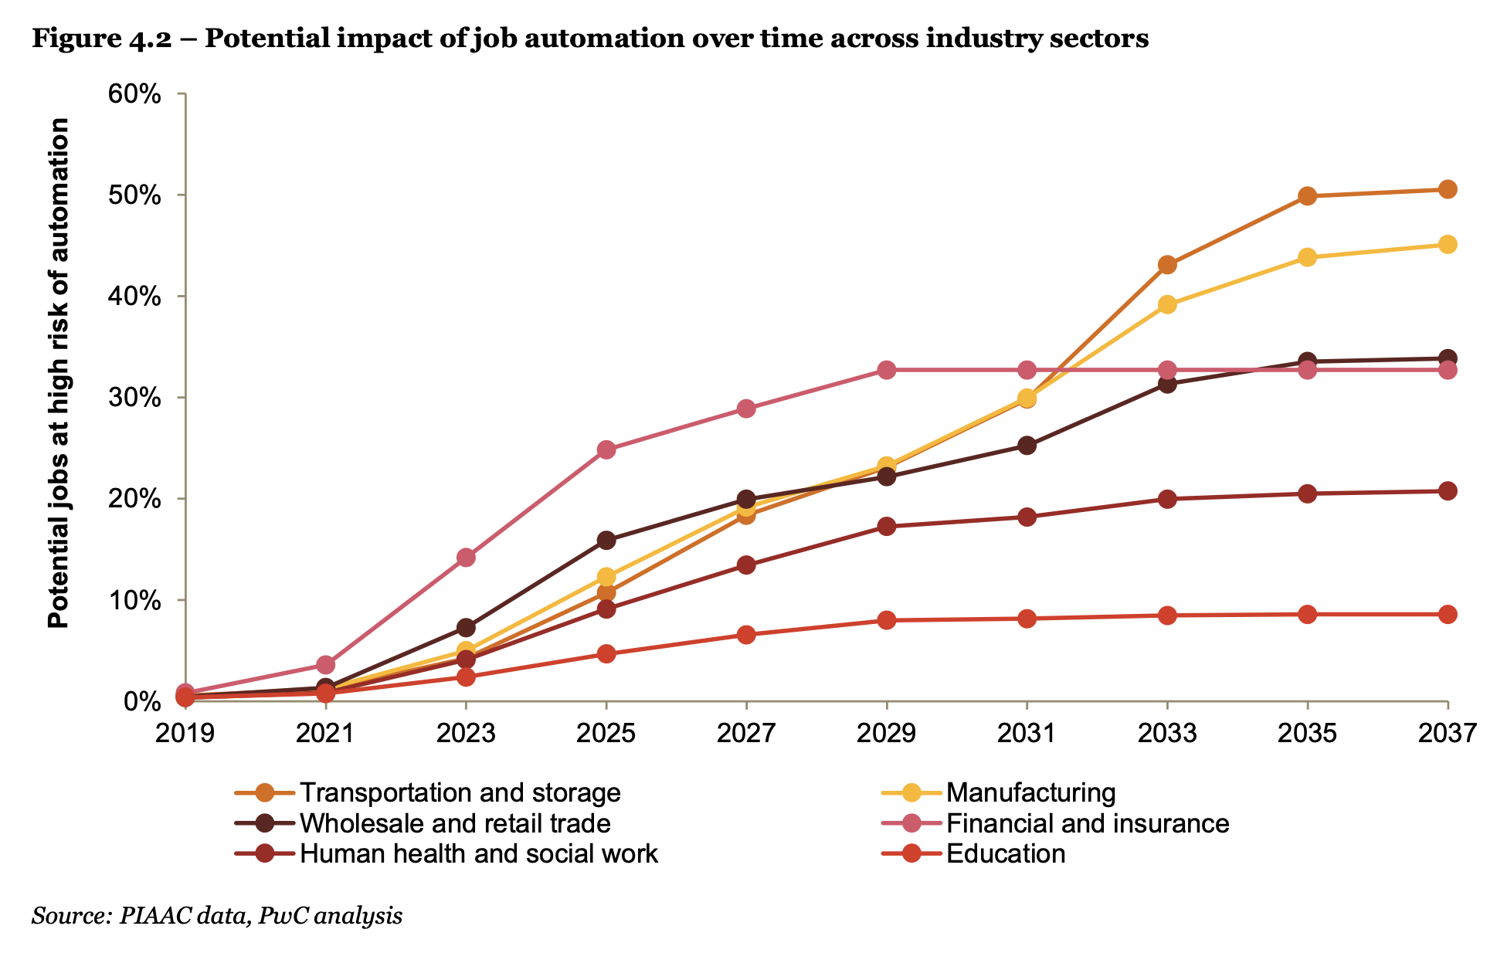
The Era of Automation is Just Beginning
50%
of jobs held by HS diploma holders are at risk of automation
60%
of occupations could have 30% of tasks automated with current technology
Projections for Gen Z Lifetime Employment
18 different jobs
6 different “careers”
15 different residences
Sources:PwC, Will Robots Really Steal Our Jobs?; McKinsey & Co (2019) Four Fundamentals of Workplace Automation; EAB Interviews and Analysis

Slide 18
Employers Constantly Searching for “New” Skills
Alternative Workers More Likely to Possess Current, In-Demand Skills
Timeframe for most recent development of new skills, Traditional vs Alternative workforce (2019, Deloitte LLP)
2027
Gig-economy projected to reach 50% of US workforce
= Traditional Workforce
= Alternative Workforce
%
60%
Of the general population believe that “few people” will have stable long-term employment in the future (PwC)
Sources: Statista (2022), Number of Freelancers in the U.S. 2017-2028; Deloitte LLP (2019) The Gig Economy and GBS Delivery Models; PriceWaterhouseCooper (2020), Workforce of the Future: The Competing Forces Shaping 2030

Slide 19
Gen Z Places a Premium on Entrepreneurship
More than half of Gen Z aspire to run their own business within 10 years (EY, 2020)
20%+
Of working age Gen Z have already started their own business (2017)
“The barrier to entry is drastically lower now. […] In today’s world if anyone—whether they’re in Gen Z or not—wants to start a business they can take all necessary steps independently, and within 24 hours.”
Jonah Stillman
Founder, Gen Guru
Source: EY & JA Worldwide (2021), Gen Z is Poised to Reframe the Future, But Are Business and Education Ready?; Gallup (2017), Forty Percent of 5th-12th Graders Plan to Start a Business; EAB Interviews and Analysis

Slide 20
Essential Questions for District Leaders
Postsecondary Choices
How are we helping students from historically underserved populations to maintain a college-bound identity?
How are we helping students to understand potential career options as they prepare for a turbulent economy?
How are we engaging students in entrepreneurial opportunities to build skill and experience (and joy)?
How are you talking about this issue with:
Students?
Parents?
Teachers?
What are you doing about this issue?
Existing practices
New initiatives
On this issue:
Do we need help from other districts?
Can we provide help to other districts?

Slide 21
3
Postsecondary Success Resource Center
Signature EAB Initiatives Connecting K-12 and Higher Ed
College Greenlight and Greenlight Match
Career Readiness and College Access Toolkits

Slide 22
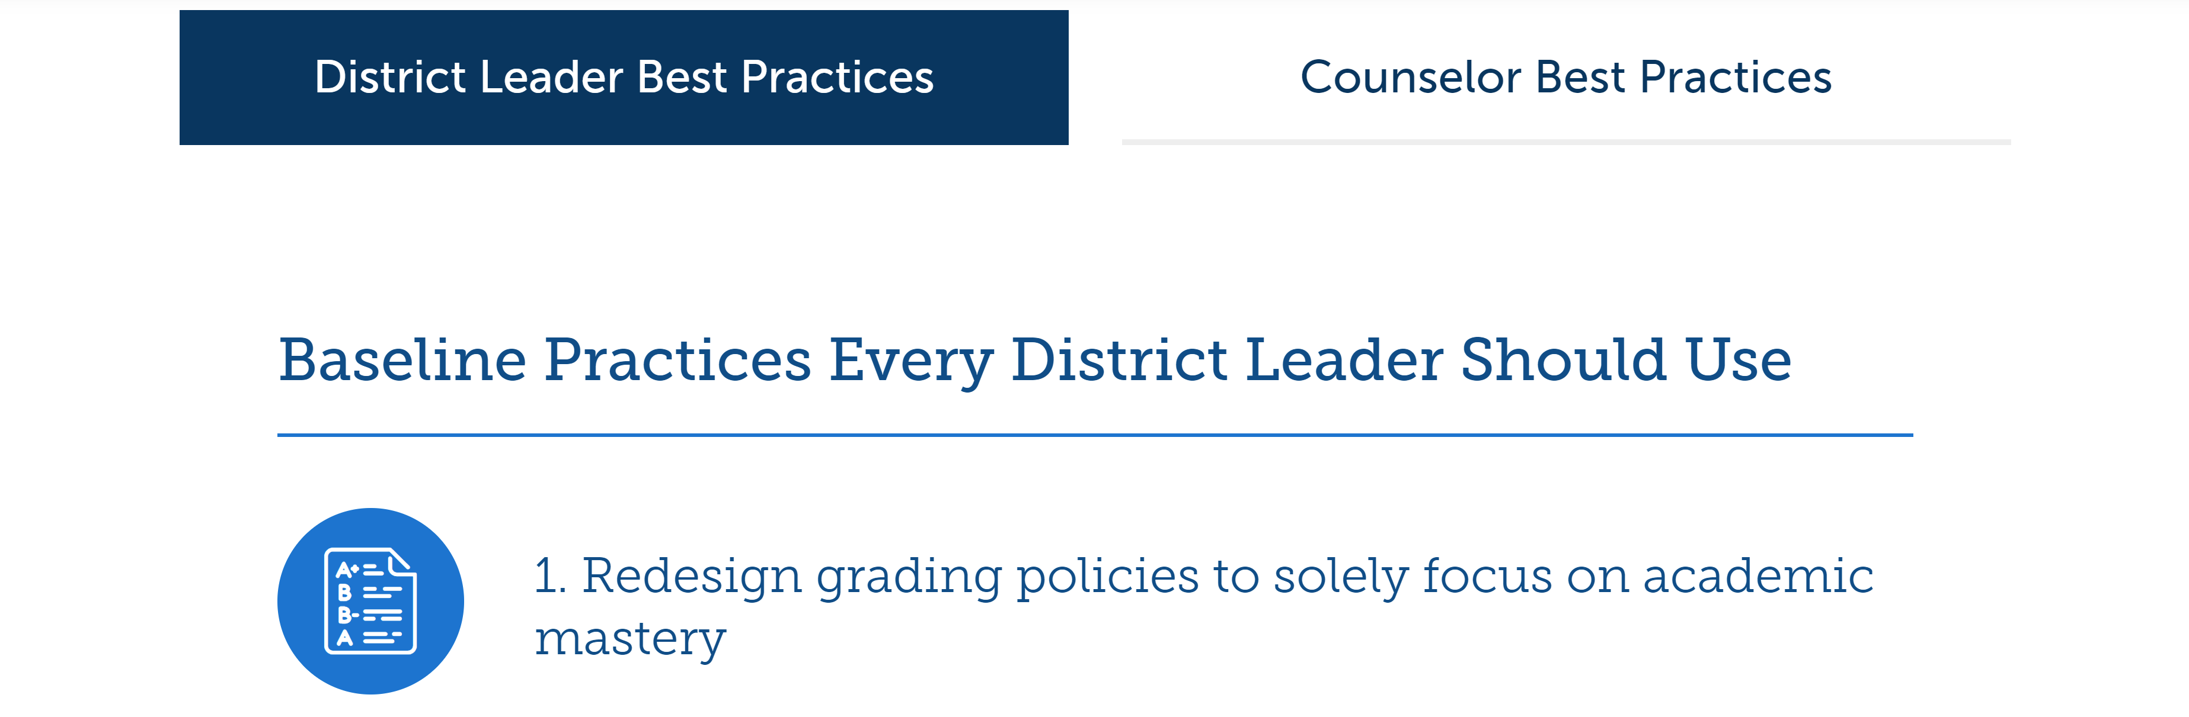
K-12 Postsecondary Success Resource Center
9 ready-to-use resources for District Leaders and College Counselors to support the success of their students

Slide 23
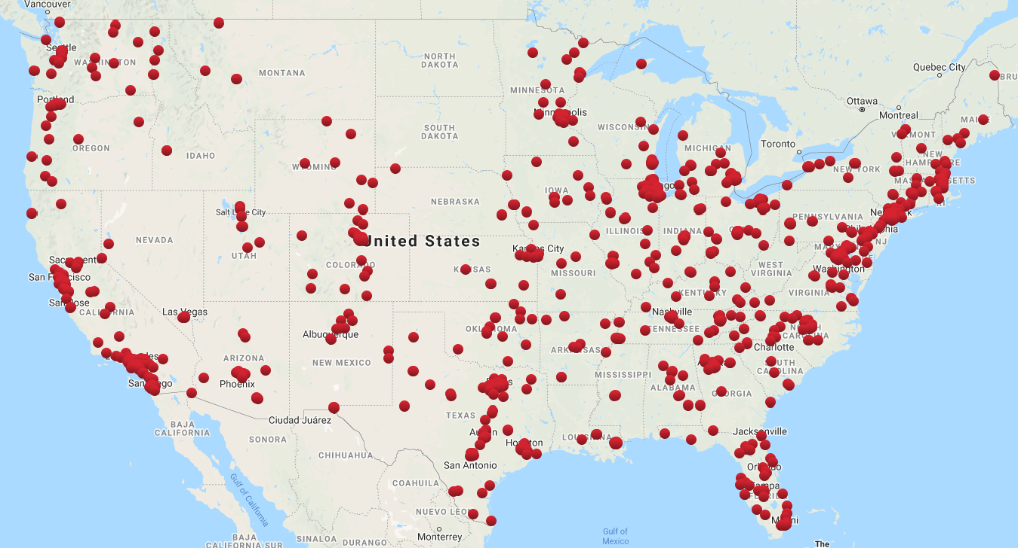
EAB’s Demonstrated Commitment to Access and Equity
Greenlight Match
Leading college admissions advocacy network addressing challenges of college access, undermatching, and affordability
A streamlined, equitable student-college match process that aims to promote access. Results from our pilot launch in Chicagoland this year.
1,500+
400+
750K+
Total Greenlight Schools/CBOs
Partner Institutions
Students served across network
24
Participating CBOs
10
Participating Colleges and Universities
658
Students Nominated On Platform
1,960
Admissions Offers Made By Colleges
$135M
Total Scholarship Dollars Awarded To Students
726
College-Student Matches

Slide 24
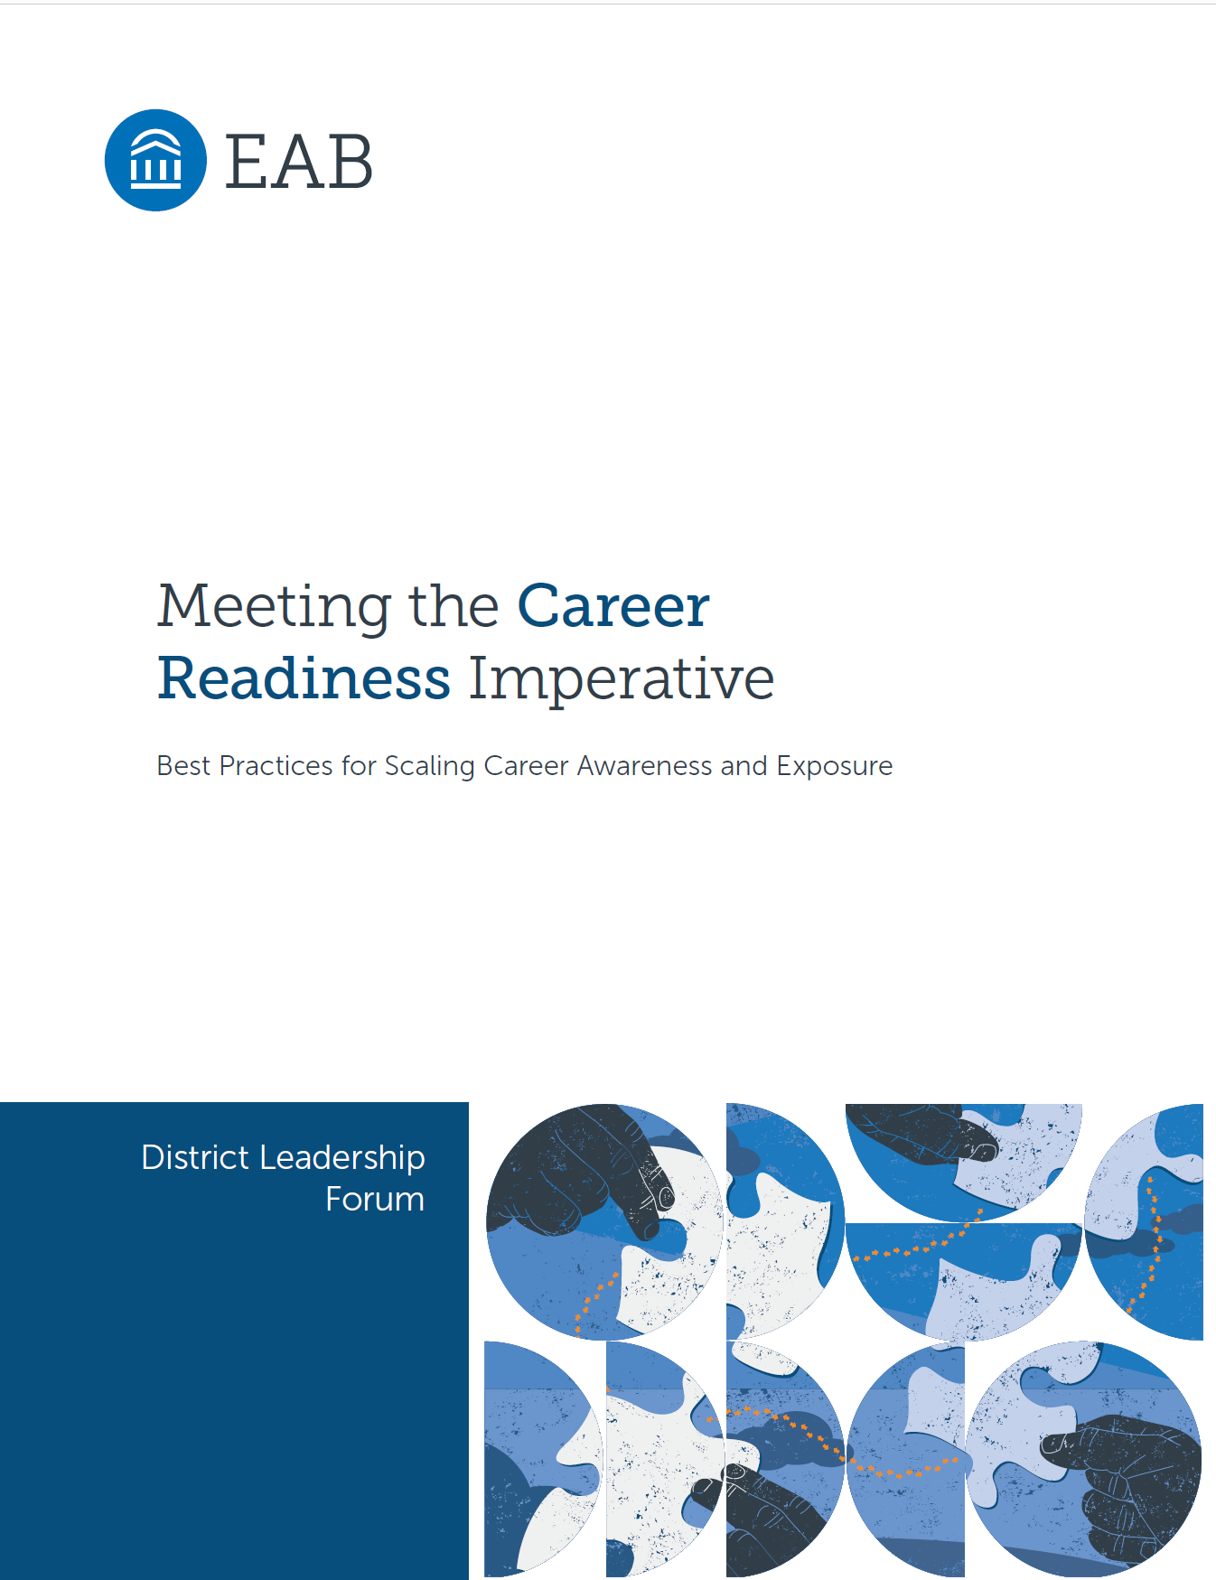
Two Comprehensive Toolkits to Boost Postsecondary Success
16 strategies to help your district…
14 strategies to help your district…
Cultivate early and broad career awareness
Create a culture of high student expectations
Increase access to career experiences
Build student confidence through advanced coursework
Offer personalized and frequent career decision support
Ensure college choice focuses on likelihood of success
Formally aid workplace transitions
Remove barriers to application and matriculation

Slide 25
Final Thoughts
Please take a moment to complete today’s session evaluations. You may leave your completed forms at your seat or hand to any member of our staff.
Thank you for taking the time to give us feedback on your experience today.

Slide 26
Two-Day Agenda
Day 1
1:00pm
Welcome: Building the Conditions for Employees to Thrive
Navigating Divisive Conversations and Preventing District Flashpoints
Pathways to Postsecondary Success: How EAB Can Bring Together
K-12 and Higher Ed
Wrap-Up and Adjournment
Dinner at Teddy & the Bully Bar
1:30pm
4:30pm
5:30pm
6:30pm
Day 2
8:00am
Continental Breakfast
Bringing Lessons Learned Back to Your District
Data and Donuts: Elevating Crucial Conversations from Surprising Insights
Supporting Successful and Sustainable School Leadership
Next Steps and Goodbyes
8:30am
9:00am
10:15am
12:00pm

Slide 27
Join Us This Evening
We’ll meet at 6:30pm at Teddy & the Bully Bar for a reception followed by dinner.
The restaurant is a 15 min walk from the office or 8 min walk from the Marriot Georgetown via M St to 1200 19th St NW.
We’ll have a group leave from the lobby of the hotel at 6:15 if you’d like to walk together.
If your plans have changed and you’d like to join us, please just stop by the registration desk to let us know. We’d love to have you!

