Slide 1


Slide 2
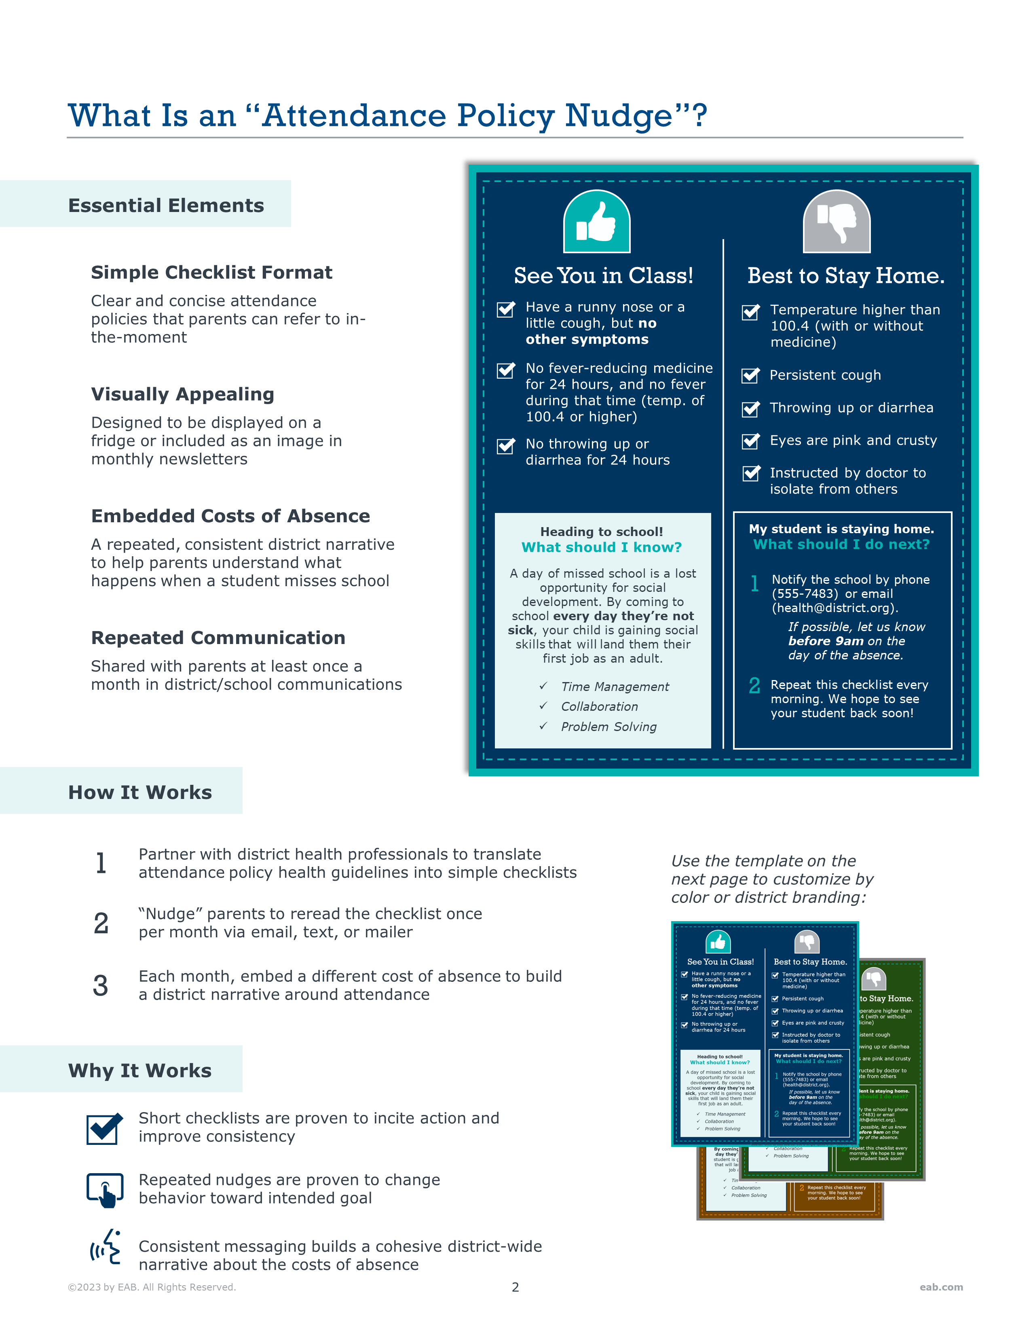

Slide 3
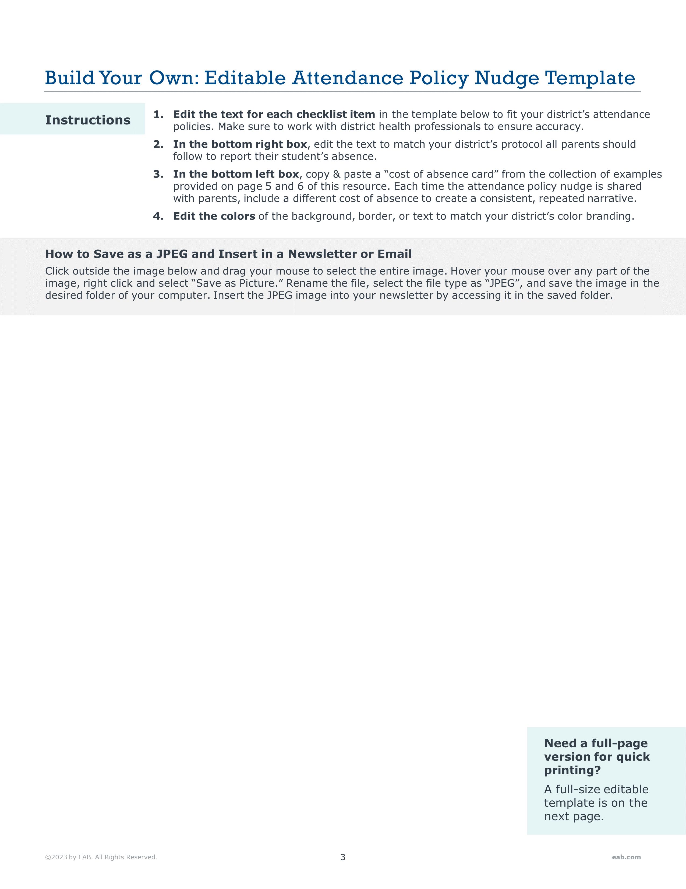



See You in Class!
Best to Stay Home.
Have a runny nose or a little cough, but no other symptoms
Temperature higher than 100.4 (with or without medicine)
No fever-reducing medicine for 24 hours, and no fever during that time (temp. of 100.4 or higher)
Persistent cough
Throwing up or diarrhea
Eyes are pink and crusty
No throwing up or diarrhea for 24 hours
Instructed by doctor to isolate from others
Heading to school!
What should I know?
My student is staying home.
What should I do next?
A day of missed school is a lost opportunity for social development. By coming to school every day they’re not sick, your child is gaining social skills that will land them their first job as an adult.
1
Notify the school by phone (555-7483) or email (health@district.org).
If possible, let us know before 9am on the day of the absence.
Time Management
2
Repeat this checklist every morning. We hope to see your student back soon!
Collaboration
Problem Solving

Slide 4
See You in Class!
Best to Stay Home.
Have a runny nose or a little cough, but no other symptoms
Temperature higher than 100.4 (with or without medicine)
Persistent cough
No fever-reducing medicine for 24 hours, and no fever during that time (temp. of 100.4 or higher)
Throwing up or diarrhea
Eyes are pink and crusty
No throwing up or diarrhea for 24 hours
Instructed by doctor to isolate from others
Heading to school!
What should I know?
My student is staying home.
What should I do next?
A day of missed school is a lost opportunity for social development. By coming to school every day they’re not sick, your child is gaining social skills that will land them their first job as an adult.
1
Notify the school by phone (555-7483) or email (health@district.org).
If possible, let us know before 9am on the day of the absence.
Time Management
2
Repeat this checklist every morning. We hope to see your student back soon!
Collaboration
Problem Solving

Slide 5

Heading to school!
What should I know?
Heading to school!
What should I know?
Heading to school!
What should I know?
A day of missed school is a lost opportunity for social development. By coming to school every day they’re not sick, your child is gaining social skills that will land them their first job as an adult.
Don’t let 2 missed days define your year! Research shows that most students with just 2 absences in the first month of school go on to miss more than 25 days total.
Start the year off strong by making sure students are in school whenever they are not sick.
Hit the ground running this year! Students missing 5 days of school in the first month fall behind in critical reading and math skills for the rest of the year.
Prepare students for a successful year by making sure they are in school when they are not sick.
Time Management
Collaboration
Problem Solving
Heading to school!
What should I know?
Heading to school!
What should I know?
Heading to school!
What should I know?
Children’s mental health is important. Students who miss just 2 days of school a month tend to be more stressed and anxious.
Help lower student stress by encouraging attendance when students are feeling well.
Make the most of classroom opportunities! When students are not in school, they miss opportunities to participate in classroom activities and socialize with their peers.
By attending school each day they are not sick, students are more engaged in learning.
Help your student AND their classmates!
Research shows that one student’s absence negatively impacts the learning of an entire classroom.
Encourage your student to be in class everyday they’re not sick to support the success of all students.
Heading to school!
What should I know?
Heading to school!
What should I know?
Heading to school!
What should I know?
Set your student up for success. Research shows that students missing 10 days by December are more likely to fail at least one class.
Maximize learning time by encouraging attendance when students are not sick.
Thinking about missing another day? Research shows that improving attendance by just 5 days a year leads to higher achievement in:
Research shows that children who miss more school in kindergarten and first grade gain 15% fewer literacy and math skills than their peers.
Students who attend school when they are not sick set a firm foundation for success in the future.
Reading
English
Math

Slide 6

Heading to school!
What should I know?
Heading to school!
What should I know?
Heading to school!
What should I know?
Did you know? Research shows that students missing just 2 days a month in kindergarten are 25% more likely to be held back by 3rd grade.
Help students stay on track by making sure they are in school each day they are not sick.
Consistent attendance builds stronger reading skills! Research shows that students who miss just 2 days of school a month are less likely to read at grade level by the end of 3rd grade.
Make sure your student is in school each day they are not sick.
Research shows as few as 2 absences a month in elementary school can lead to missing 15 days or more a year throughout a child’s education.
By giving your child a routine each morning, you are helping them develop the habit of coming to school every day they are not sick.
Heading to school!
What should I know?
Heading to school!
What should I know?
Heading to school!
What should I know?
Consistent attendance is the best way to prevent high school drop-out. Research shows students who miss 2 or more days a month in high school are 7 times more likely to drop out by senior year.
Going to school each day they’re not sick helps students set positive habits for attendance throughout their school career.
Thinking about staying home?
Research shows that students that miss more than 10 days a year are 20% less likely to graduate on time.
By coming to school each day they aren’t sick, your student is staying on track for graduation.
Attending school every day has impacts beyond elementary, middle, and high school.
Research shows almost 90% of students that miss 15 days a year in high school drop out of college.
Prepare for the future by encouraging consistent attendance every day your student isn’t sick.

Slide 7

Beginning of the Year
Don’t let 2 missed days define your year! Research shows that most students with just 2 absences in the first month of school go on to miss more than 25 days total. Start the year off strong by making sure students are in school whenever they are not sick. (Source).
Hit the ground running this year! Students missing 5 days of school in the first month fall behind in critical reading and math skills for the rest of the year. Prepare students for a successful year by making sure they are in school when they are not sick.(Source) (Source).
Any time of year
A day of missed school is a lost opportunity for social development. By coming to school every day they’re not sick, your child is gaining social skills that will land them their first job as an adult like time management, collaboration, and problem-solving.
Children’s mental health is important. Students who miss just 2 days of school a month tend to be more stressed and anxious. Help lower student stress by encouraging attendance when students are feeling well. (Source).
Make the most of classroom opportunities! When students are not in school, they miss opportunities to participate in classroom activities and socialize with their peers. By attending school each day they are not sick, students are more engaged in learning. (Source).
Help your student AND their classmates! Research shows that one student’s absence negatively impacts the learning of an entire classroom. Encourage your student to be in class everyday they’re not sick to support the success of all students. (Source).
Mid-year
Set your student up for success. Research shows that students missing 10 days by December are more likely to fail at least one class. Maximize learning time by encouraging attendance when students are not sick. (Source).
Thinking about missing another day? Research shows that improving attendance by just 5 days a year leads to higher achievement in reading, English, and math (Source).
Elementary School
Research shows that children who miss more school in kindergarten and first grade gain 15% fewer literacy and math skills than their peers. Students who attend school when they are not sick set a firm foundation for success in the future. (Source).
Did you know? Research shows that students missing just 2 days a month in kindergarten are 25% more likely to be held back by 3rd grade. Help students stay on track by making sure they are in school each day they are not sick. (Source).
Consistent attendance builds stronger reading skills! Research shows that students who miss just 2 days of school a month are less likely to read at grade level by the end of 3rd grade. Make sure your student is in school each day they are not sick. (Source).
Research shows as few as 2 absences a month in elementary school can lead to missing 15 days or more a year throughout a child’s education. By giving your child a routine each morning, you are helping them develop the habit of coming to school every day they are not sick. (Source).
Middle/High School
Consistent attendance is the best way to prevent high school drop-out. Research shows students who miss 2 or more days a month in high school are 7 times more likely to drop out by senior year. Going to school each day they’re not sick helps students set positive habits for attendance throughout their school career. (Source).
Thinking about staying home? Research shows that students that miss more than 10 days a year are 20% less likely to graduate on time. By coming to school each day they aren’t sick, your student is staying on track for graduation. (Source).
Attending school every day has impacts beyond elementary, middle, and high school. Research shows almost 90% of students that miss 15 days a year in high school drop out of college. Prepare for the future by encouraging consistent attendance every day your student isn’t sick. (Source).

