Slide 1
The Case for IT Strategic Planning
What It Is and Why It Matters
IT Forum

Slide 2
A Manifesto for the Future Course of the Institution
Strategic Planning Systematically Shapes a Future Vision
Strategic Planning
The process of systematically setting an institution’s goals, organizing efforts to achieve them, and setting ways to measure results.
Gather Inputs
Set Goals
Identify Actions
Define Progress
Survey internal and external environments to discover factors defining the institution’s opportunities and capabilities.
Articulate a future vision and what must be accomplished to realize it.
Express what actions must be taken to achieve goals.
Decide how to measure progress toward success.
Document in a strategic plan.
Source: EAB interviews and analysis.
Notes:
Strategic planning is a systematic way of making decisions about the institution’s future, and organizing effort to accomplish those decisions. It’s a way of preparing for change. And lately there has been plenty of change to prepare for.

Slide 3
Why IT Strategic Planning?
Disruption Demands a Strategic Re-Think
Institutional Strategic Planning Is Needed to Confront Diverse Challenges
Presidents’ Sentiment on Sustainability of Business Model by Institution Type
Percent of presidents that strongly agree/agree business models for their type of institution will be sustainable over next ten years:
(n=706)
Unavoidable Question:
As the underpinnings of our former strategy weaken, what new strategy do we need in order to prosper?
Existential Urgency Dependent on Segment; Strategic Impact Faced by All
“We’re not going to go out of business. But will our current financial model allow us to maintain excellence, serve the community, and meet our ambitions? I don’t think so.”
- Public Flagship Research University
Source: Inside Higher Ed and Gallup 2017 Survey of College and University Presidents, EAB interviews and analysis.
Notes:
One way to frame our strategic challenge is to ask how institutions whose culture and operations were designed in an era of plenty will readjust to an era of flat demand, hostile politics, and economic austerity. As you can see here, many presidents—even some at the most elite institutions—believe current business models aren’t sustainable. Fiddling with details isn’t going to address these problems; we need new strategies.

Slide 4
Ambitious Goals, Unclear Actions
Inclusive Nature of Institutional Strategic Planning Often Results in Broad, Vague Goals
…Produces Ambitious Goals with Little Implementation Guidance
Example goals from Pleasant State University¹ strategic plan:
Make PSU the first choice of more students
Improve health, wellness, and quality of life for children, adults, families, and communities
Offer transformational undergraduate and graduate education
Support faculty as they work collaboratively with diverse communities
Integrate international and intercultural experiences
Strategic Planning
by Committee…
Committee of more than 70 faculty, staff, students, alumni, and community members develops an institutional strategic plan over the course of a year
Pseudonym, public research university.
Source: EAB interviews and analysis.
Notes:
So it’s not surprising that you see a lot of college and university strategic plans being developed, or that so many of them make urgent calls for change. The problem is, our consensual culture and inclusive processes tend to turn strategic plans into lengthy wish lists that look much the same from one institution to another. Specific, targeted action is left to the units—or simply left for another day.
It’s especially important that IT fill that vacuum, because it’s unique among major institutional units in the range of activities it supports.

Slide 5
Finding IT Implications Beneath the Surface
Systematic Planning Effort Needed to Link Strategic Goals to Enabling IT Actions
1
2
3
4
5
Institutional Objectives
Growth Imperative
Student Success
Student Experience
Research Profile
Process Improvement
Integrate Market Benchmarks into Models
Build Operational, Financial Databases
Provide Decision-Support Tools
‘What If’ Functionality
Deliver a Personalized Cross-Device Experience
Enable Machine Learning
High Performance Computing
Data Visualization
Articulate Process Automation Opportunity
Provide Self-Service Functionality
Implicit IT Objectives
Source: EAB interviews and analysis.
Notes:
Technology is an essential enabler of almost everything we do in higher ed. Look at common institutional strategic goals; they almost always have tech implications:
Find new students—analytics
Improve retention and success—more analytics, pedagogy support
Great student experience—see above, plus collaboration tools, networks, and security
Raise the research profile—HPC, data visualization
Resource stewardship—process efficiency, enterprise systems
But these tech needs are at best implicit in most institutional strategic plans. IT strategic planning brings them to the surface in a systematic way.

Slide 6
Filling the Gaps in Institutional Vision
Institutional Strategic Plans Lack Global Technology Perspective that IT Can Provide
Emerging Technologies
Assess cloud computing, blockchain, etc. for ability to transform pedagogy, research and administration
Security and Compliance Risk
Track threats rising in other sectors for higher education implications
IT Team
Product and Vendor Evaluations
Ensure that critical systems remain viable to serve institutional needs into the future
Data Architecture and Integration
Evaluate practices and tools to provide for the evolving business intelligence needs of the institution
Source: EAB interviews and analysis.
Notes:
And tech is always evolving, in ways that are opaque to most of the institution but central to IT’s mission. IT plays an important role identifying institutional opportunities and threats presented by the emerging tech environment.
Without an ITSP, the institution is exposed to risk of misalignment of this major enabling resource. That results in lost opportunities and a reactive rather than proactive response to technology threats and opportunities.

Slide 7
A Phased Process for IT Strategic Planning
How IT Strategic Planning Works
Step-by-Step Effort Identifies How IT Will Support Institutional Goals
PREPARE
DISCOVER
DISTILL
FINALIZE
IMPLEMENT
CIO determines readiness for IT strategic planning, creates working groups, builds project plan.
Conduct environmental scan, cascade institutional goals into IT activities.
Create mission & vision statements, analyze scan results, identify strategic goals and objectives.
Produce draft, review, revise and complete IT strategic plan.
Communicate plan to campus, develop detailed action plan with metrics and checkpoints.
Assess readiness
Scan environment
Set mission and vision
Look for design ideas
Roll out plan to campus
Recruit participants
Cascade goals
Identify IT goals
Develop draft
Detailed action plan
Develop project plan
SWOT analysis
Identify IT objectives
Iterate and finalize
Measure and adjust
Source: EAB interviews and analysis.
Notes:
IT strategic planning is a process that results in a document. We divide the process into five phases:
Prepare – Assess your readiness to conduct IT strategic planning and get resources into position
Discover – Evaluate internal, institutional, and external factors that shape the institution’s ability to use IT to support its strategic goals
Distill – Use the information from the Discover phase to identify the IT vision and mission, and set IT strategic goals and objectives
Finalize – Write and edit the plan in an iterative review process
Implement – Roll out the plan and create detailed action plans to operationalize the IT strategy

Slide 8
How Are We Doing?
Environmental Scan Assesses IT, Institutional Customers, Tech at Large
1
Internal Scan of IT strengths and weaknesses
IT Organizational Health
Operational Performance
Functional Area Maturity
IT
2
Institutional Scan of customer needs, satisfaction
Customer Needs
Central IT Brand
Distributed IT
Institution
3
Technology Trends
Compliance, Regulation
IT Skills Marketplace
External Scan of global IT developments
Broader Market
4
Summary SWOT Analysis (Strengths, Weaknesses, Opportunities, Threats)
Source: EAB interviews and analysis.
Notes:
The process opens up discussion of IT to a wider community and explicitly addresses bigger directional questions that can easily be lost in day-to-day IT operations. This begins with an environmental scan, looking at internal, institutional, and external factors that affect the institution’s ability to realize its goals with IT systems and services.

Slide 9
Breaking Down Goals into IT Activities
Goals Cascading Aligns IT Activities with Campus Strategies
Institutional Goals
Institutional Objectives
IT Categories
Enabling IT Activities
Institutional strategic goals are the starting point
Goals are broken down into smaller objectives
Institutional objectives are examined for components requiring IT support
The IT components and activities are regrouped into broad categories
Institutional Goal: Provide an exceptional and holistic student experience.
Institutional Objective: Support innovative ways for students to collaborate and form communities.
IT Component
Provide student collaboration tools
IT Component
Match students with communities of interest
IT Component
Help students share information
IT Component
Protect privacy of student data
IT Activity
Monitor and assess collaboration products
IT Activity
Support student life analytics
IT Activity
Systems, process, and data integration
IT Activity
Conduct protected information risk assessment
Source: EAB interviews and analysis.
Notes:
The Discover phase also includes an examination of institutional strategic goals to identify the IT activities implied (but usually not explicitly present) in them.

Slide 10
Distinct IT Goals Emerge from Analysis
Institutional Goals Cascade and Environmental Scan Help Identify IT Goals and Objectives
Picture of IT’s Strengths, Weaknesses, Opportunities, and Threats derived from environmental scan.
IT activity categories result from institutional goals cascade.
Goals Cascade
SWOT Analysis
Objective: An action that contributes to realizing a goal. SMART: Specific, Measurable, Achievable, Relevant, and Time-bound.
Goal: A broad outcome or desired state that fulfills a strategic IT need.
IT Strategic Goal
IT Strategic Objective
IT Strategic Objective
IT Strategic Objective
Source: EAB interviews and analysis.
Notes:
As the IT strategic planning process unfolds, the information discovered in the environmental scan and goals cascade is systematically scrutinized to identify IT strategic goals and related objectives.

Slide 11
The Value of an IT Strategic Plan
Plan Provides a Foundation for Effective IT Action Across the Institution
Mutual Benefits for IT and Its Customers
Benefits for
IT Organization
Benefits for
Campus Stakeholders
Road map for how to serve campus and meet stakeholder needs
Consensus driver for IT activities and investments
Articulates strategic value of IT
Alignment between IT activities and institutional goals
Opportunity for input regarding IT’s future direction
Single IT perspective for all campus members, from students to executives
Prioritization of Initiatives
Transparency of Priorities
Notes:
Once created, the ITSP’s goals/objectives become, like the institutional plan, a statement to the community about what to aim for, what to expect, how to proceed.
Properly done, should reinforce overall institutional goals and provide a basis for IT accountability.

Slide 12
Making the Plan
Resource Commitments
Dedicated Resources and Quick Feedback Key to Staying on Track
Start
Finish
Estimated Duration from Project Start
6 months elapsed time
1 month
3 months
4 months
5 months
PREPARE
DISCOVER
DISTILL
FINALIZE
IMPLEMENT
CIO determines readiness for IT strategic planning, creates working groups, builds project plan.
Conduct environmental scan, cascade institutional goals into IT activities.
.
Create mission & vision statements, analyze scan results, identify strategic goals and objectives.
Produce draft, review, revise and complete IT strategic plan.
Communicate plan to campus, develop detailed action plan with metrics and checkpoints.
Source: EAB interviews and analysis.
Notes:
Without a defined process and timeline, IT strategic planning processes can drag on indefinitely. Timelines will vary, but 3-6 months of part time effort is a reasonable expectation for working group members.
Note to presenter: Please update this slide with timelines that reflect the needs of your campus.

Slide 13
A Bicameral Approach to IT Strategic Planning
Dividing the Labor Between Two Interacting Groups
Engaging Leaders Across Campus
Representative Working Group Members
Review group with executive composition reviews and approves drafts, gives direction.
Steering Committee
Deputy CIO (Chair)
Directors of Enterprise Systems, Infrastructure, Client Services
Core group of 5-8 responsible for plan development. Holds workshops, prepares materials, finalizes drafts.
IT Strategic Planning Working Group
Distributed IT Council Chair
Associate Vice Provost for Instruction
Director of Finance, Office of the CFO
Faculty Senate IT Committee Chair
Notes:
A bicameral committee approach allows an IT strategic planning process to meet those aforementioned deadlines. A core working group will put in most of the legwork, with a steering committee to referee and review.

Slide 14
An Opportunity for Community Input
Input and Review from Community Members Is Critical
IT Asks Campus Partners Key Questions
1
What Is Your Department’s Mission?
What are the major focuses of your faculty and staff in the next three years?
2
How Does Your Team Work with IT?
Faculty and Deans
Experts and Specialists
Campus Administrators
What are ways in which your staff and constituents use technology?
3
What Is a Successful IT Relationship?
If IT meets all your expectations in the coming year, what will you able to achieve that you couldn’t last year?
4
How Does IT Provide You Services?
IT Strategic Plan
In the past, how have you worked with central IT to achieve your goals? Were you satisfied with those services?
Notes:
IT will not work on the strategic plan in a vacuum. At defined points in the process, select experts stakeholders from the IT department and campus community will be asked to participate. Community members will also offer periodic reviews.

Slide 15
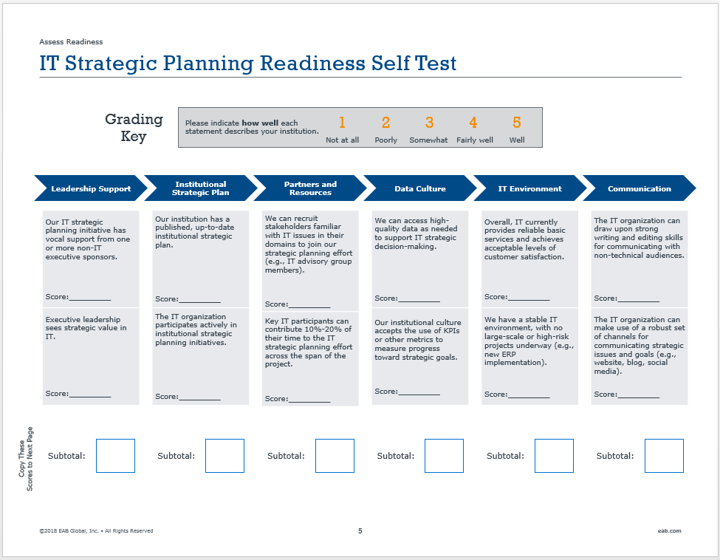
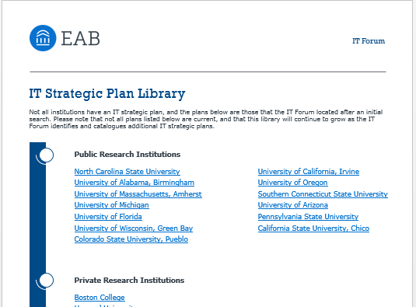
Assistance From EAB
IT Strategic Planning Center of Excellence
Tools Spanning the Entire IT Strategic Planning Process
Readiness Self-Test
Institutional Goals Alignment Playbook
Environmental Scan Playbook
Vision & Goals Development Playbook
IT Strategic Plan Library
For More Details: www.eab.com/ itforum/ITSPCenter
Notes:
As we move through this process, the IT strategic planning working group and steering committee will be relying on documents from EAB’s IT Strategic Planning Center of Excellence. If you are interested in previewing any of the material, it is available at their website at the link.

