Slide 1
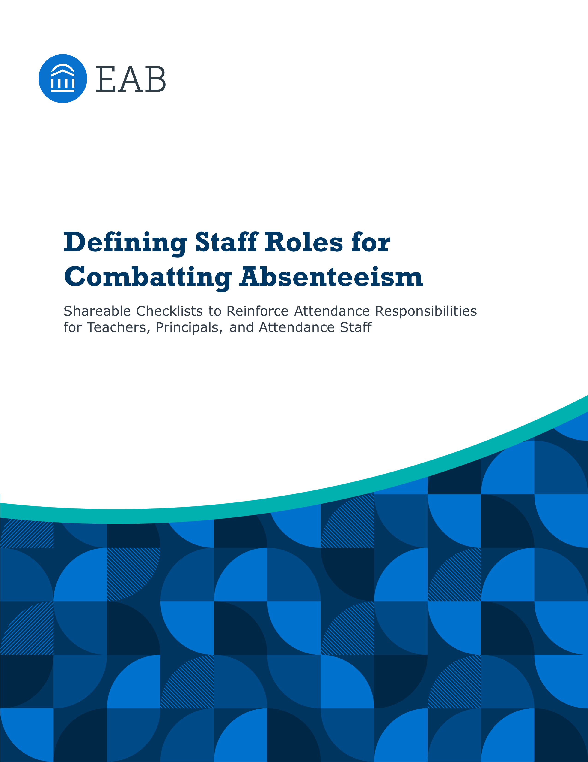

Slide 2
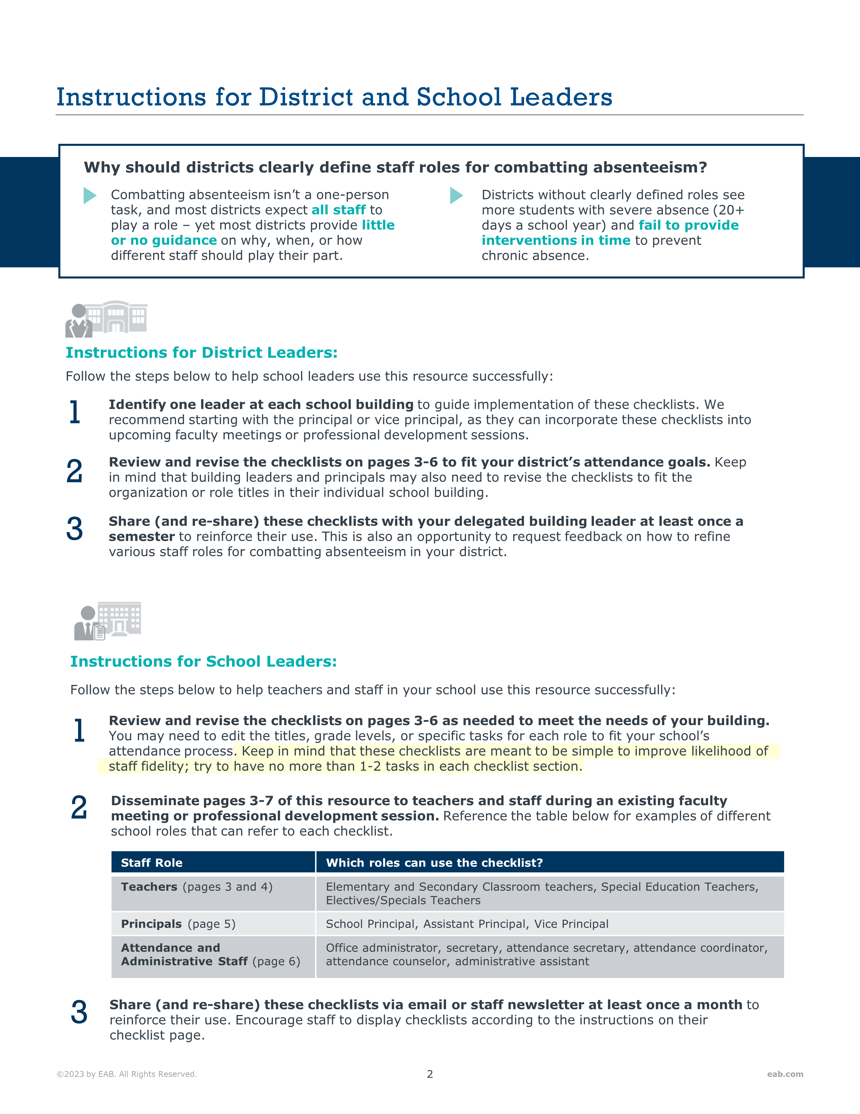

Slide 3
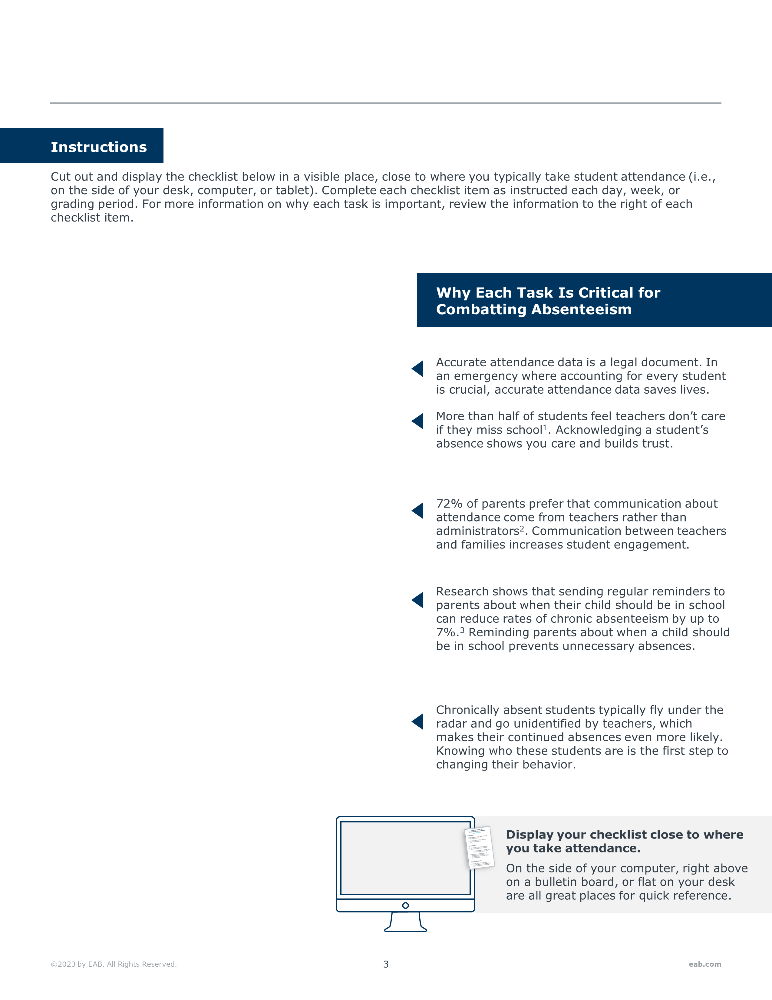
Grades Pre-K to 5: Tasks to Combat Absenteeism
Teacher Tasks for Combatting Absenteeism
Grades Pre-K to 5
Every Day:
Take attendance and log it in Student Information System
Personally welcome back students returning from absence
Every Week:
Call parents or guardians of students absent more than 2 days in a row
  Refer to the Teacher Guide for Discussing Absenteeism
Remind parents and students of attendance expectations by using Attendance Policy Nudges in weekly communications
Every Grading Period
Identify and record which of your students are chronically absent. Refer to attendance reports provided by your principal.
Education World, “What Students Really Think of Their Education, Teachers,” 2009.
Ad Council, “California Attendance Parent Survey Results,” 2015.
IES, “Can Texting Parents Improve Attendance in Elementary School?,” 2020.

Slide 4

Grades 6-12: Tasks for Combatting Absenteeism
Teacher Tasks for Combatting Absenteeism
Grades 6 - 12
Every Day:
Take attendance and log it in Student Information System
Personally welcome back students returning from absence
Every Week:
Report the names of student missing more than 3 classes in a row to your principal or grade level team
Remind parents and students of attendance expectations by using Attendance Policy Nudges in weekly communications
Every Grading Period
Identify and record which of your students are chronically absent. Refer to attendance reports provided by your principal.
Discuss student absences during parent-teacher conferences referring to the Teacher Guide for Discussing Absenteeism
Education World, “What Students Really Think of Their Education, Teachers,” 2009.
IES, “Can Texting Parents Improve Attendance in Elementary School?,” 2020.

Slide 5
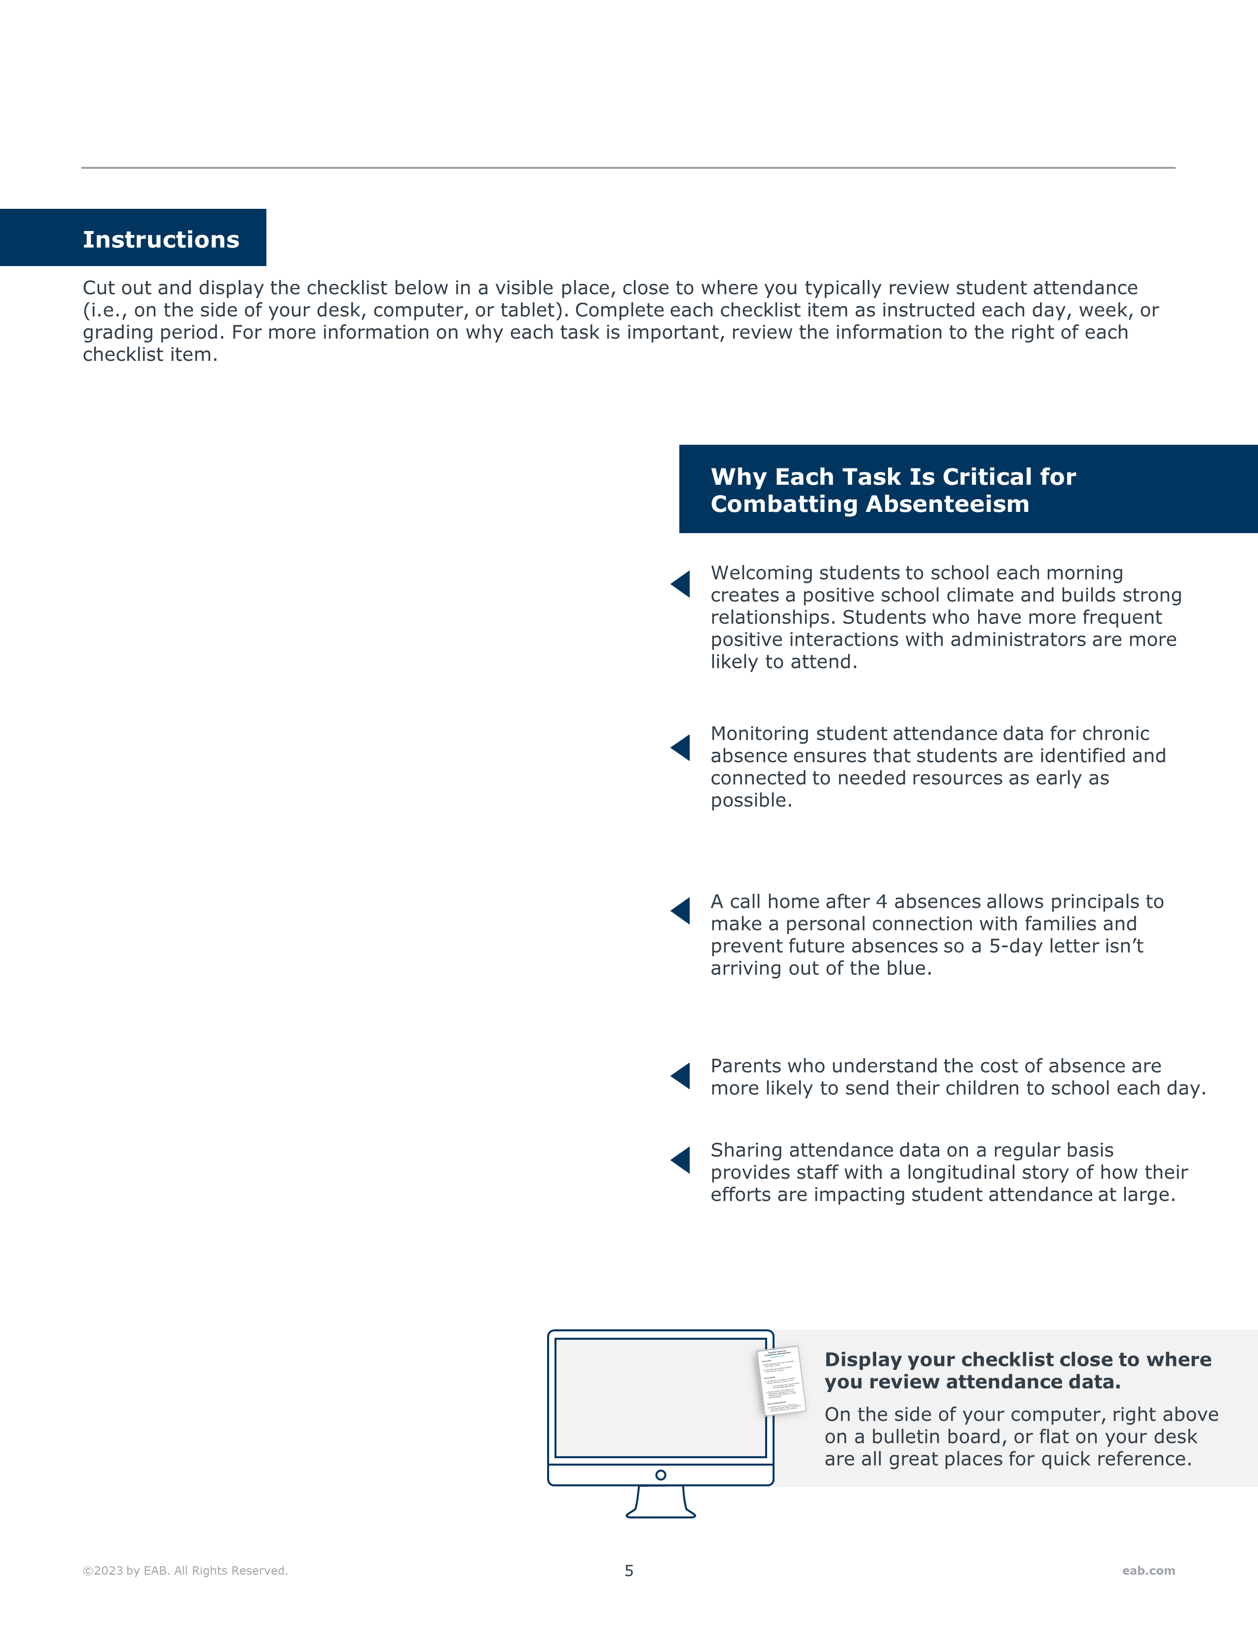
Principal/VP: Tasks for Combatting Absenteeism
Principal Tasks for Combatting Absenteeism
Every Day:
Greet students as they arrive at school each day
Every Week:
Pull an attendance report from your SIS that clearly flags all students who are chronically absent
  Share with attendance and administrative staff
Call parents or guardians of students that have been absent for 4 days in a row
Every Grading Period
Include messaging about the costs of absence in parent communications
Review attendance data and policies with school staff during existing faculty meetings or professional development

Slide 6

Attendance and Administrative Staff:
Tasks for Combatting Absenteeism
Attendance and Administrative Staff Tasks for Combatting Absenteeism
Every Day:
Verify that teachers have submitted attendance and follow up with all teachers who did not submit attendance before 9am
Communicate with parents or guardians of students that have been marked as unexcused to determine students’ reasons for absence
Every Week:
Send 5- and 10-day absence letters to families of qualifying students
Review attendance reports provided by principal for students that have been flagged as chronically absent
Every Grading Period
Meet with attendance team to set goals for improving school attendance
Send quarterly reminders for staff to reference their checklists for combatting absenteeism

Slide 7
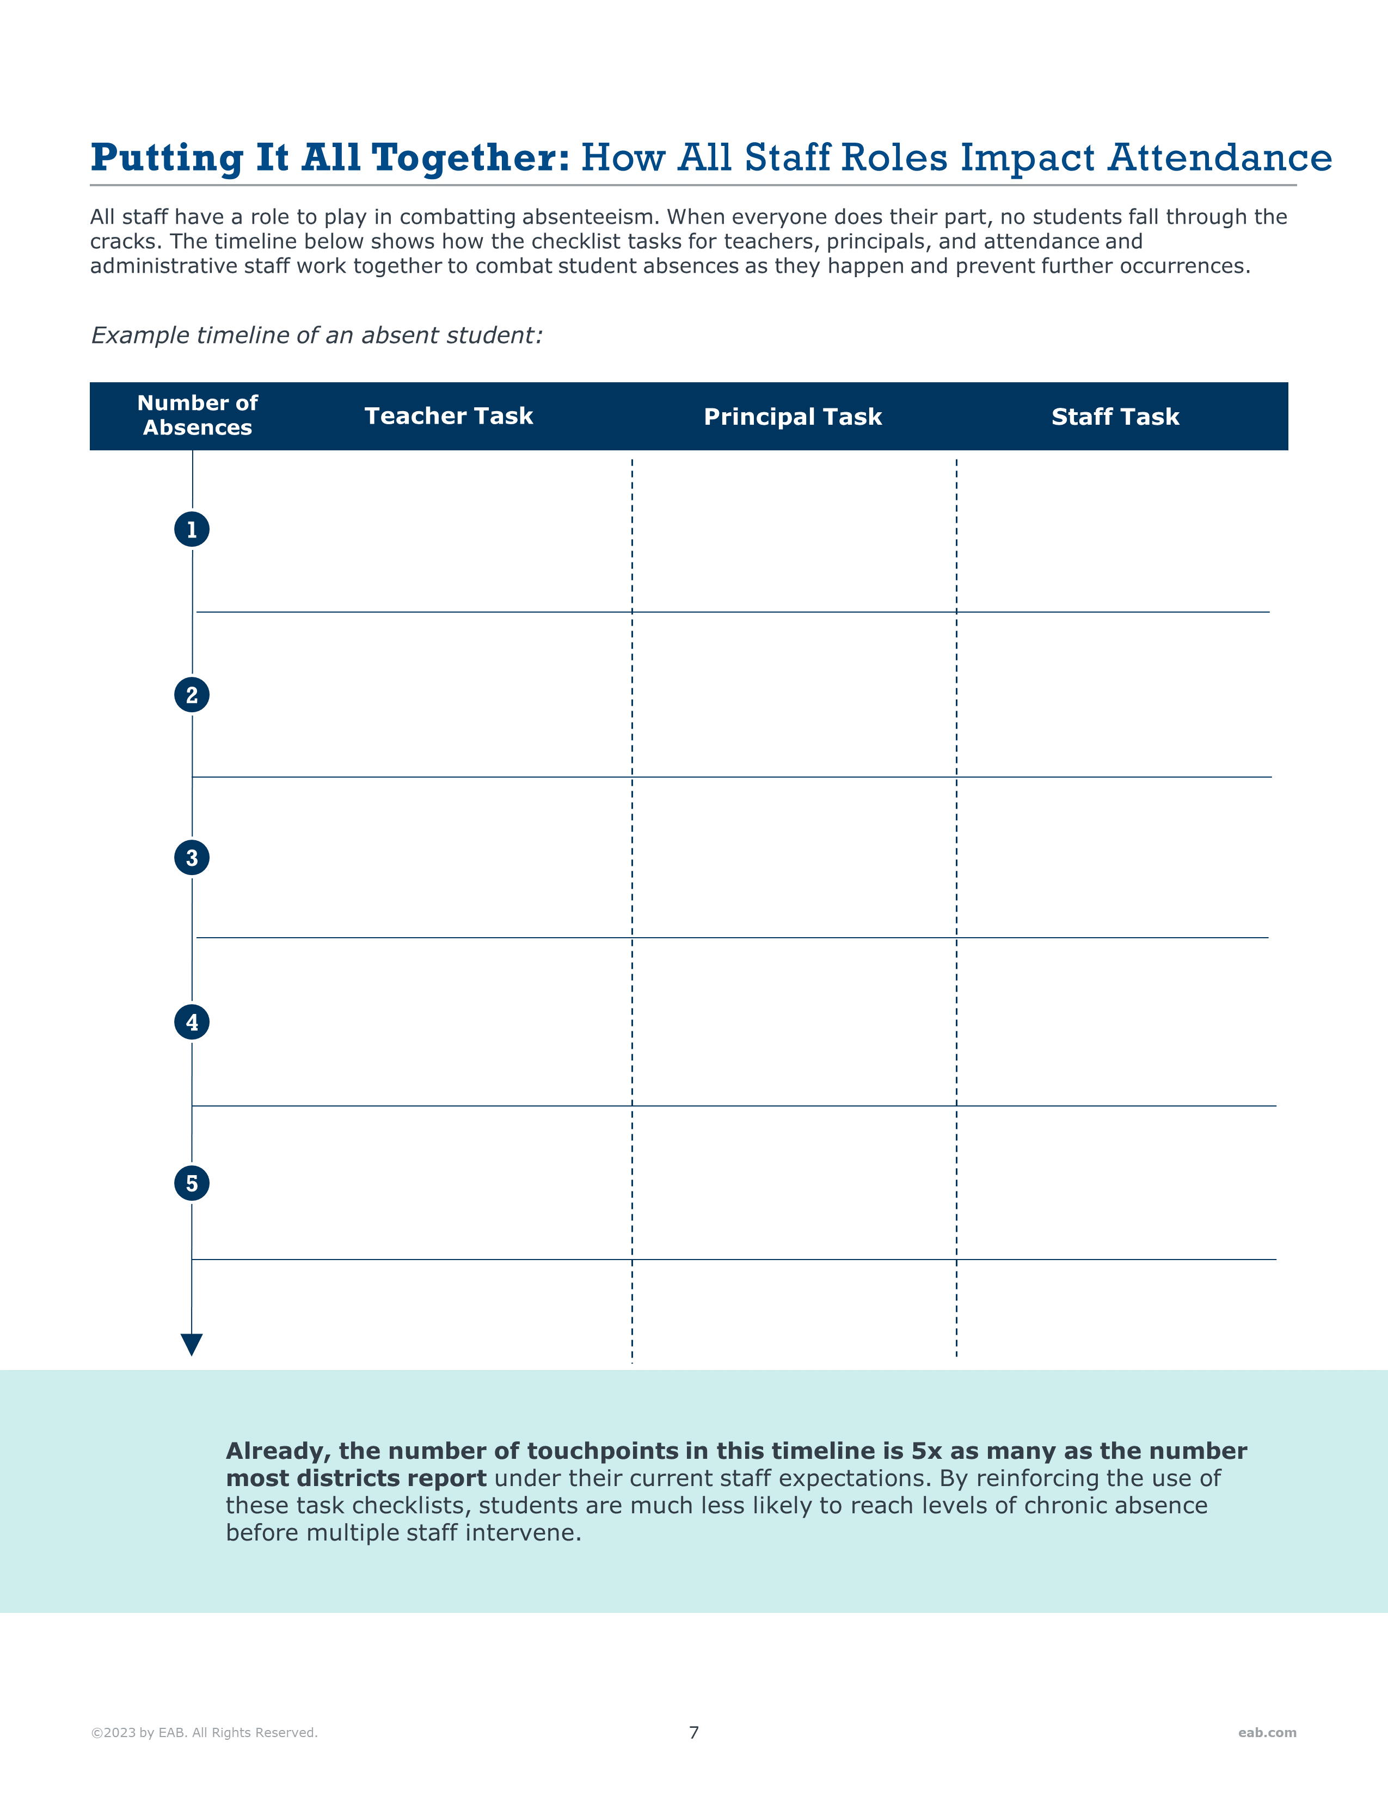
Log absence in SIS
Communicate with parents or guardians if absence is unexcused
(Grades Pre-K to 5) Communicate with parents or guardians about student absences
(Grades 6-12)
Report the name of students missing 3 classes in a row to principal or grade level team
Communicate with parents or guardians if absence is unexcused
Call parents or guardians to discuss student absences
Send home 5-day absence letter

